Slide 1
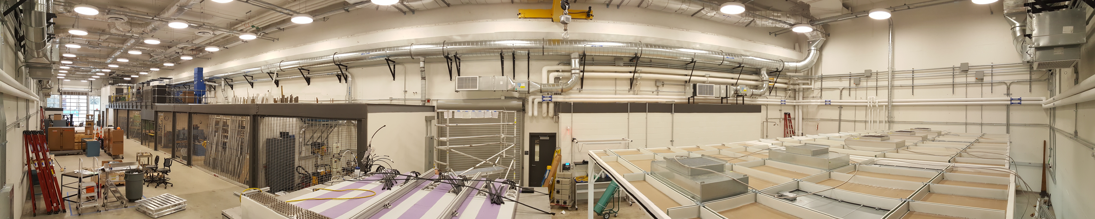
APA development site at Yale (or Regional Center)

Slide 2
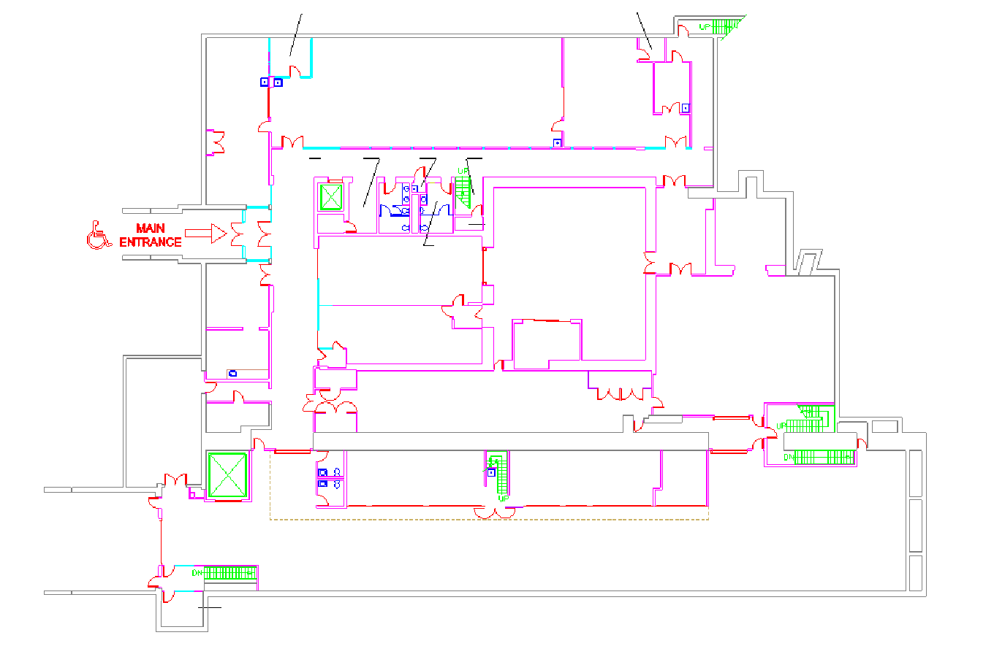
Wright Laboratory as it is today

Slide 3
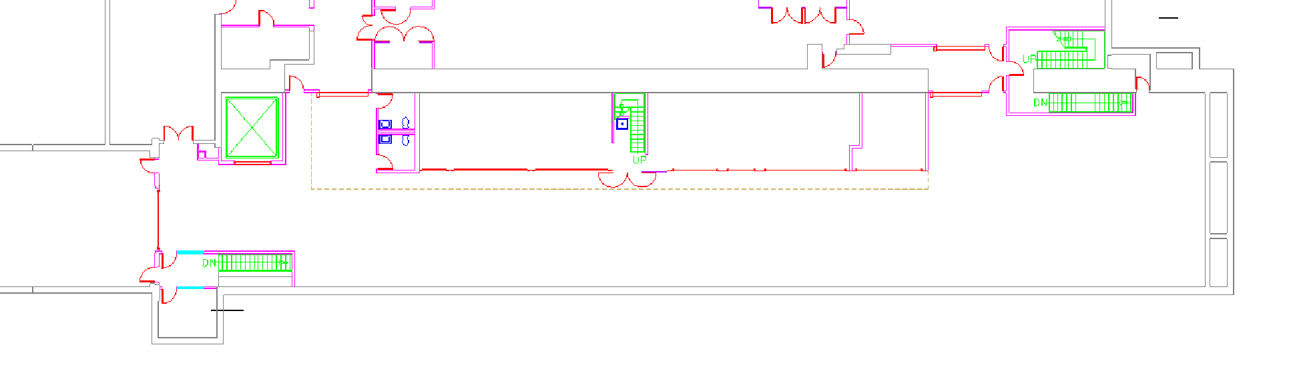
The Vault
Very long area of ∼600 m²
10 Ton crane already present
Direct connection with parking area (i.e. street)
Parking
12 m
50 m

Slide 4
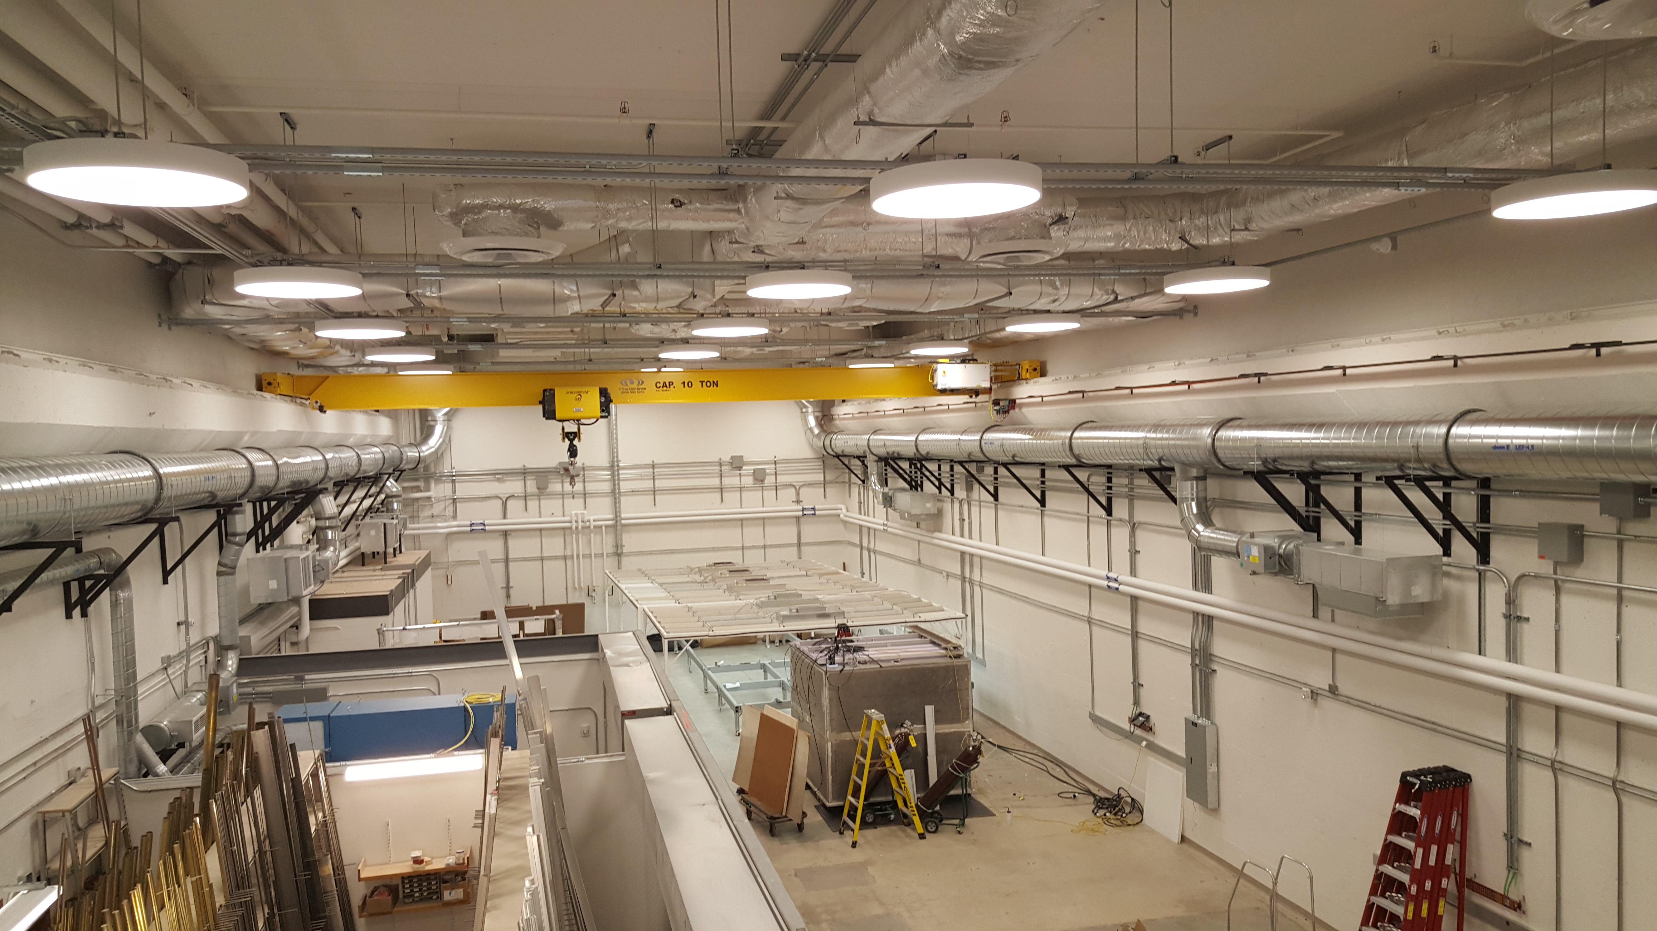
The Vault

Slide 5
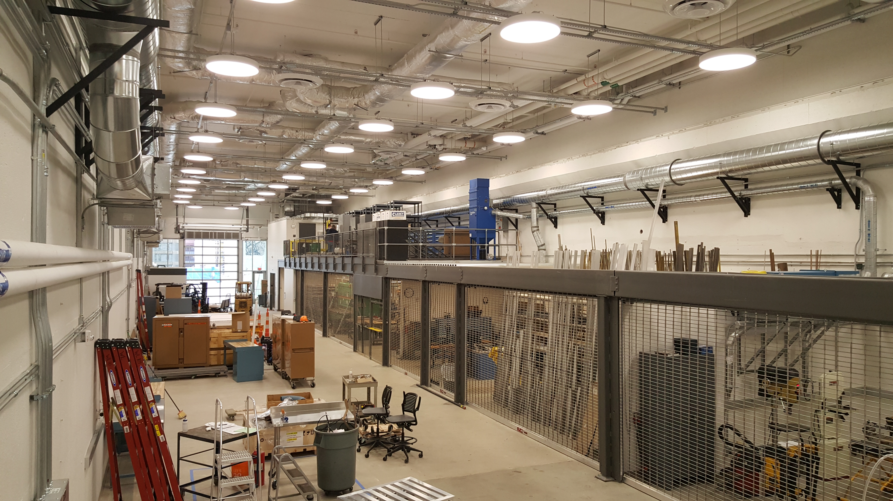
The Vault

Slide 6
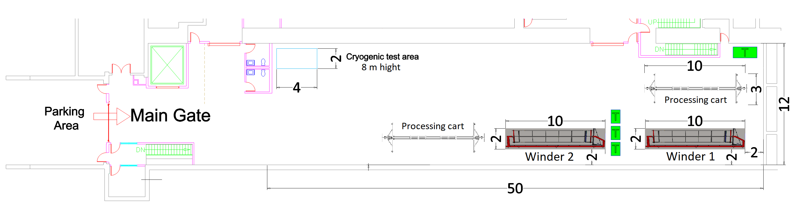
The APA development site in the Vault
2 production lines + Cold test

Slide 7
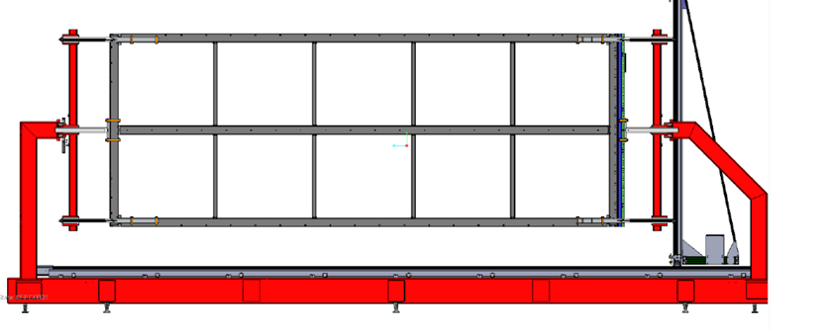
ProtoDUNE winder

Slide 8
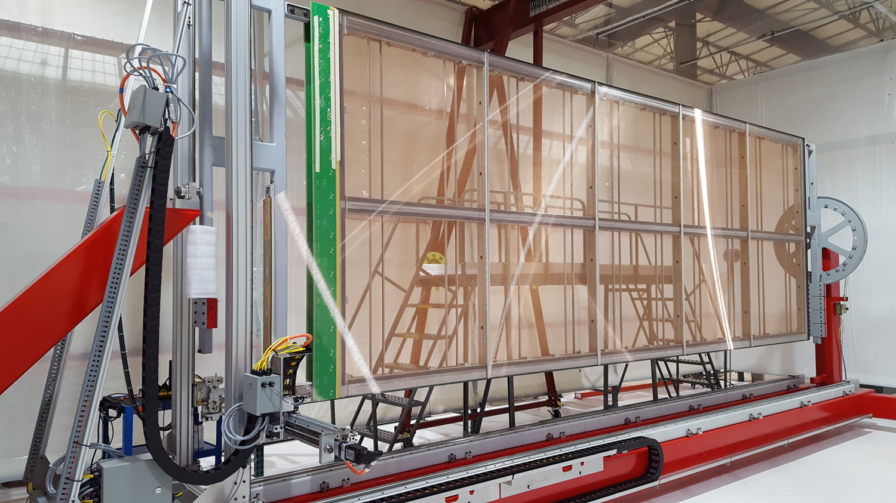
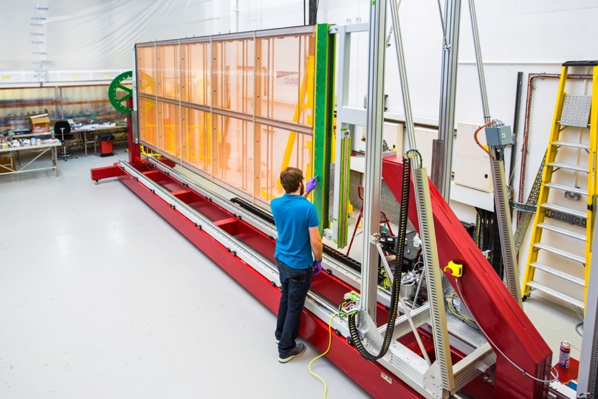
ProtoDUNE APA Winders
@ Daresbury Lab, UK
@ Physical Sciences Lab (PSL),
University of Wisconsin, US

Slide 9
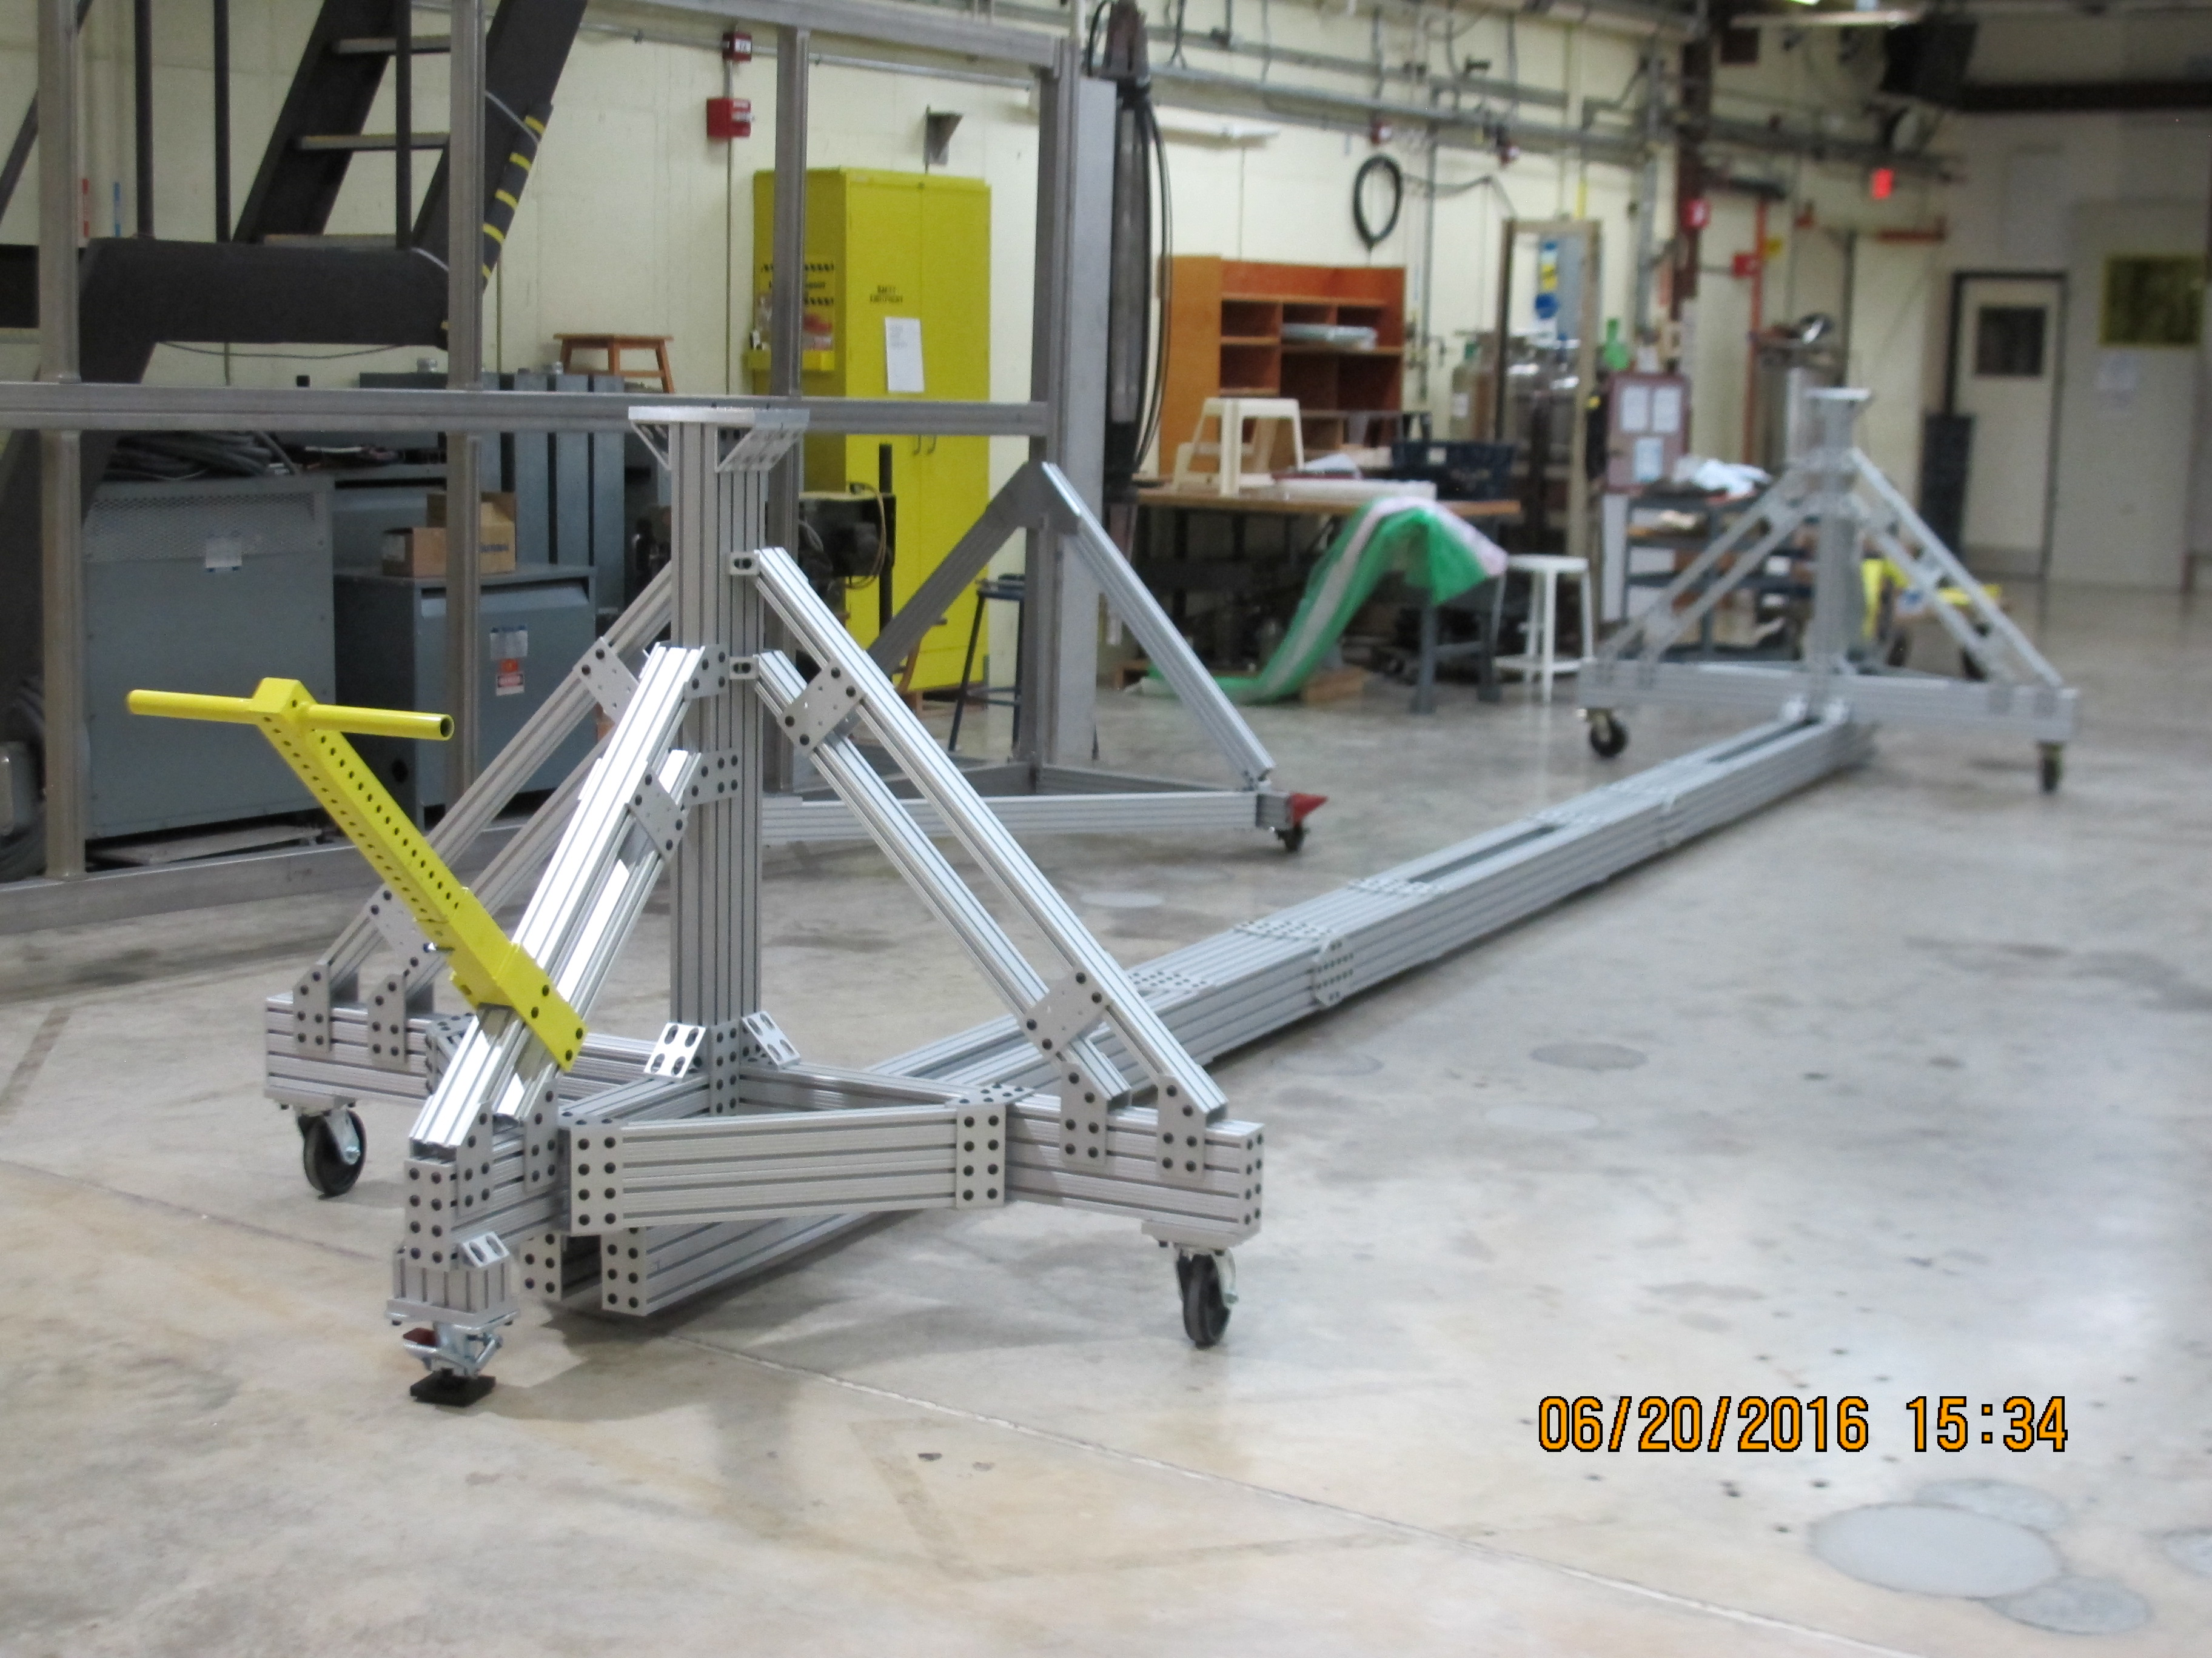
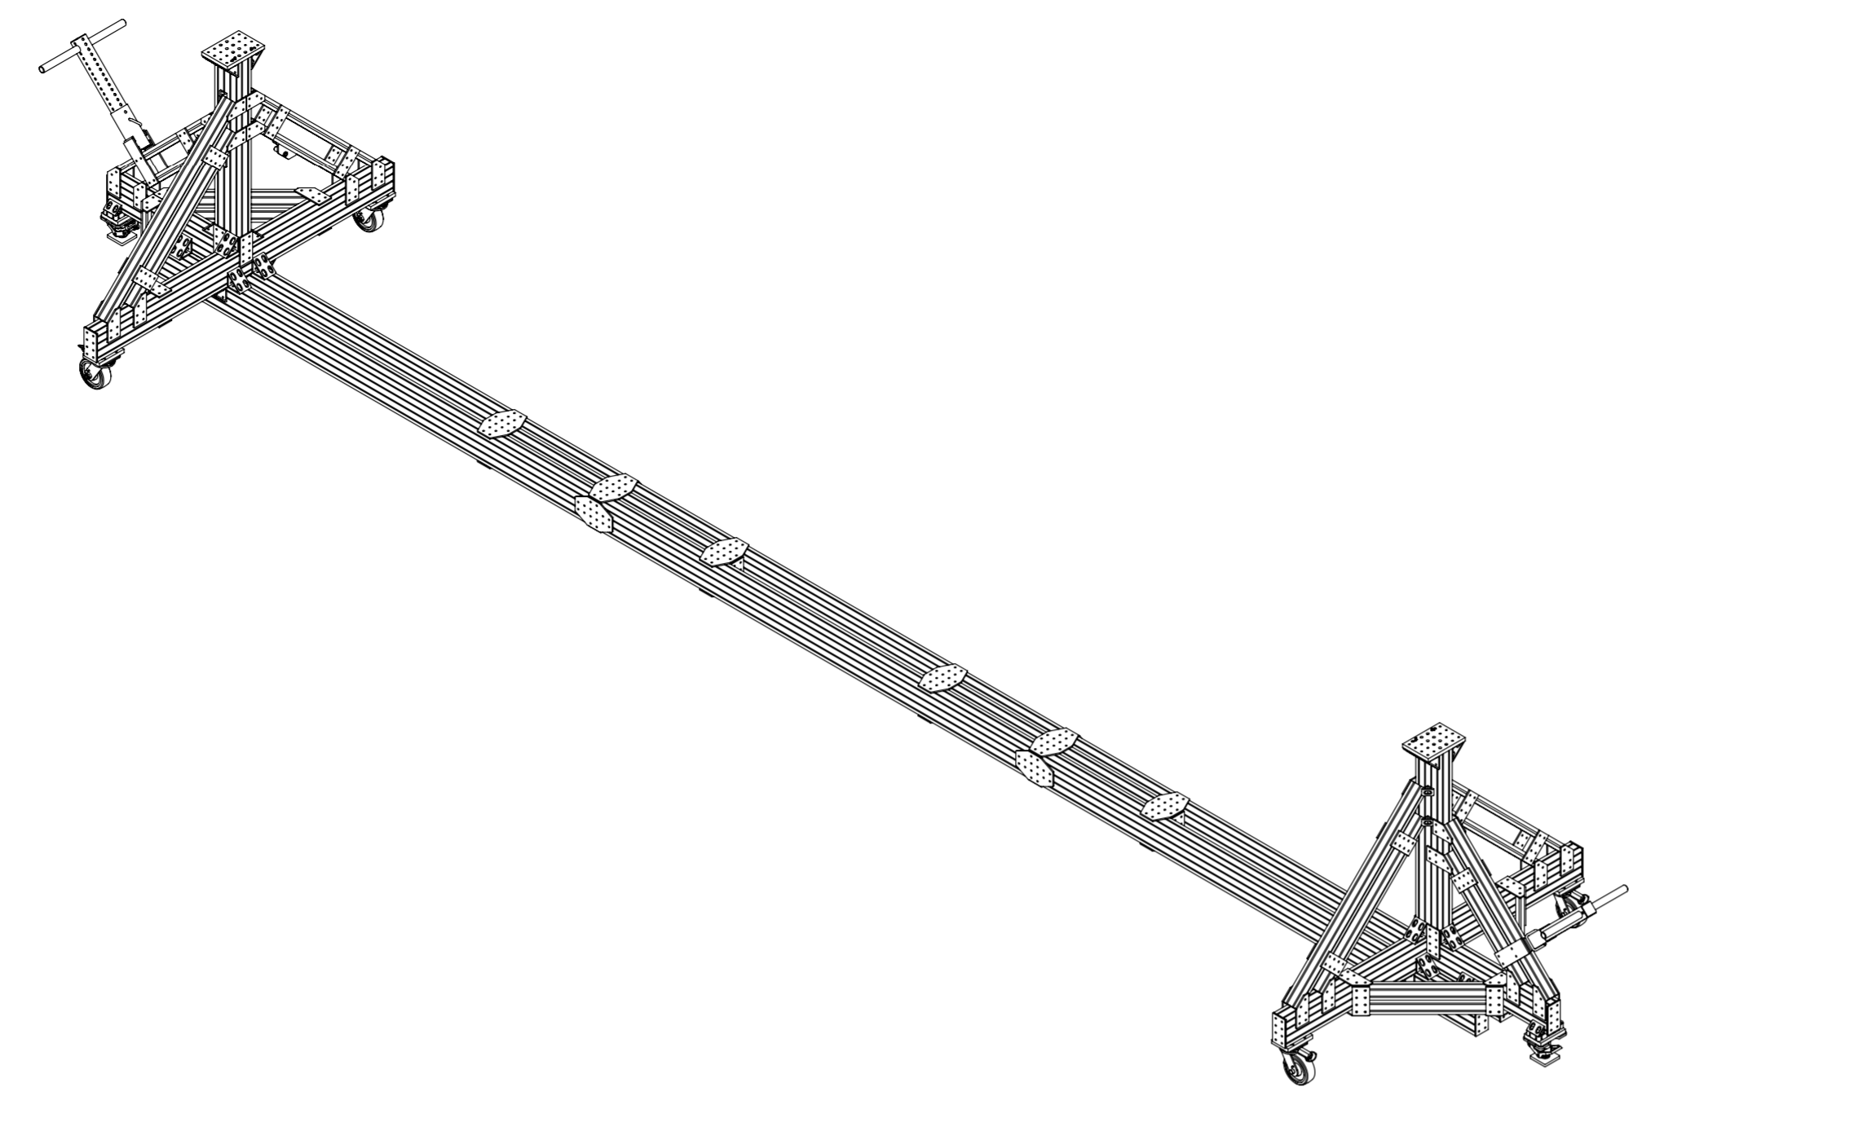
APA Processing Cart

Slide 10
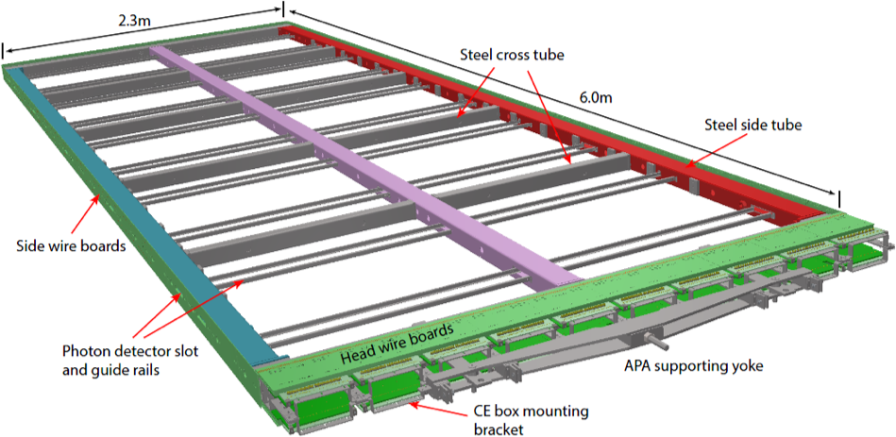
APA Frame

Slide 11
Requirements
Clean tent area CLASS 10.000.
Crane (in the clean tent).
Fans with HEP filter.
Standard laboratory electric connection.
No special requirements for water lines.
Nitrogen gas (or compressed clean dry air) line.
For cold test, some structural modification are necessary, rail to drive the APA in the cryostat

Slide 12
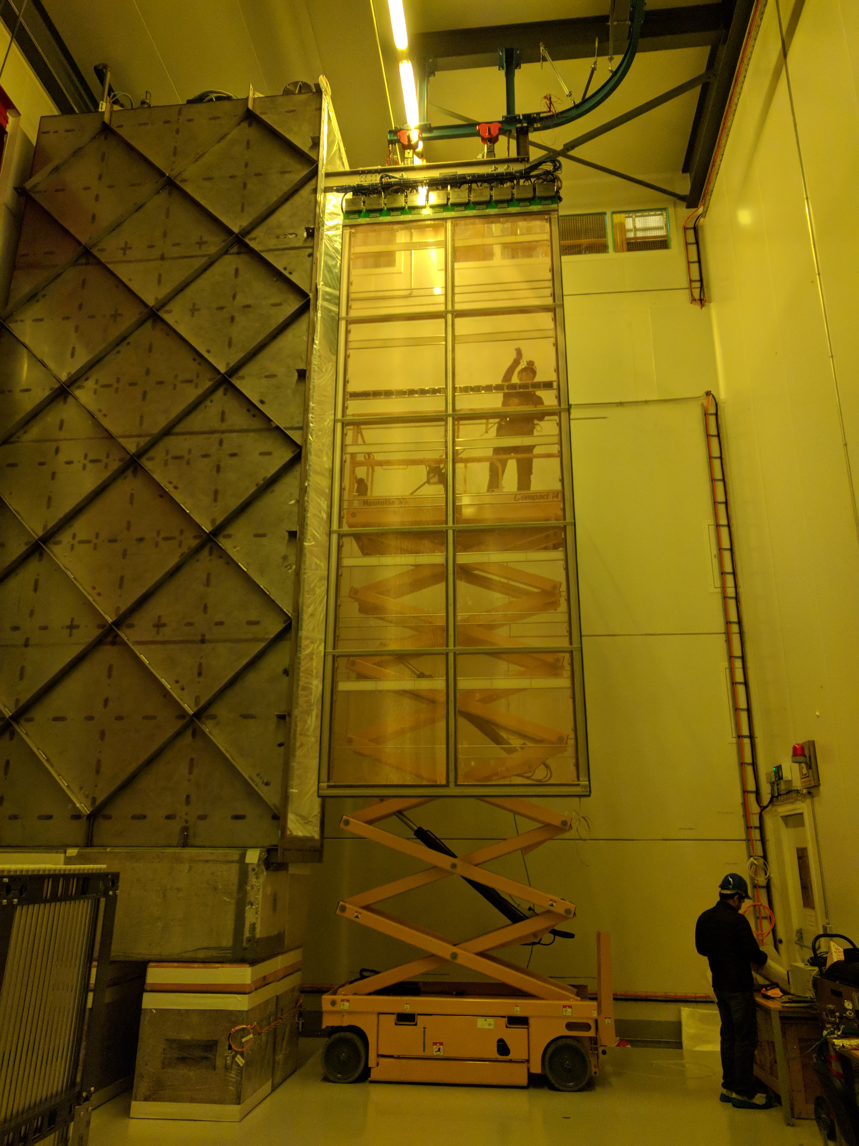
Cold test for ProtoDUNE APA at CERN
Wright lab could host also a cold test benchmark for slice test in which the APA structure, the wires and the electronic boards can be tested with the cold electronic readout, miming the final detector configuration.
The APA is driven into the cold test cryostat with a rail.

Slide 13
Goals for WL
To have a leading role in DUNE experiment and become a regional DUNE center for APA production.
Facilitate engagement between scientists and technical staff on APA production, testing and integration including potential cold tests and electronic tests.

