Slide 1
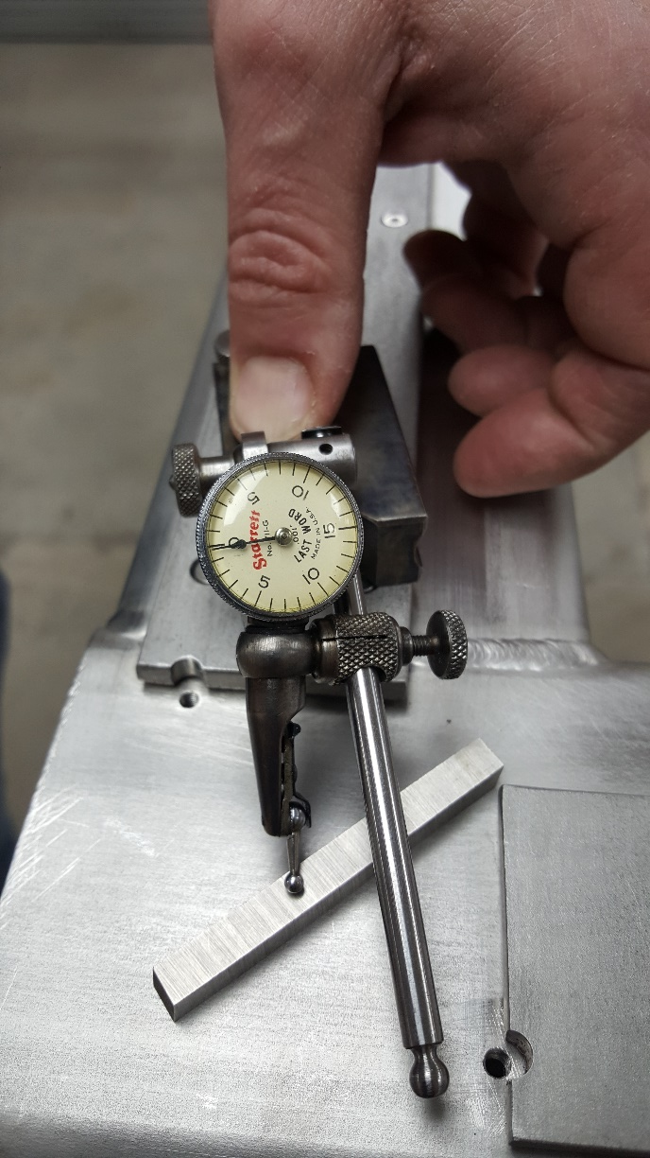
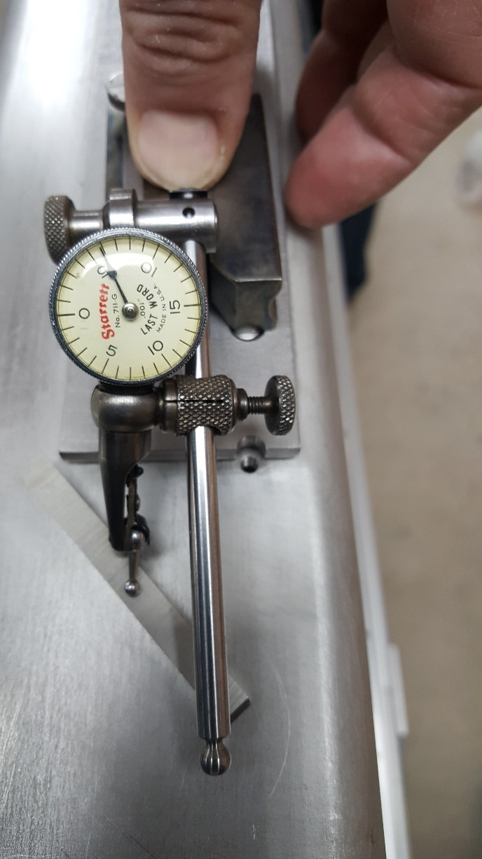
Leveling of the APA’s corners
Cut downs shims are used to level the corner on two axis
Measurement for the two corner are below the tolerance:
∼0.15mm and ∼ 0.025mm

Slide 2
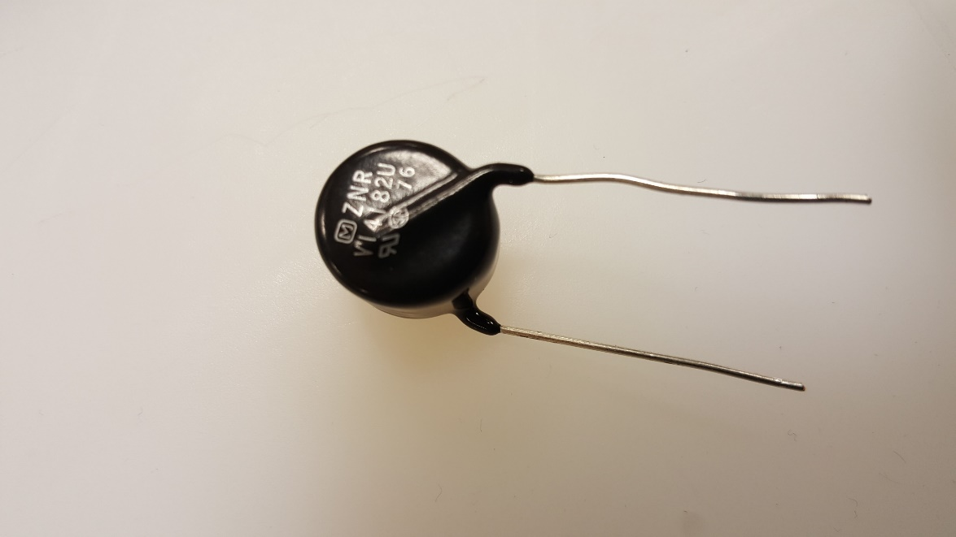
MOVs test: status and plans

Slide 3
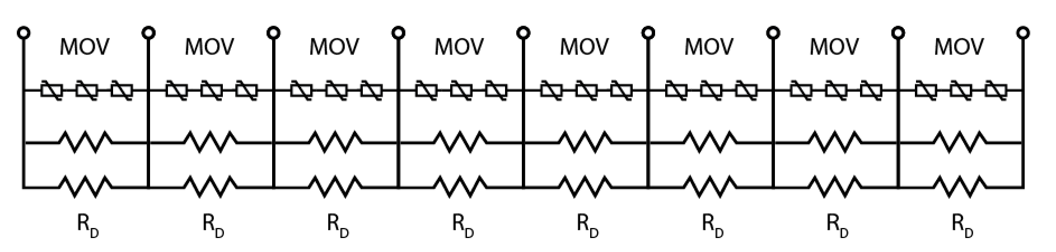
Metal Oxide Varistor (MOV)
Voltage Dependent Resistor (VDR) with nonlinear and non-ohmic current-voltage characteristic.
Used to control and compensate in circuits to prevent and protect against transient voltages.

Slide 4
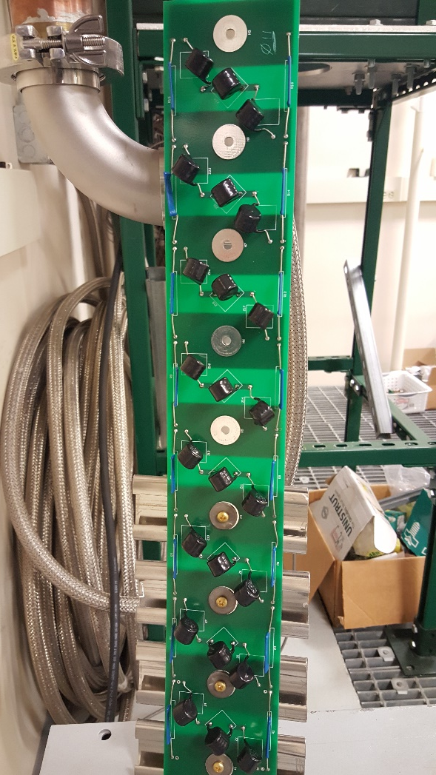
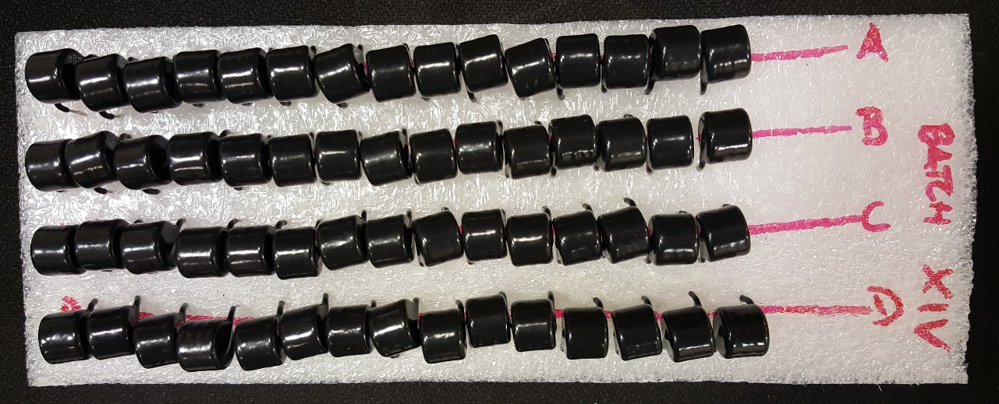
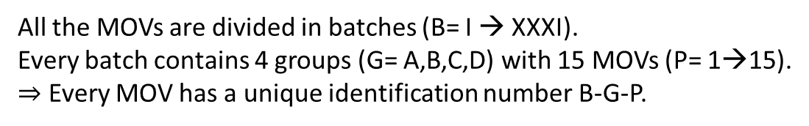
Field cage ∼ 1500 MOVs + spare = 1800 MOVs.
To be tested at LAr temperature.
To be tested around a nominal voltage of 2kV.
Available in the lab: 1847 MOVs.
Test in 2 phases
Room temperature.
LAr temperature + Room temperature + Cracks checking.
All the MOVs are divided in batches (B= I → XXXI).
Every batch contains 4 groups (G= A,B,C,D) with 15 MOVs (P= 1→15).
$⇒$ Every MOV has a unique identification number B-G-P.

Slide 5
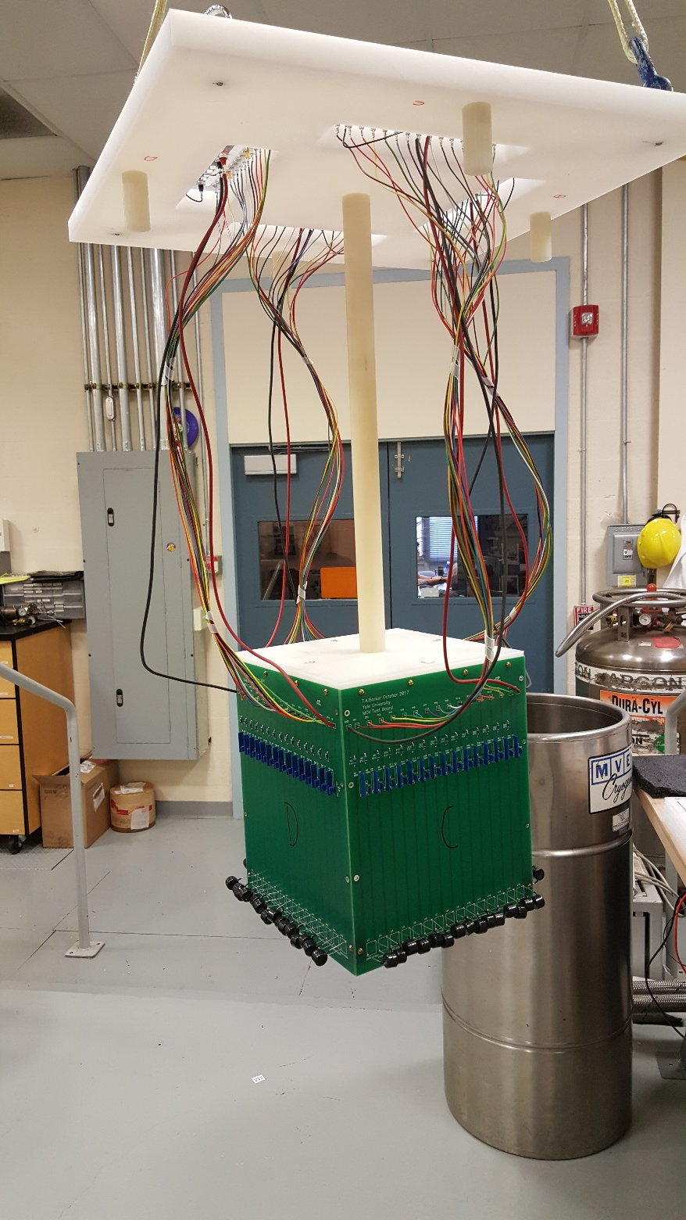
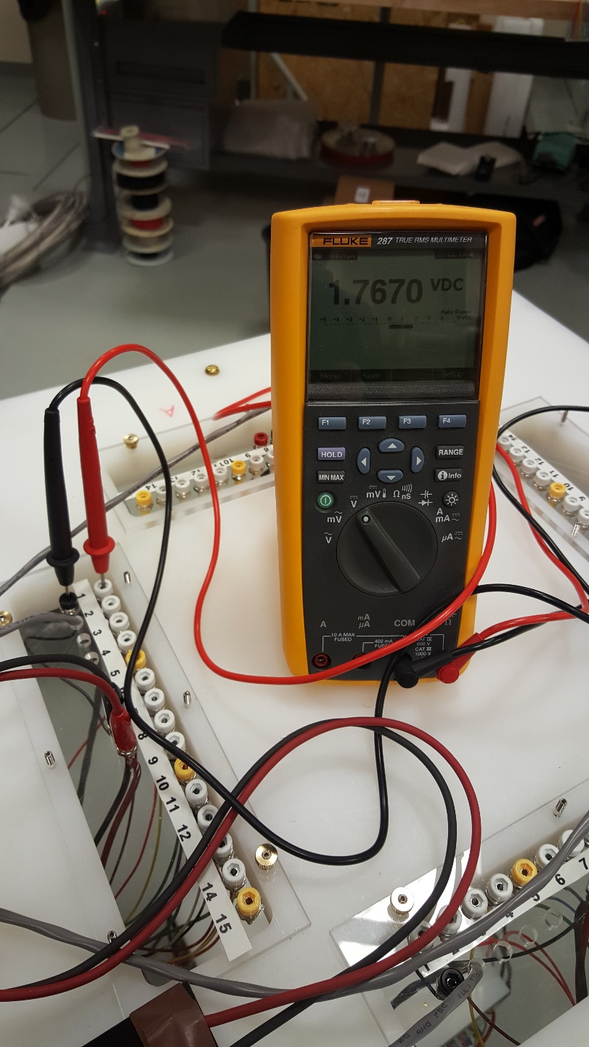
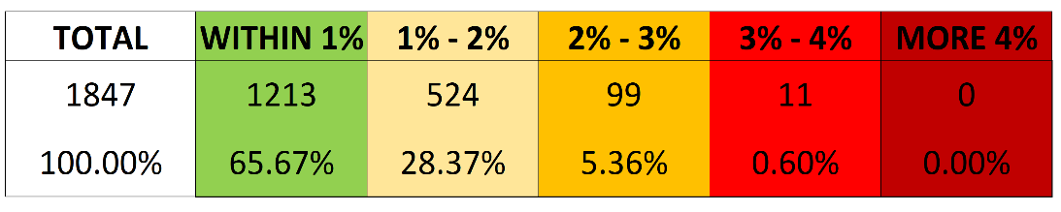
Phase 1 – Warm Test
7th March→16th March at Yale Cryo-Lab.
1847 MOVs tested at 2kV.
The readout can be easily made by a standard digital multimeter.
Data record on worksheet.
Defined 5 shells around 1.8kV (1%,2%,3%,4% and 5%).

Slide 6
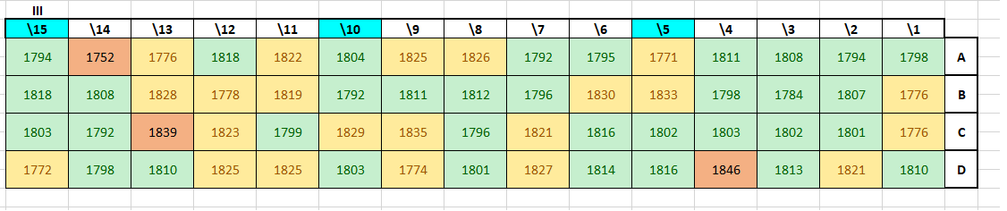
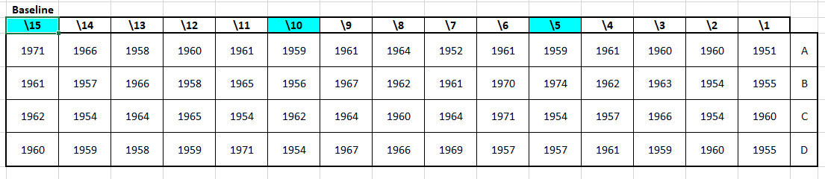
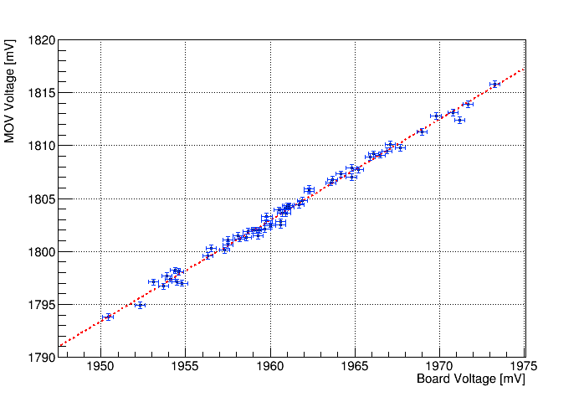
Nominal Voltage of 1960 V
The difference in voltage among channels must be corrected.
We measure one MOV value along all the channels.
We fit the distribution in function of the actual voltage on the empty channel.
We apply the correction.

Slide 7
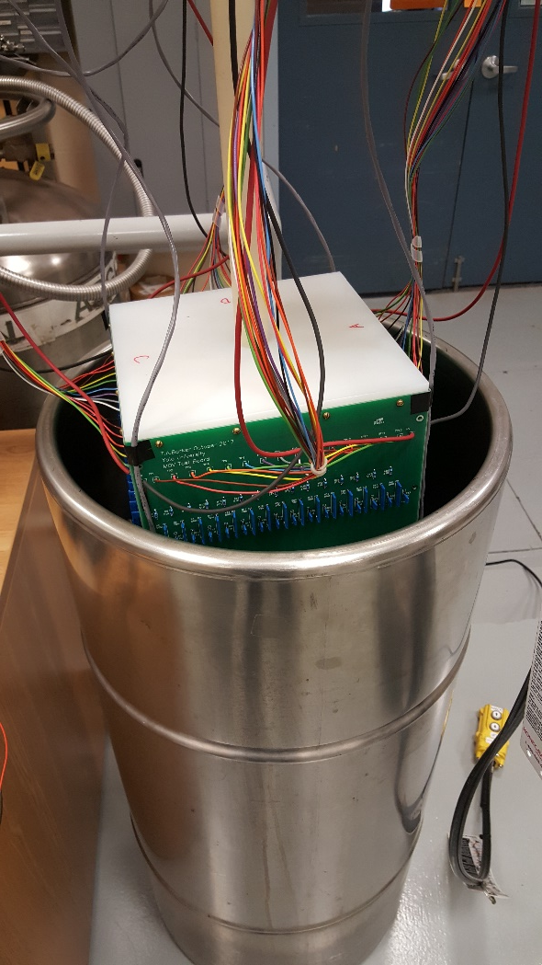
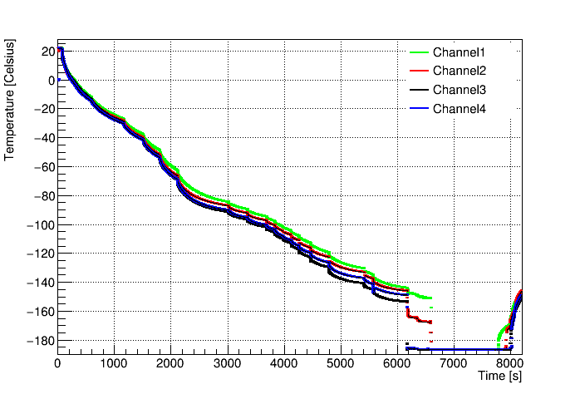
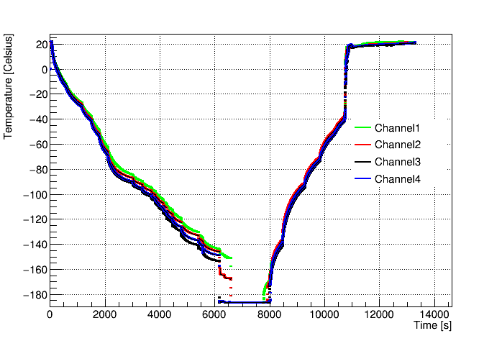
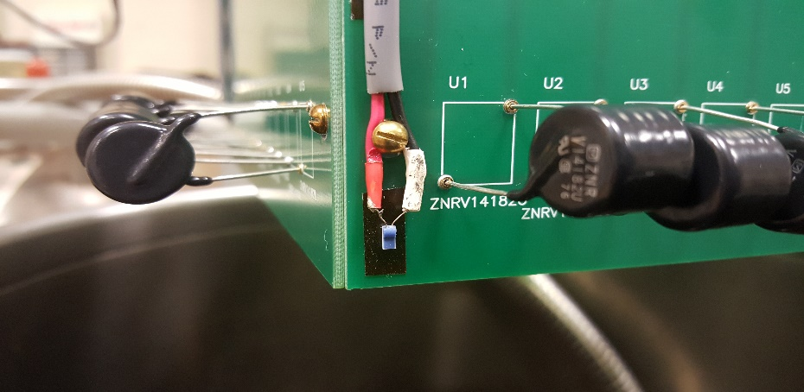
Phase 2: Cryogenic test
Every single batch is:
Mounted back on the boards.
Slowly lowered by a crane in a dewar with LAr trying to keep a controlled cooldown (linear approximation ∼0.03 °C/s).
Temperature are monitored with 4 PT1000 RTD.
When in LAr bath, MOVs are tested.
The system is then raised and (less) slowly warmed up.
MOVs tested again at room temperature.
MOVs are inspected for cracks.

Slide 8
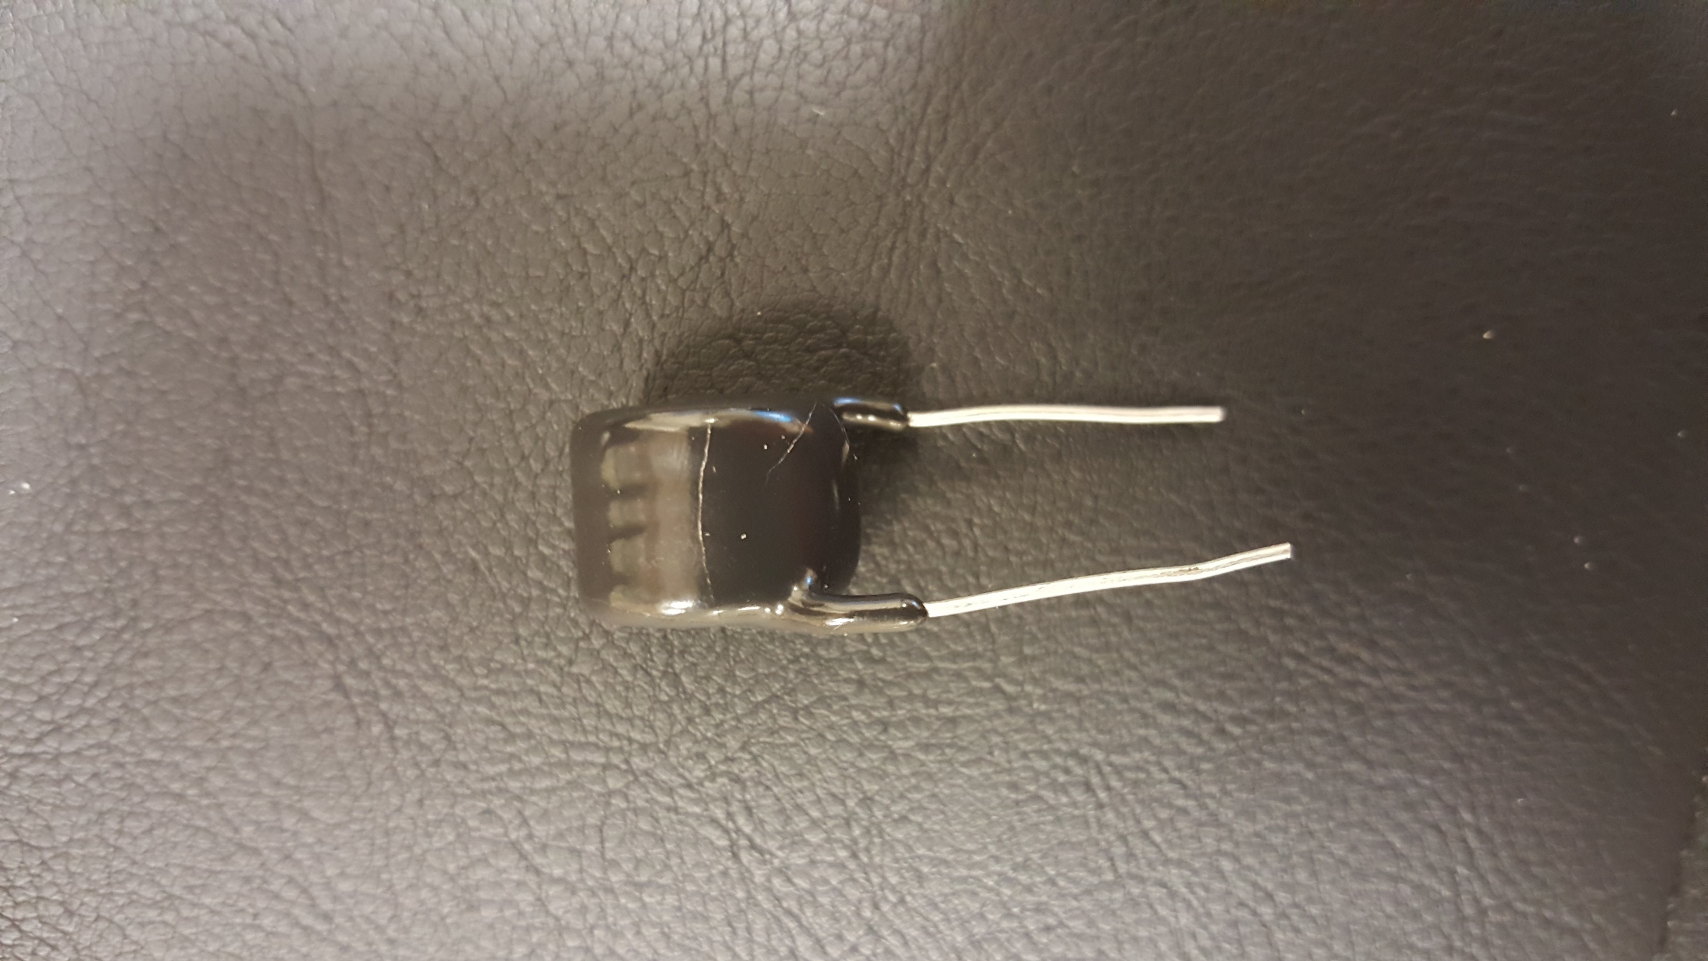
Plans
Resume
1847 MOVs tested at room temperature and in LAr.
146 MOVs cracked (∼ 8%) during immersion in Lar.
Data analysis to perform selection of “good” MOVs.
Repeat cold test on some random batches to investigate cracks formation.
Long-standing test. We will keep one batch running in LN at 2kV.
Start test of resistors (tomorrow)
Prepare the boards (beginning of May)

