Slide 1

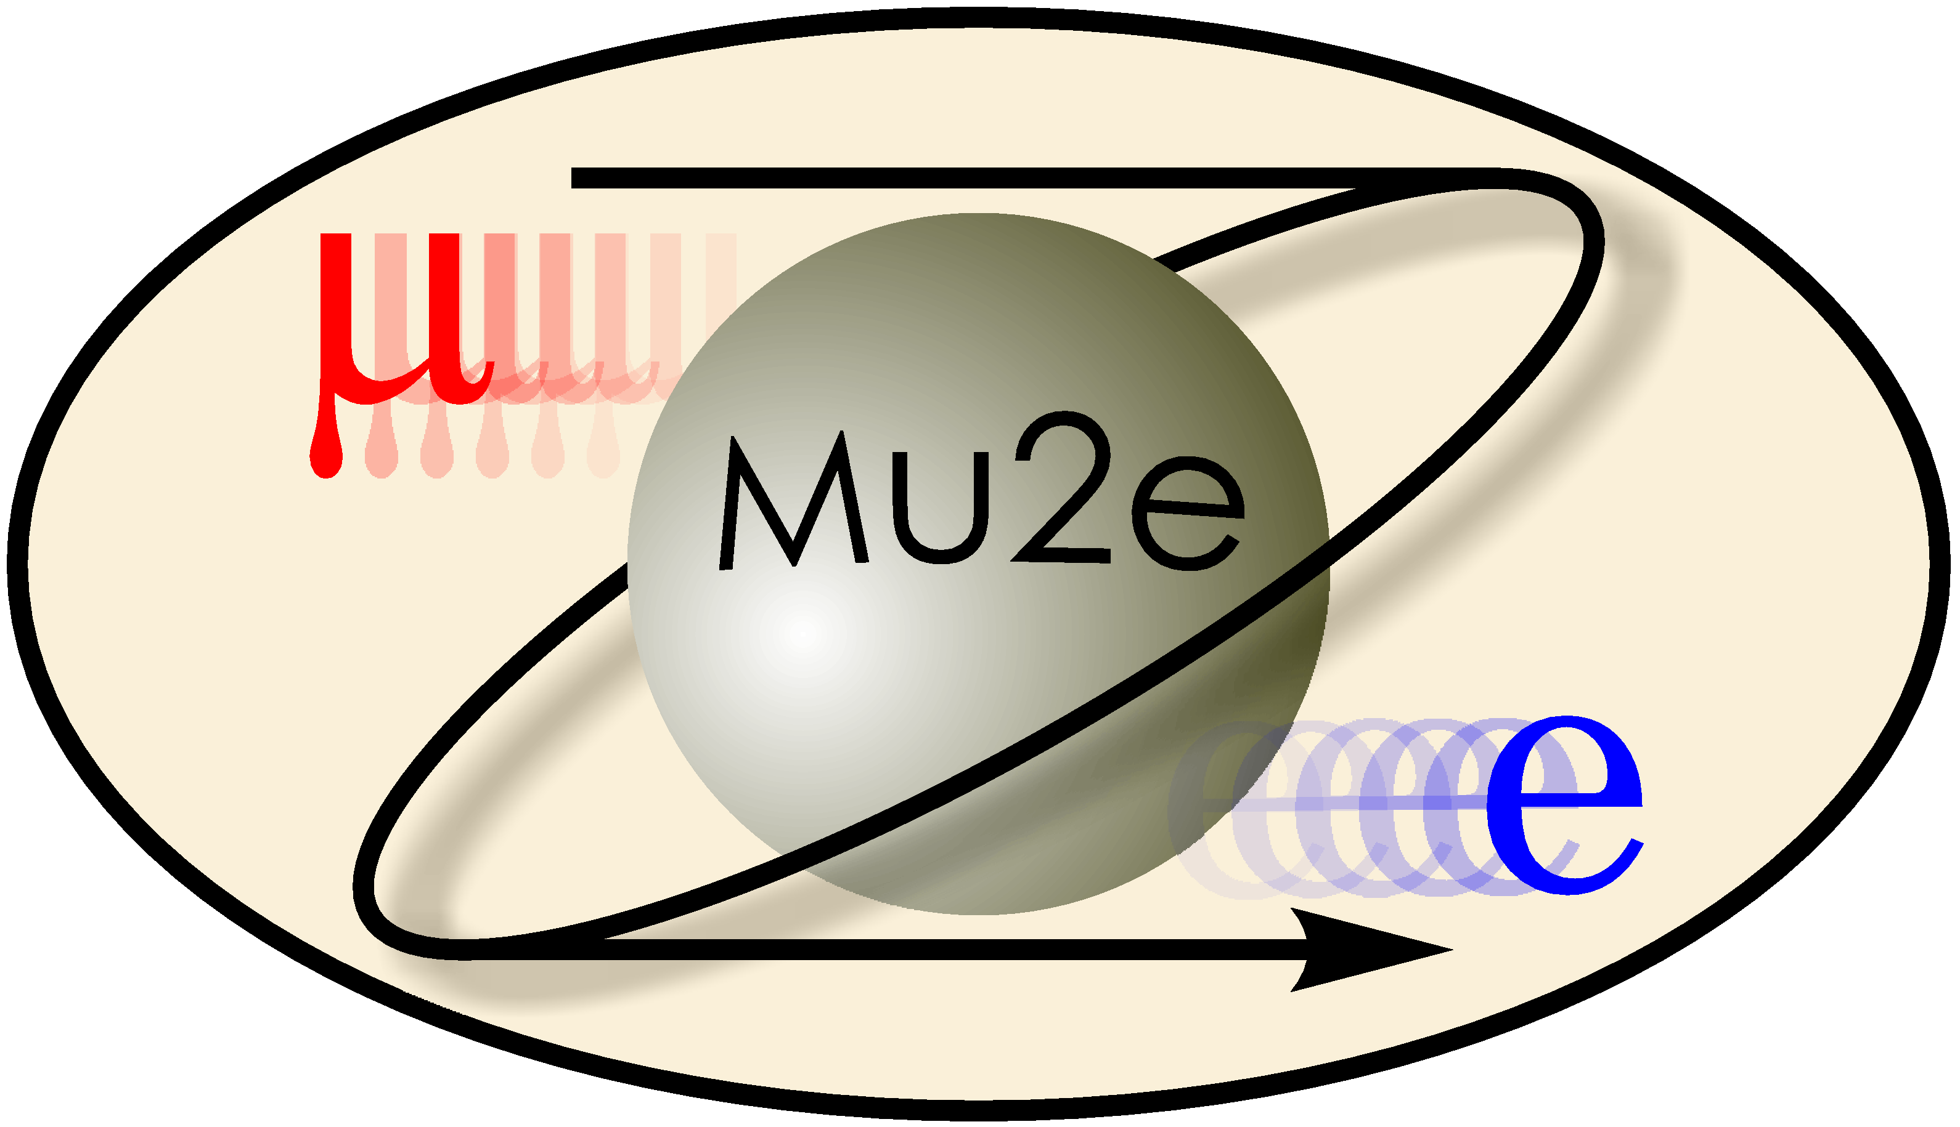

Updates for Calorimeter-Seeded Tracker
Claire Laffan
11/30/18
Supervised by Sarah Demers and Giani Pezzullo

Slide 2
Source of Problem
  The algorithm was looping in hits that did not belong during RescueHitsBeforeSeed
  As it searched for new hits, it did not take into account that a face that already has a hit should not be used
  This caused some faces to have multiple hits in the helix – not allowed!

Slide 3
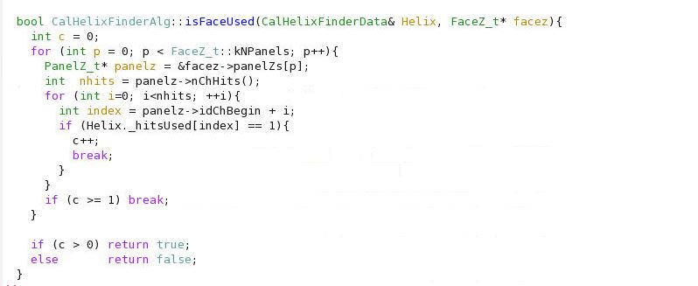
The Fix

Slide 4
Results
Compared my version of the algorithm with a version of the algorithm that does not include my edit from Giani’s repository
We ran it on the same exact data set – one with signal and background mix and the other with only background

Slide 5
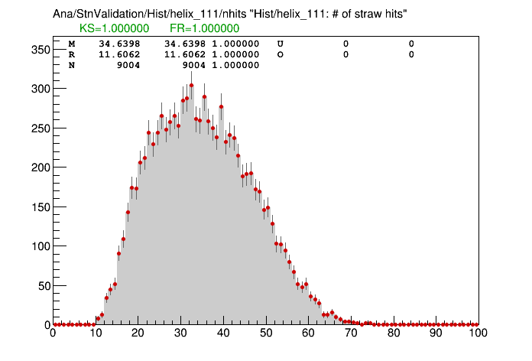
Results
nhits for signal only:
Detected same amount
of hits

Slide 6
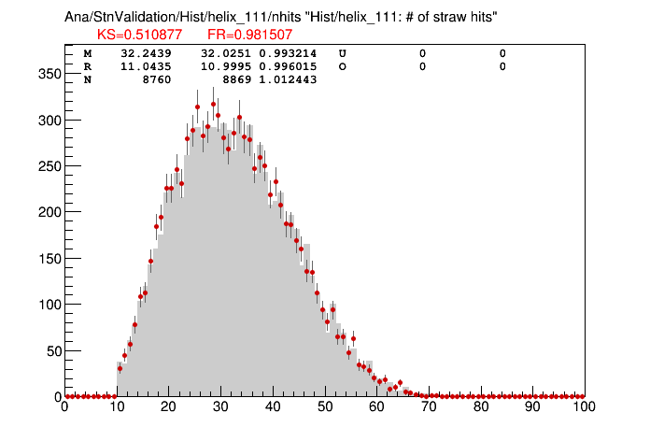
Results
Signal-mix nhits:
Updated algorithm
detected more hits

Slide 7
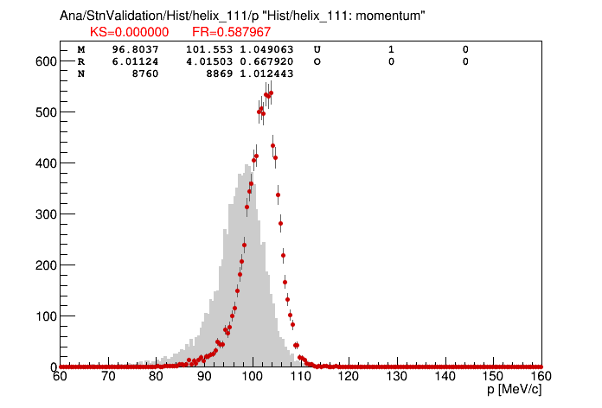
Results
Signal-mix momentum:
Updated algorithm
reconstructed more
accurate momentum

Slide 8
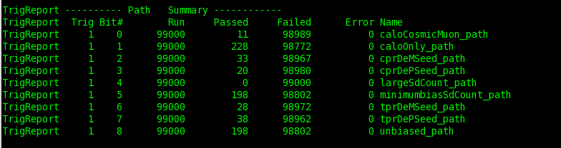
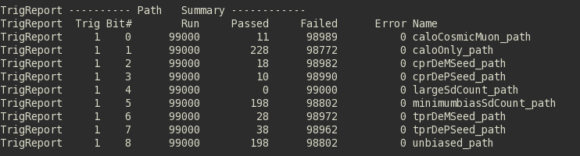
Results
Ran both versions of algorithm on trigger
Found improved rejection!

