Slide 1

CubeSat Cosmic Ray Observatory
ASPERA/Novapix/L. Bret: Symmetry Magazine
Yale Undergraduate Aerospace Association (YUAA)

Slide 2
The goal
Design and construct a cosmic ray detector for use in low-Earth orbit
Assemble a functional satellite to carry this payload
Secure a launch date from NASA
Bring Yale into the space age
Simon Swordy (U.Chicago), NASA

Slide 3
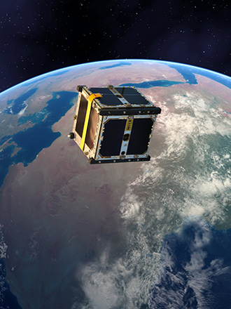
CubeSat history
Project began four years ago with an optical communications payload
Organization has never launched a satellite into orbit, but many other universities have
New frontier for Yale University

Slide 4
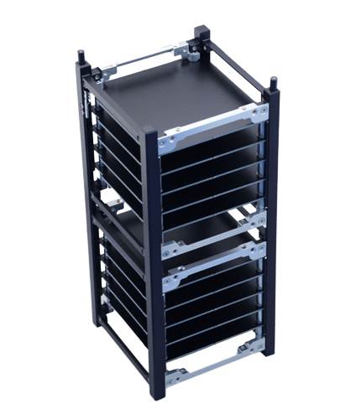
The satellite
Dimensions: “2U,” or 20 cm × 10 cm × 10 cm
Attitude determination/control – magnetorquer, sun sensor
Radio system (antenna retracted at launch, extended in orbit by a nichrome burn wire)
Develop our own software: sensor drivers, PID control,
data transmission
Cosmic ray detector
photo: Innovative Solutions in Space

Slide 5
Cosmic ray detector
Planning to launch a layered scintillator-based cosmic ray detector in LEO
Detector will yield information about particle coincidence, energy, and charge (Pulse shape discrimination techniques)
Open source designs: CosmicPi project at CERN and the CosmicWatch team at MIT. Adapting these muon detectors to orbital conditions.

Slide 6

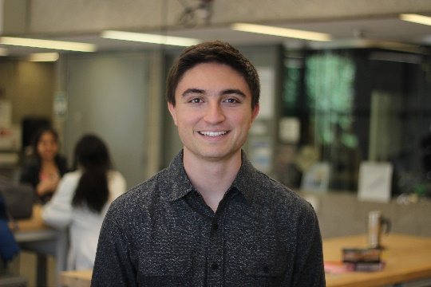

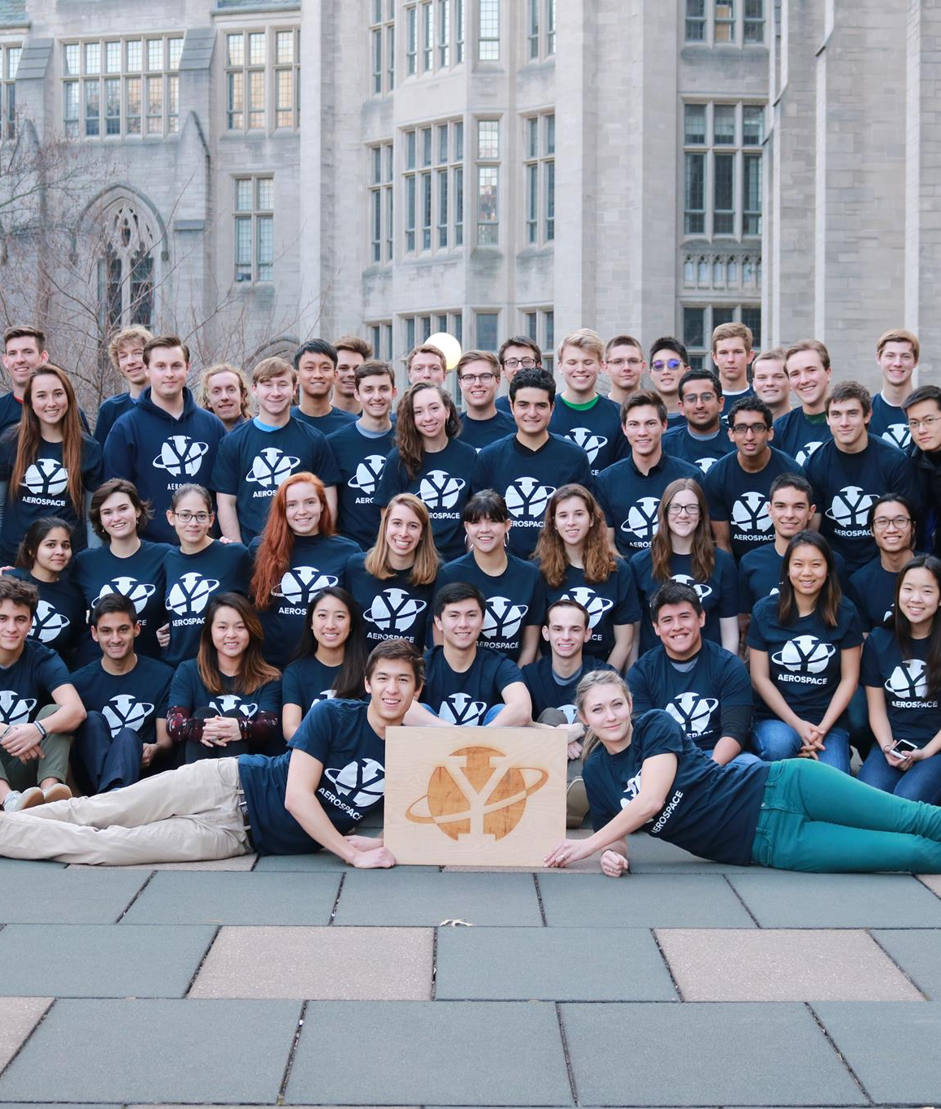

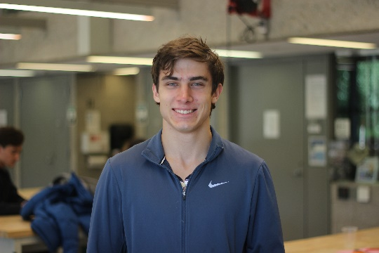
Our team
Undergraduates who are interested in aerospace engineering
Many different majors, but typically in STEM fields
While we’ve all been working on this project for a while, we very much understand the complexity of the task before us, and where we are inadequate

Slide 7

Where we get advice
Partnership with Wright Lab
Our advisor: Dr. Larry Wilen
YUAA Technical Advisors Alex Hoganson (prior CubeSat experience) and Warren Zhang
The rest of the world: NASA (published CubeSat guidance), CERN (e.g. adapting the CRD to LEO)
And our fellow team members: past research, accumulated documentation library over the past 4 years. Practical expertise across other teams such as solar panel fabrication.

Slide 8
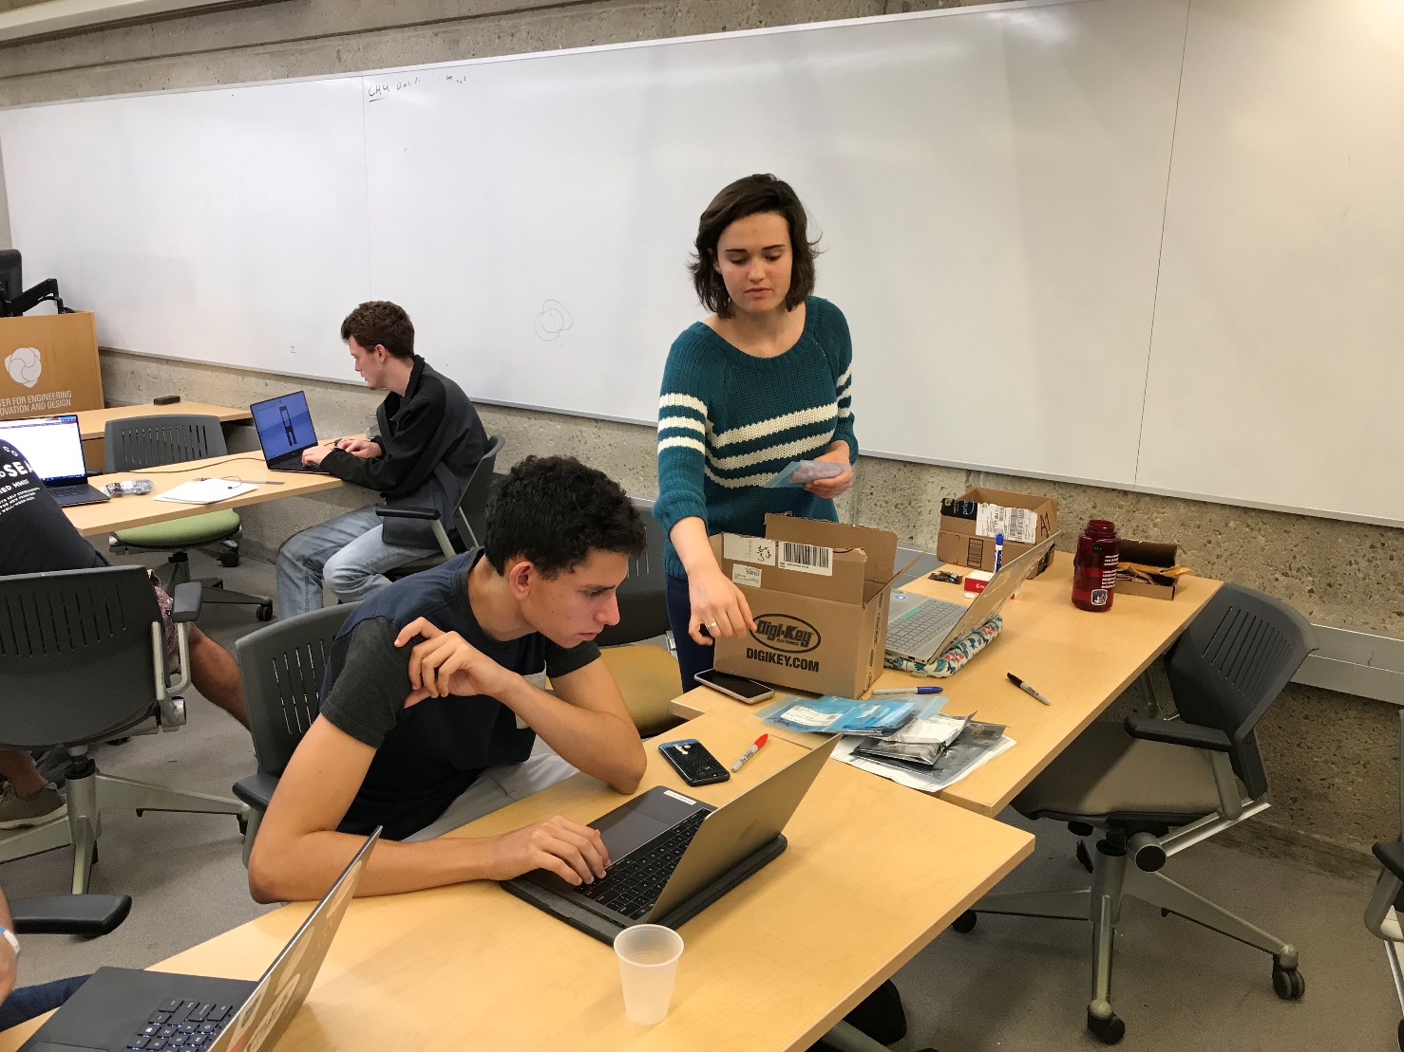
Where we work
Primarily the CEID in Becton
We are also excited about developing a second presence for CubeSat at Wright Lab, with cleanroom capabilities.
Looking to begin assembly work later this year
In the future, will need to conduct environment tests (vacuum, vibration, etc.) at Wright Lab

Slide 9
Thank you all for your time!

