Slide 1
Comprehensive imaging resource in the Yale Magnetic Resonance Research Center
Yale- MRRC
R. Todd Constable
Professor, Radiology and Biomedical Imaging

Slide 2
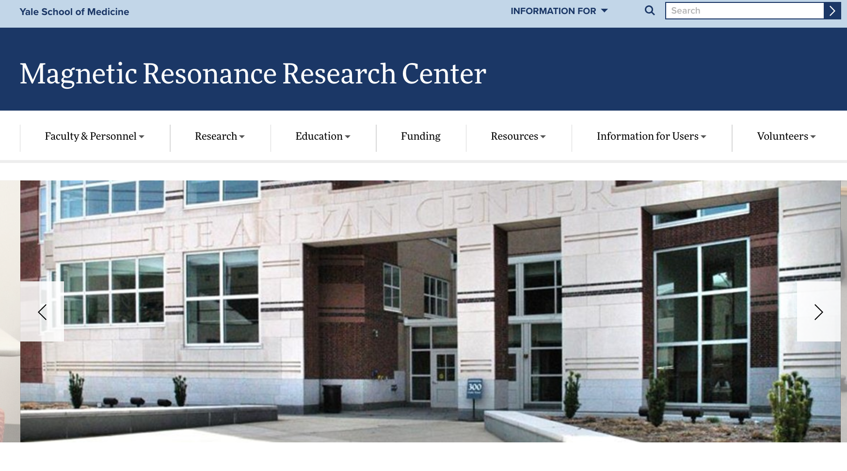
Yale MRRC
300 Cedar Street (Corner of Cedar and Congress Ave)
https://medicine.yale.edu/mrrc/

Slide 3
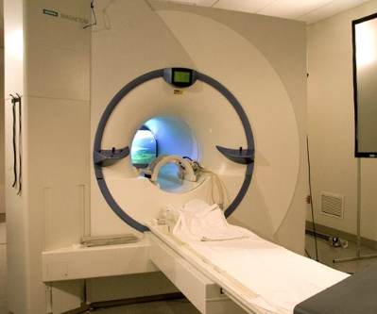
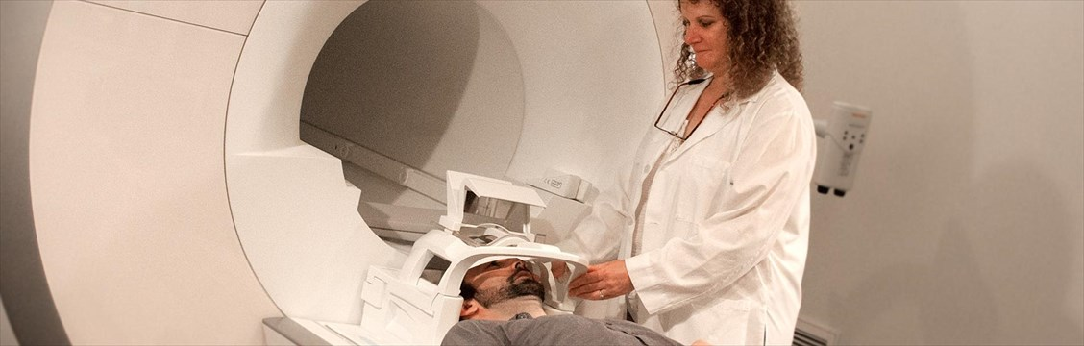
Yale MRRC
33,000 square feet
6 human MRIs, 3 preclinical magnets, and 2 structural NMRs
Machine shop
Electronic shop
Numerous workstations, servers
} build custom hardware

Slide 4
Current Inventory of MRIs
5 magnets for human imaging
  3T Siemens Prisma
  3T Siemens Prisma
  3T Siemens Trio
  3T Siemens Vida (just ordered this week)
  4T Bruker
  7T Siemens head-only magnet

Slide 5
Current Inventory of MRIs
3 magnets for preclinical MRI
  4T Bruker (20cm bore)
  9.4T Bruker (20cm bore)
  11.75T Bruker (20cm bore)
2vertical bore magnets
  500MHz for structural NMR

Slide 6
What do we provide?
Comprehensive imaging resource
  design protocols
  provide safety training
  assist with IRB (YCCI and HIC) protocols
  provide professional MR techs to run scanners for human imaging studies
  provide data transfer and analysis support

Slide 7
What do we provide? MRI
In terms of imaging we can do pretty much anything
  Cardiac MRI
  MR angiography
  MSK
  Liver and renal imaging
  Spine
  Lung
  Neuroimaging
    perfusion, diffusion, DTI, T1, T2, proton density contrast, MTC, dynamic contrast

Slide 8
What do we provide? MRS
In terms of spectroscopy we can do pretty much anything
  single voxel
  multivoxel
  chemical shift imaging
  multinuclear capabilities
    protons, carbon (C13), phosphorous, sodium

Slide 9
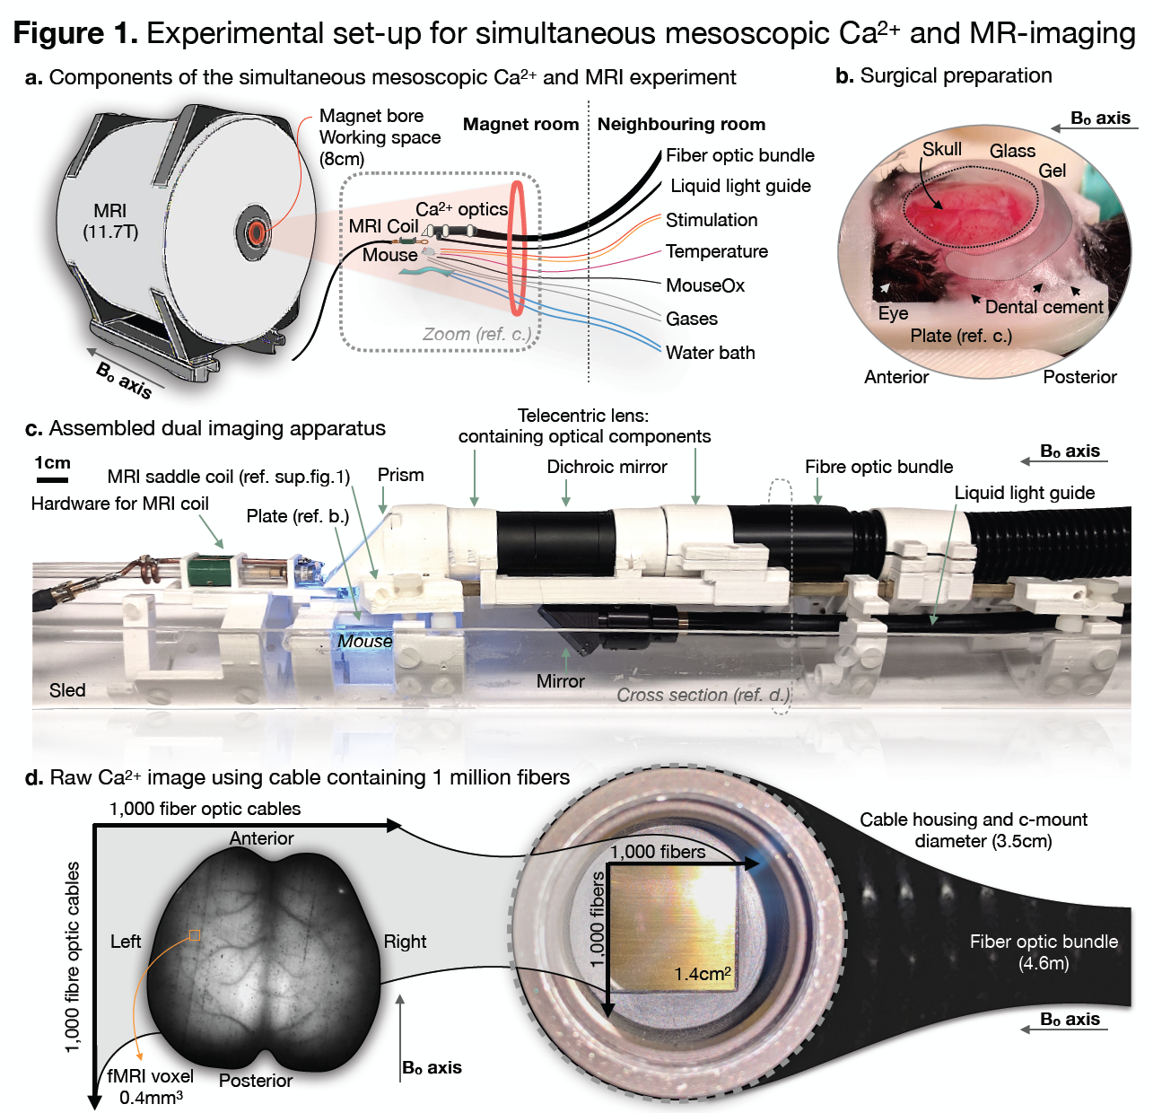
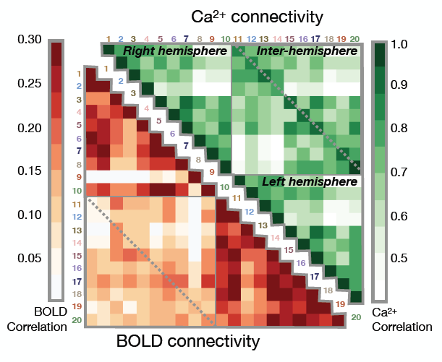
Yale MRRC
Awesome, State-of-the-art MR imaging resource
Serves over 60 PIs throughout the University
Simultaneous mesoscopic Ca2+ and fMRI
https://medicine.yale.edu/mrrc/

Slide 10
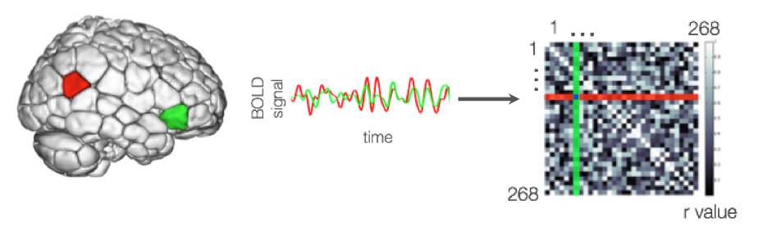

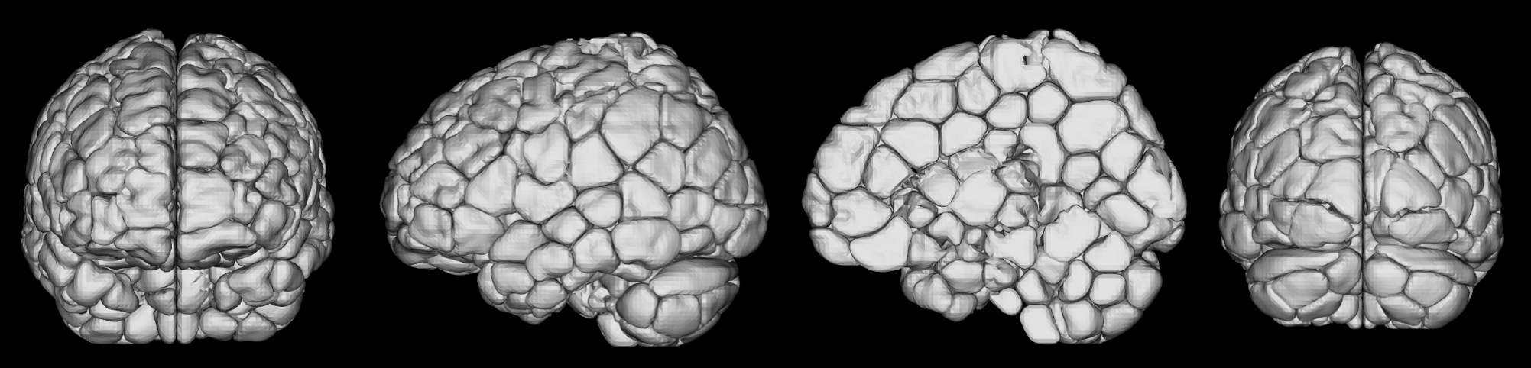
Yale MRRC
Functional Parcellation of the brain
https://medicine.yale.edu/mrrc/

Slide 11
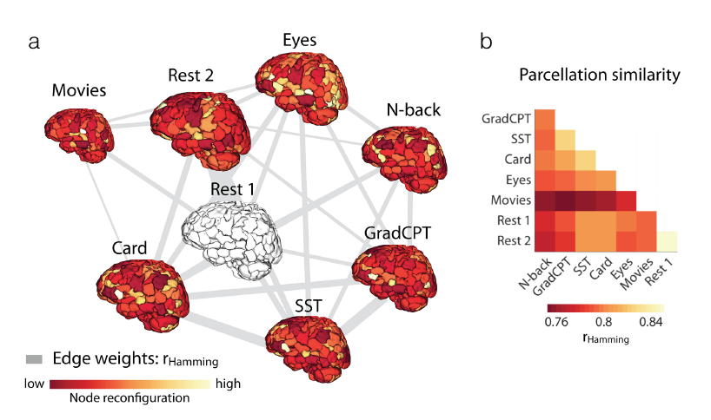
Yale MRRC
Functional Parcellation of the brain
https://medicine.yale.edu/mrrc/

Slide 12
Thank-you
https://medicine.yale.edu/mrrc/

Slide 13
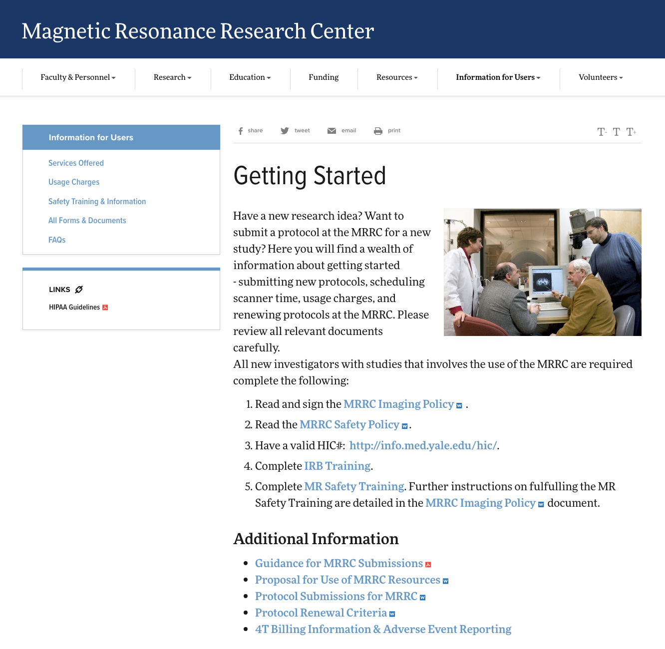
What do we provide?
https://medicine.yale.edu/mrrc/users/

