Slide 1
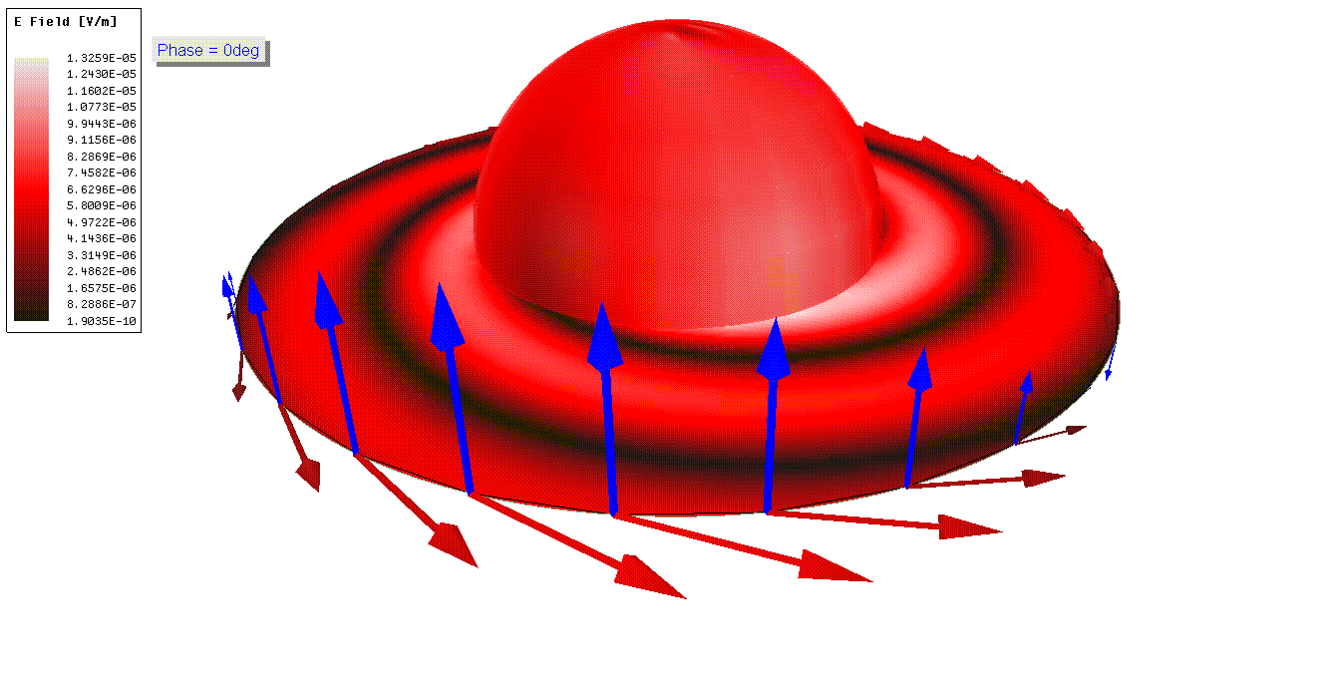



Progress toward Phase III Design of the Project 8 Experiment
Tim Wendler
Post-Doc
$$\overset{⃑}{E}$$
$$\overset{⃑}{H}$$
Notes:
The alien we are trying to communicate with

Slide 2
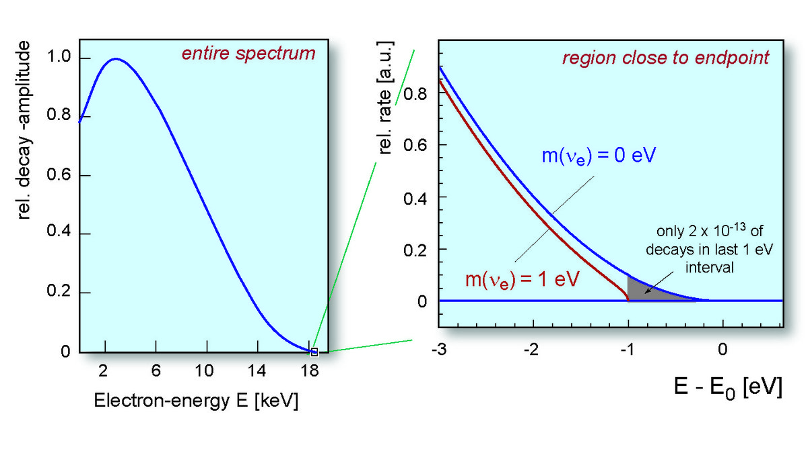

Direct Neutrino Mass Limit from Tritium Beta Decay
Beta Decay: The masses and kinetic energies of the products must add up to the mass of original nucleus
Tritium spectrum endpoint changes with finite neutrino mass
  Determine the greatest upper-bound for electron neutrino mass from the shape of the tritium beta-decay endpoint
Beta Energies
³H → ³He⁺ + e⁻ + 𝜈e
n
anti-neutrino
n
𝜈e
p
³H
e⁻
β-decay
electron
p
n
Measuring this electron’s initial energy is a direct method of electron neutrino mass measurement
p
³He
Notes:
CRES

Slide 3
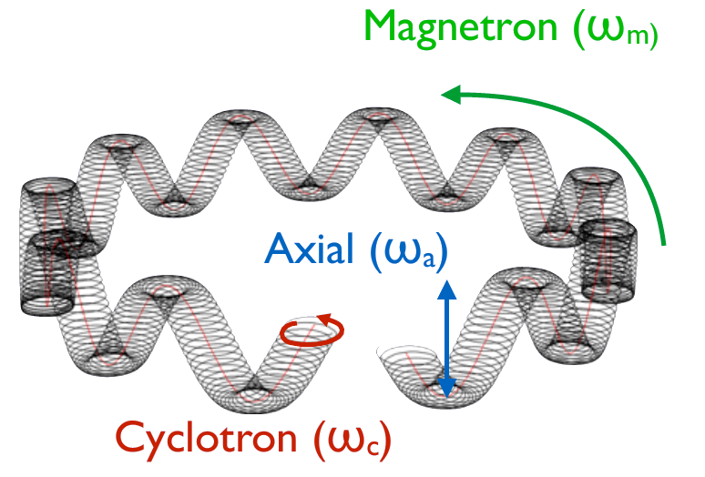
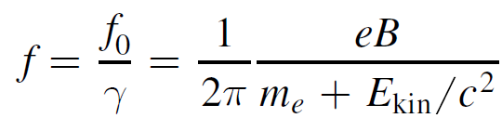
Cyclotron Radiation Emission Spectroscopy (CRES)
New Spectroscopy Technique: Formaggio and Monreal, Phys. Rev. D 80, 051301 (R), 2009
Magnetically Trapped Electron in a cyclotron state emits K-band (26GHz) radiation in a 1 Tesla field
Amplifier/Digitizer
Grad-B Motion
Detector Concept
26 GHz
Trap coil
$${{}_{ }^{3}{\text{H}}}_{}$$
antennas
$$B$$
Trap coil
Notes:
Project 8

Slide 4
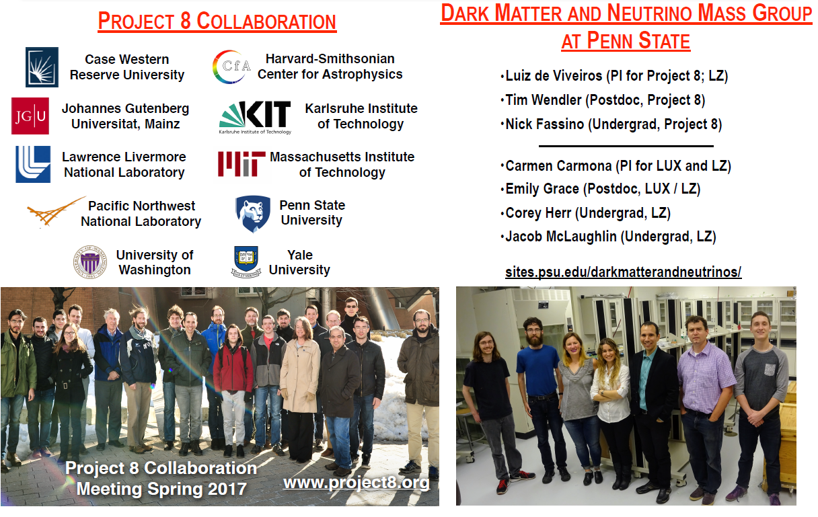
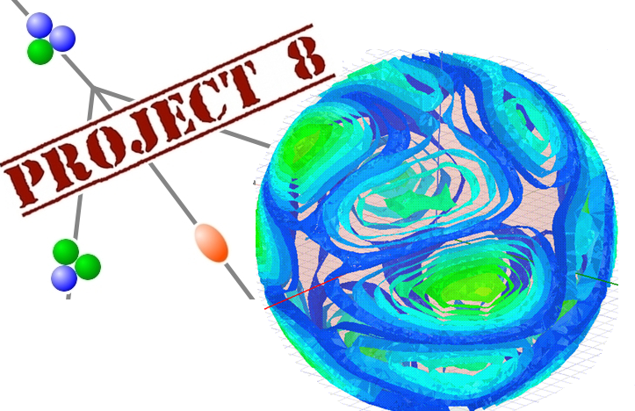
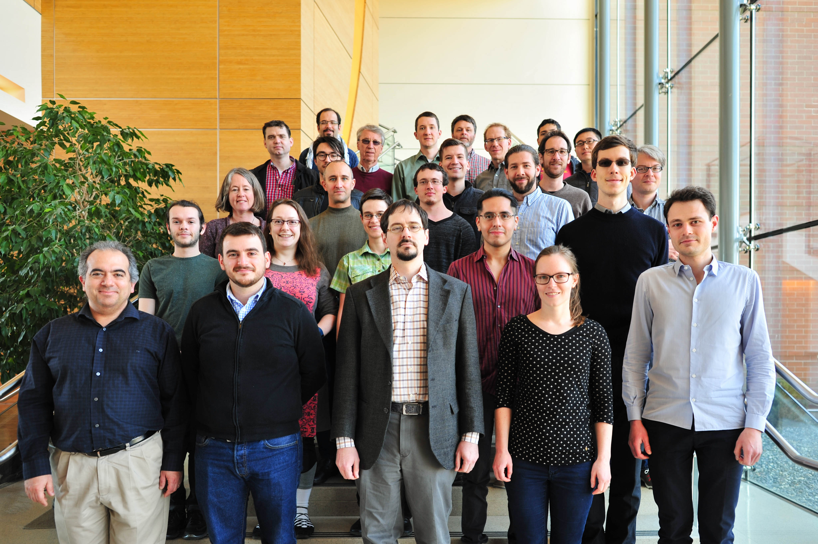



Project 8 Collaboration – 10 Institutions
Supported by the NSF and the DOE Office of Nuclear Physics
Notes:
Phases

Slide 5
Project 8 Long Term Logistics
 | Timeline | Scientific Goal | Source | R&D Milestone
Phase I | 2010-2016 | Proof of Principle; Kr spectrum | ^{83m}Kr | Single Electron Detection
Phase II | 2016-2019 | T-He Mass Difference (Kurie plot) m𝜈 ≲ 10-100 eV | T2 | Tritium cell systematic studies (B-field calibration)
Phase III | 2017-2022 | m𝜈 ≲ 2 eV (competitive limits) | T2 | large volume new receiver design (not waveguide)
Phase IV | 2018+ | m𝜈 ≲ 40 meV Measure m𝜈 or determine normal hierarchy | T | Atomic T source and trap large scale (100 m³) control channel count
Completed
Currently Running
Currently Designing
Currently Designing
Notes:
The detector

Slide 6
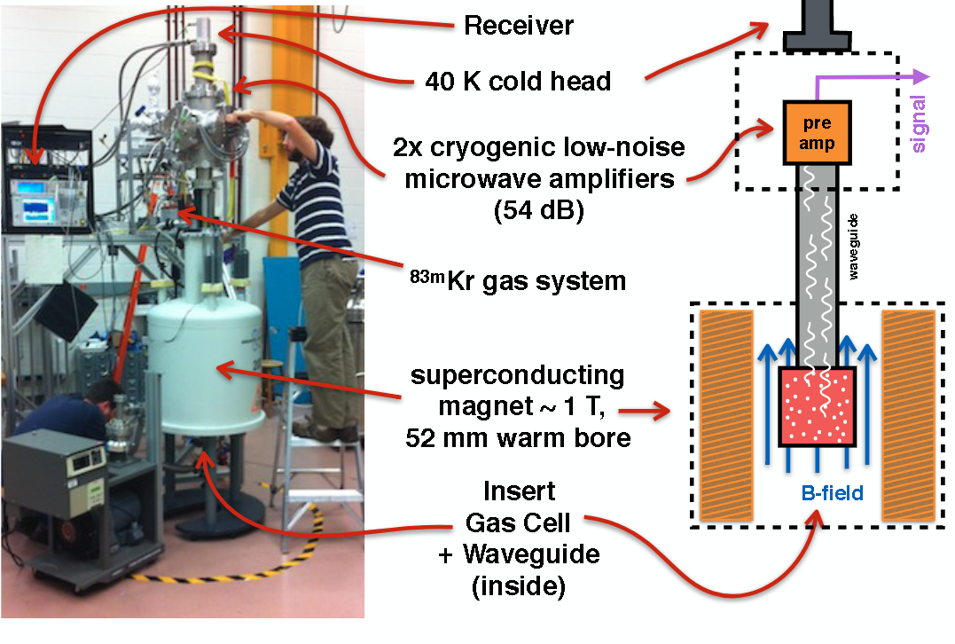
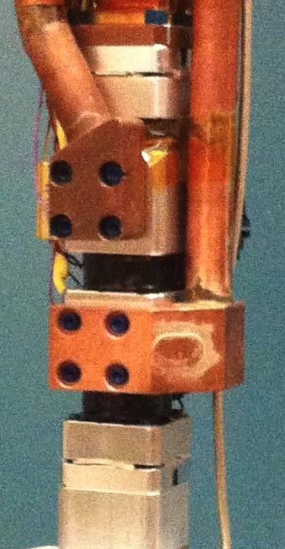
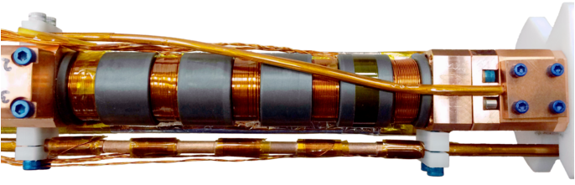
Project 8 Detector (Phase I and II)
Phase II insert
Phase I insert
3
Trap
Coils
cell
5
Trap
Coils
cell
University of Washington
Phase III Insert will be much bigger
Notes:
Larger trap

Slide 7
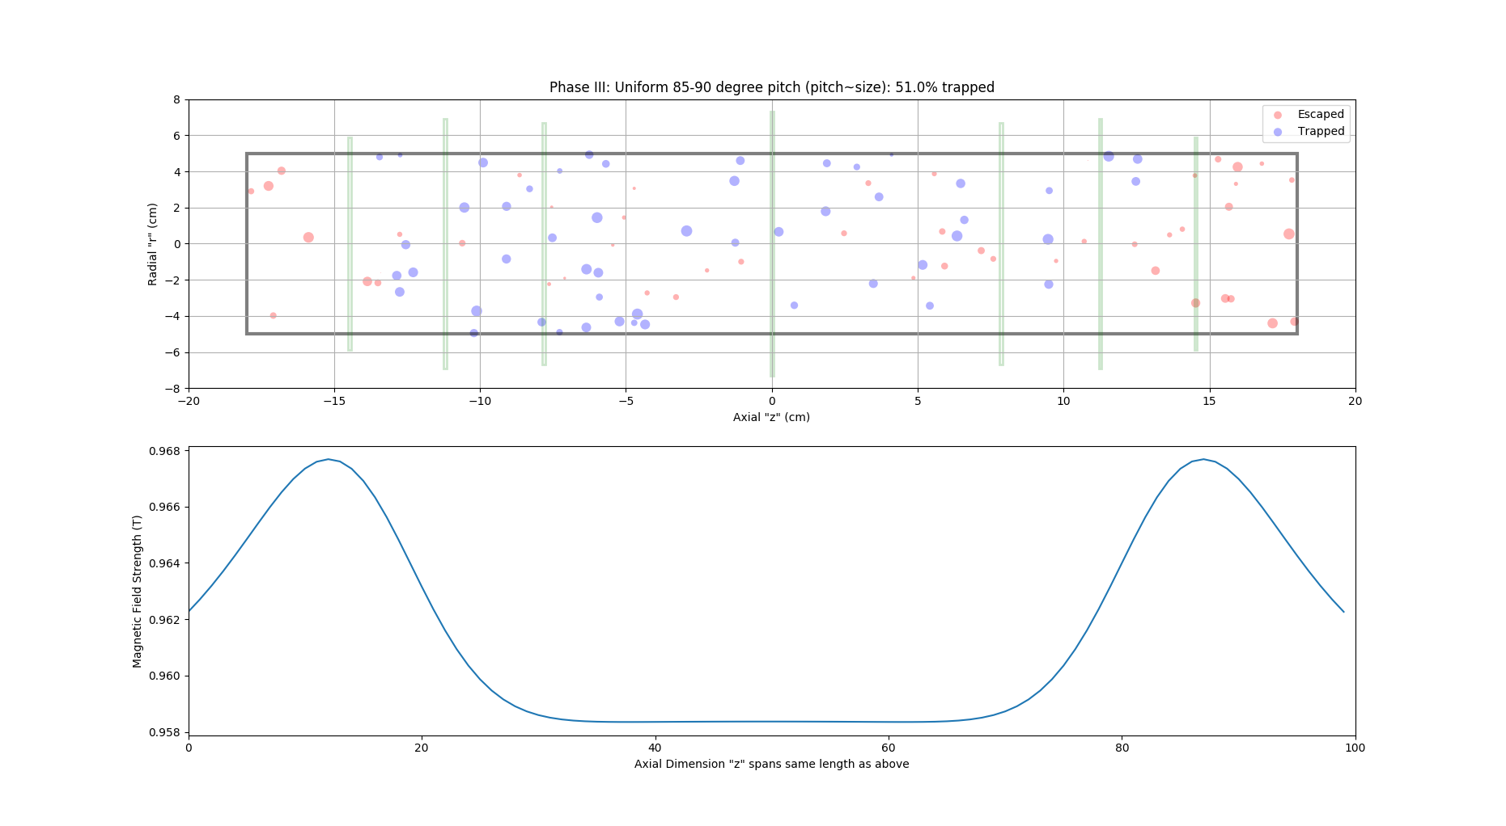




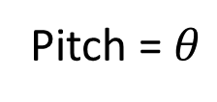
Trapping Electrons in Phase III (Kassiopeia)
Trap Coils
$$\overset{⃑}{B}$$
Phase II Trap
Background Field
$$\overset{⃑}{v}$$
Trap Coils make bathtub walls
$$θ$$
“bathtub trap”
Pitch =$θ$
$$\overset{⃑}{B}$$
e⁻
Background Field
Notes:
video

Slide 8
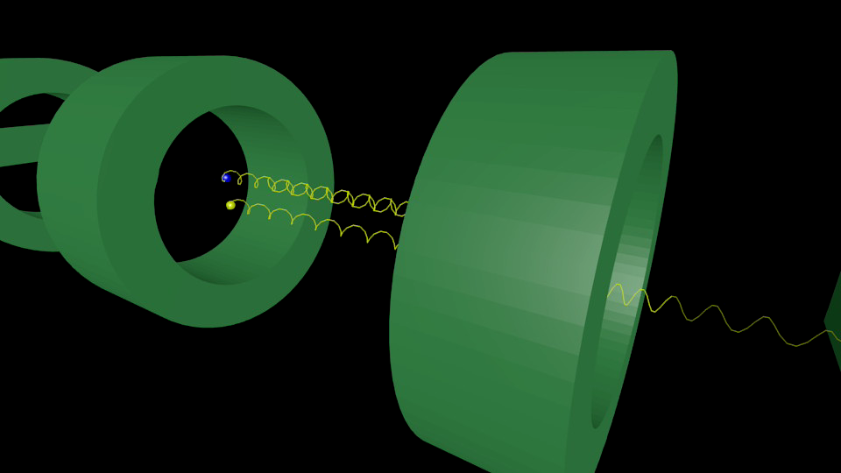
Phase I Trap with two events
Notes:
Here is a simulation of phase 1 bathtub Trap configuration.
There is a background 1 Tesla field over this whole space. The green loops are coils with current to generate a local field to trap the axial moving beta decays.
Shown is two electrons with the same kinetic energy but slightly different initial velocity angle as they leave the beta source nucleus.
This is how we trap the electrons to measure their energy

Slide 9
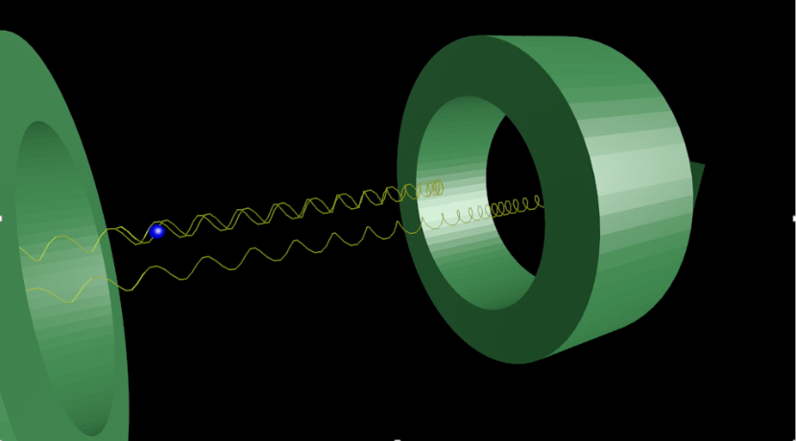
Pitch angle relative to H field
Electron Trapped Long enough to see signal
86$°$
85$°$
Notes:
Phase I results

Slide 10
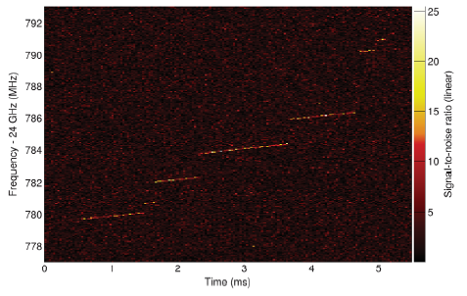
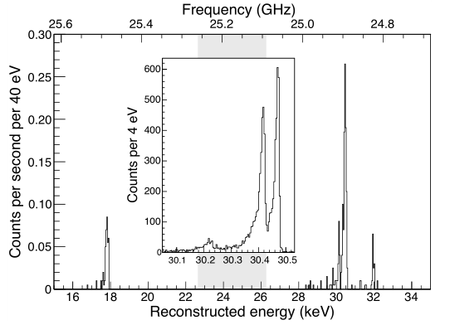
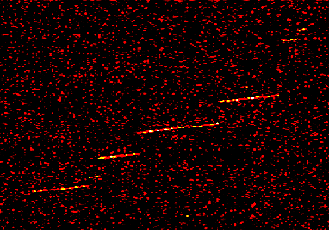
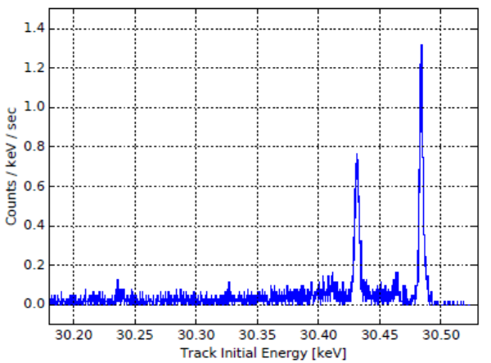
Initial Results – ${}_{}^{83m}{\text{Kr}}$ Internal Conversion Lines
Results from Phase I
O(1eV) energy resolution!
Scattering off
A residual gas
molecule
Energy loss
Via cyclotron
radiation
Event starting frequency
used to build spectrum
…Phase II Currently Running…
Phys. Rev. Lett. 114 , 162501 (2015)
Ashtari et. al., J. Phys. G (2017)
Notes:
Phase II results

Slide 11
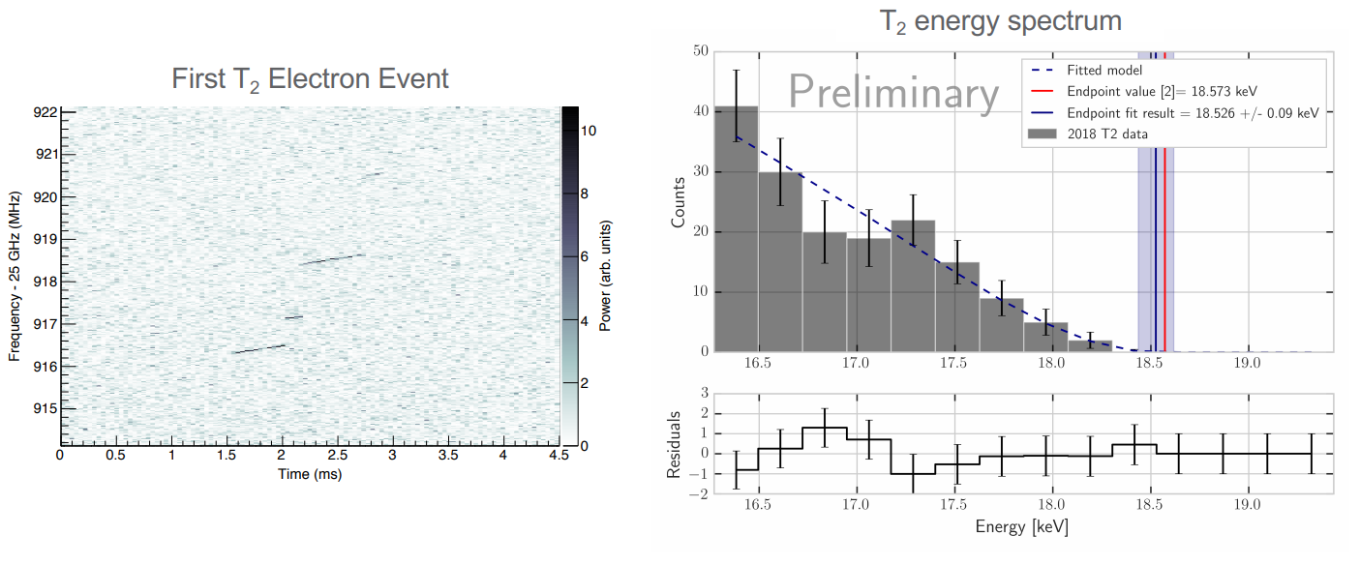

Initial Results from Phase II – ${}_{}^{3}{\text{H}}$
Notes:
Low counts, need bigger volume

Slide 12
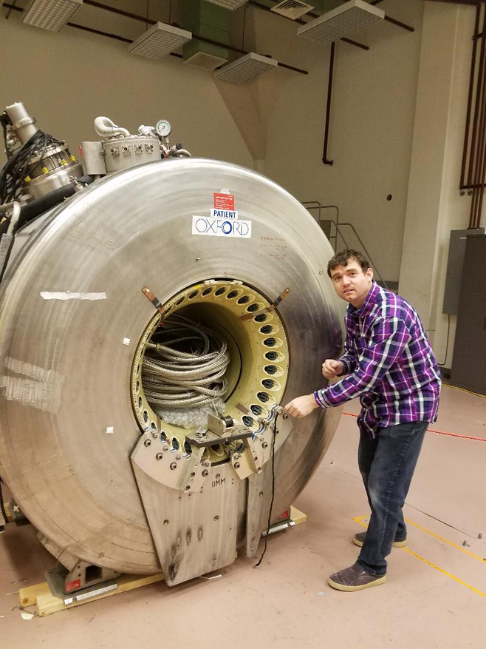
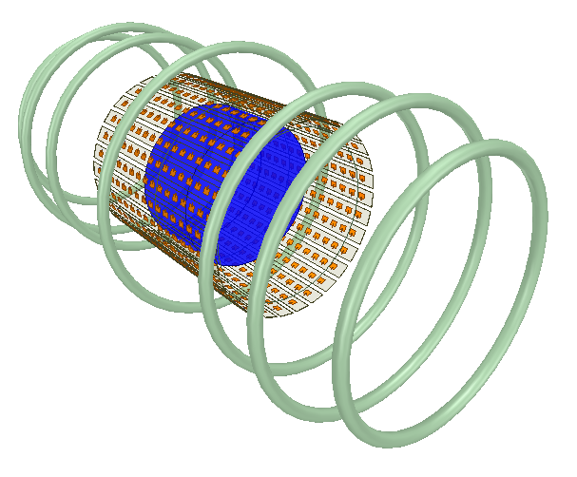
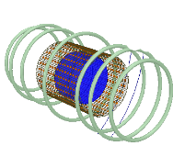
Phase III Design Features
7 coils on top of background MRI 1T field
Size of
Phase I and II
200 cc volume in blue cylinder
2 orders bigger than previous phases to increase count rate
MRI magnet in lab at UW
Antennas
(My Focus)
Notes:
Got this because of by NAVY exerience

Slide 13
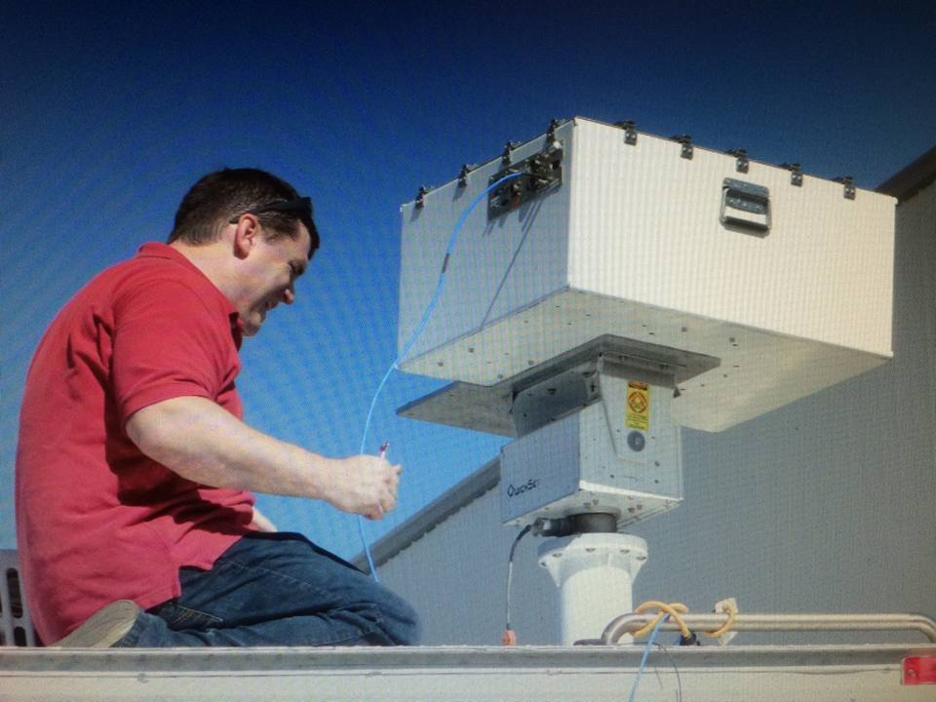
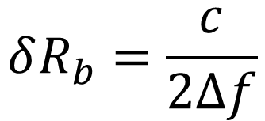

Basic RADAR Imaging Principles
Minimum object distance that can be resolved is called range-resolution
$$δR_{b}$$
Convolution with original waveform produces a range profile (Pulse Compression)
Chirp travelling at c toward target
Antenna
Returning signal contains 2D range profile data
Area to Image
Range-resolution can be obtained:
$$δR_{b}=\frac{c}{2Δf}$$
Bandwidth of chirp
Me with the dual-polarization mono-static K-band RADAR
Notes:
This only tells us distances in one dimension, what about Cross-range

Slide 14
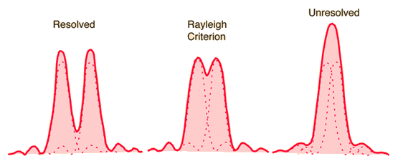
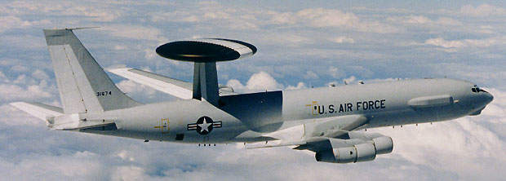
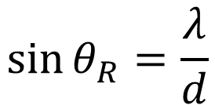
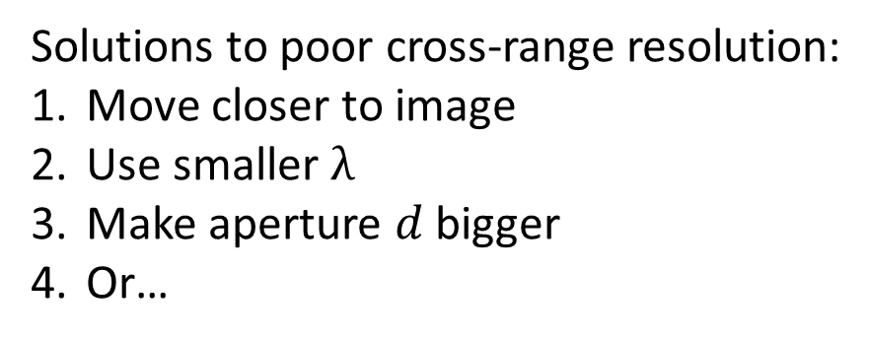


Rayleigh Criterion for Electromagnetic Apertures
$$\sin{θ_{R}=\frac{λ}{d}}$$
Limit of Cross-Range Resolution
Limit of Cross-Range Resolution
RADAR System
$$θ_{R}$$
$$d$$
Solutions to poor cross-range resolution:
Move closer to image
Use smaller $λ$
Make aperture $d$ bigger
Or…

Slide 15
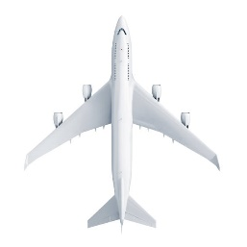

Synthesize a larger aperture
$$\sin{θ_{R}=\frac{λ}{d}}$$
Limit of Cross-Range Resolution
Limit of Cross-Range Resolution
RADAR System
$$θ_{R}$$
$$d$$
Phase History
synthesize the aperture with the data made at different points in space
Area to Image
$$d$$
Mono-static Synthetic Aperture RADAR (SAR): Tx/Rx are at same position for each point in the phase history

Slide 16
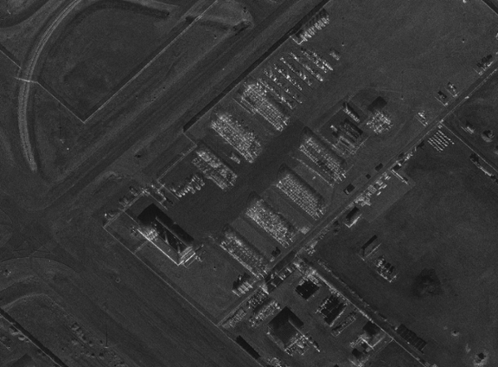

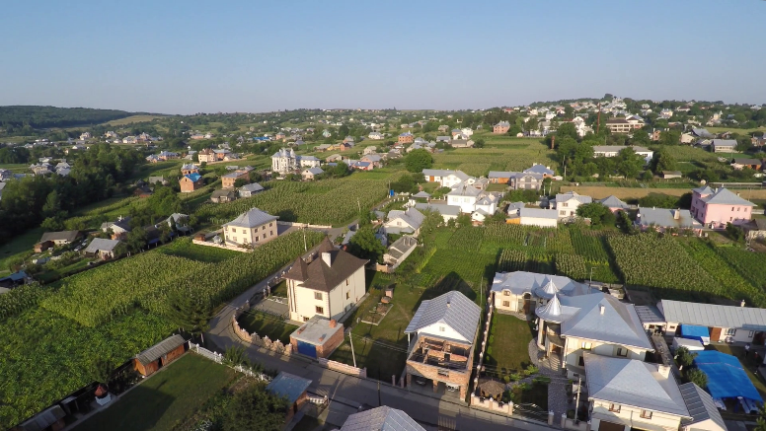
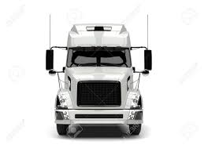
Spotlight-mode Synthetic Aperture RADAR
The Drone/Satellite stays on a perfect circular trajectory and images a single central region
More data from same area means more to be integrated out of the noise floor
Can image landscapes at night and/or through the clouds
Can only make 2D images
Bi-static SAR: Tx/Rx are at different positions
2D SAR Image without ground projection of phase history
Nearby Mountain

Slide 17

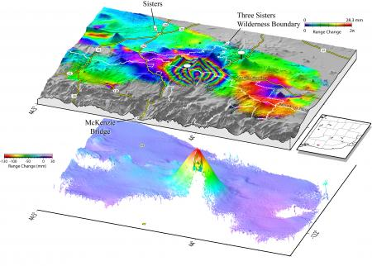
Interferometric Spotlight-mode SAR (InSAR)
Similar trajectories at multiple altitudes can produce data that can reconstruct the height of targets as well as their positions
I got my post-doc position designing Phase III because of my RADAR Imaging and microwave engineering experience.
Notes:
Phase III antenna array

Slide 18
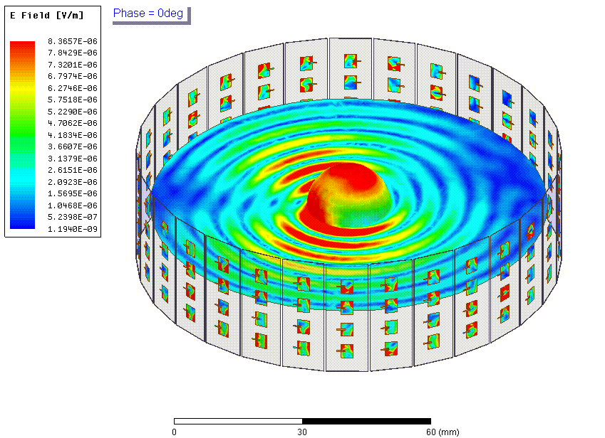
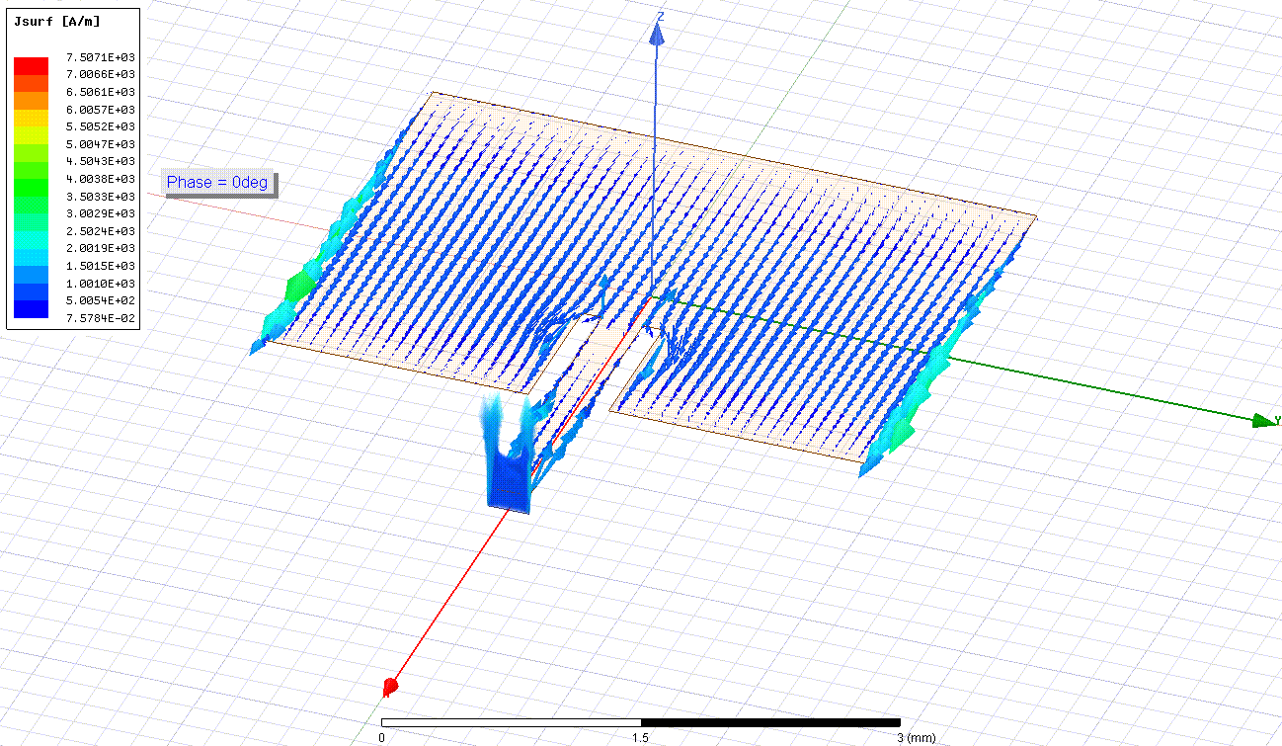
Phase III Simulation of Antenna Array
Shown is a trapped electron radiating into a surrounding antenna array
18.6keV of initial energy (Tritium Endpoint)
.9583 Tesla field
90 degree pitch
1.1 fW of power
Rectangular patch arrays couple to the field to record the signal and measure the frequency
Software: HFSS (High Frequency Structure Simulator)
Electric Field
Magnitude Shown
Surface currents generated
Notes:
Combine power in software/hardware to get out of noise floor

Slide 19
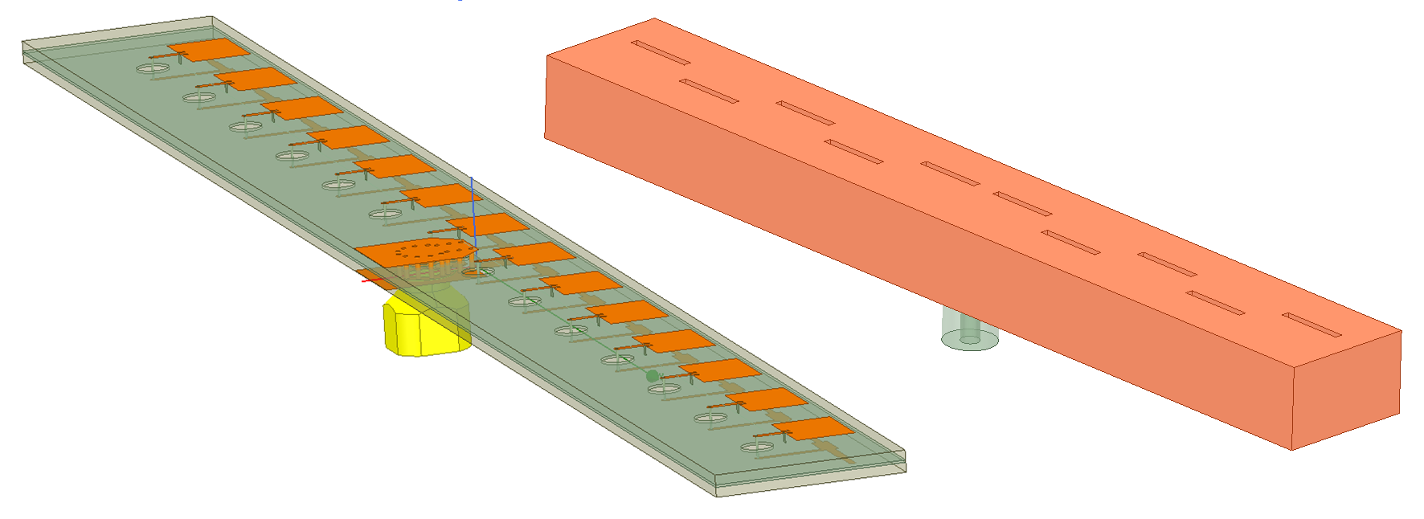
Two Spatial Power Combining Designs (hardware)
Slotted Wave-guide Array
Lower loss in power combiner
Lower gain per element
Center Fed Series Patch Array
Higher gain per element
Higher loss in power combiner
Notes:
Beam forming

Slide 20
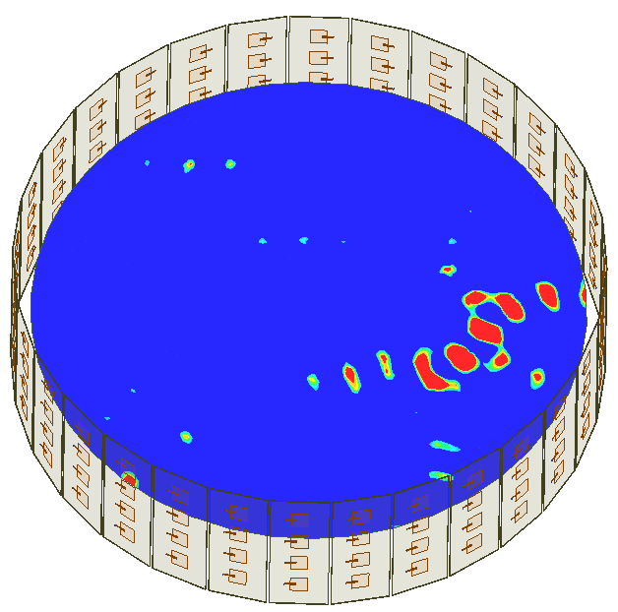
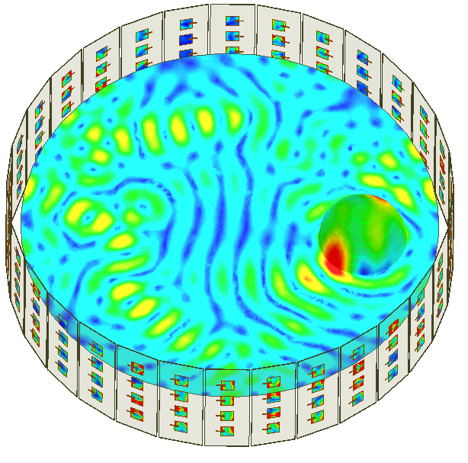

Software Power Combining is used to identify/isolate simultaneous events
E-field Magnitudes Shown
E-field Magnitudes Shown
Trapped electron off-center (Receive mode)
Beam forming to increase sensitivity to that point (Transmit mode)
Software: HFSS (High Frequency Structure Simulator)
Notes:
Stuck in frequency domain

Slide 21
Frequency Domain is only so useful for Phase III
Traditional Antenna Engineering is mostly in the Frequency Domain so most methods and software are optimized for frequency domain (steady-state) solutions but…
Frequency Domain is very limited
Can’t model axial motion of our source and/or the modulation that comes with it
Can only produce steady-state FEM solutions for single frequencies
Can only calculate coupling to pitch=90 time-avg electrons
Cannot use current Project 9 software to model the ADC and DAQ.
How can we model our detector in the time-domain with only frequency domain solutions?
Notes:
How can we go to time-domain using powerful commercial software?

Slide 22
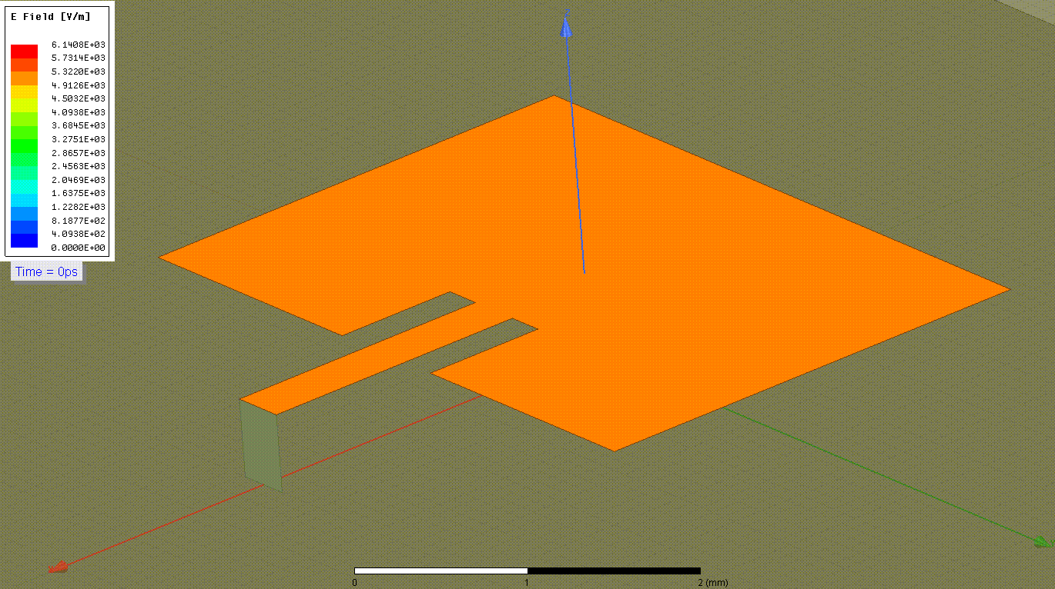
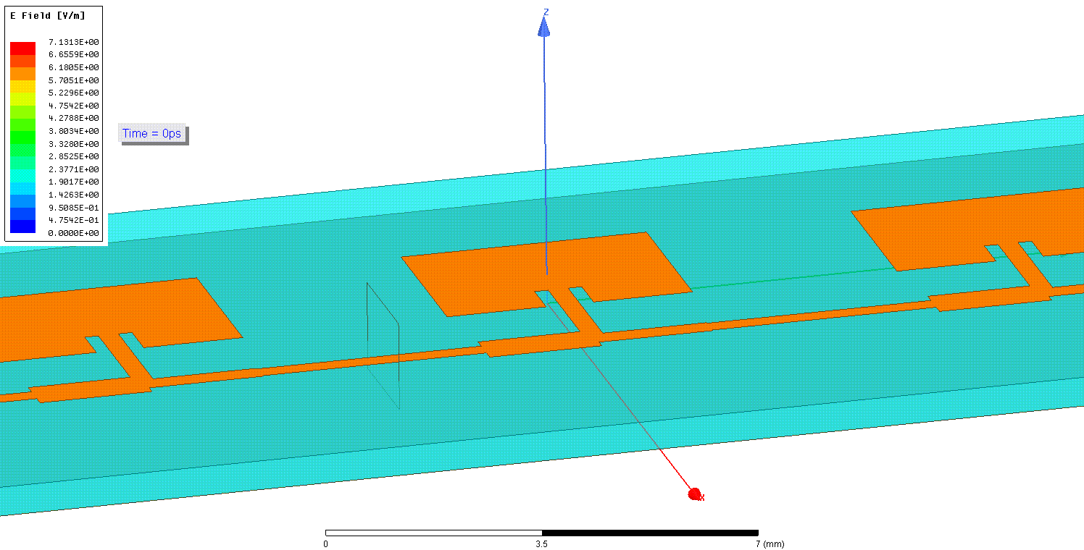
Finite Impulse Response Filters
Calculate transfer function of antenna in frequency domain
Use IFFT of transfer function to generate an impulse response
Impulse Response can be used in time-domain to model the antenna’s amplitude and phase response to any arbitrary time-varying electromagnetic field
Locust is Project 8’s simulation package
Penny Slocum, Arina B. Telles, and Pranava T. Surukuchi use a variety of Finite Impulse Response filters in Locust, originally derived by HFSS
Transient responses of antennas to Gaussian pulse
Notes:
Locust localizes

Slide 23
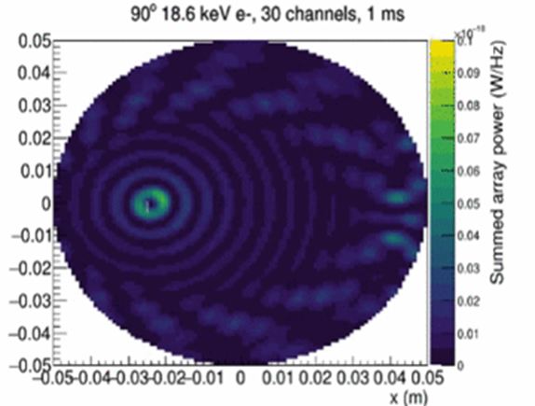
Locust simulates the full Phase III detector
Penny Slocum has found a way to beam-form and localize electrons in the time-domain
y(m)
Notes:
But there’s motion

Slide 24

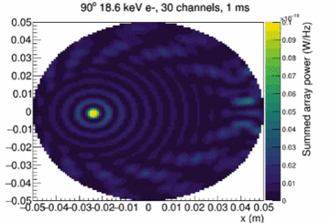
Locust simulates the motion and tracking
Penny Slocum has found a way to beam-form and track electrons in the time-domain
Phases of each array must be shifted to match CRES
Notes:
At this point, Need for lab measurement calibration

Slide 25
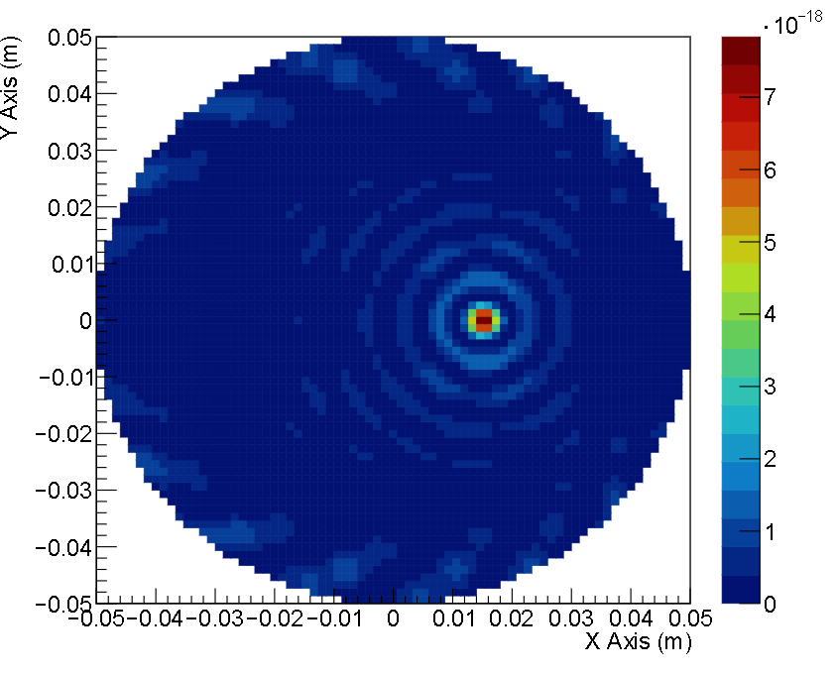
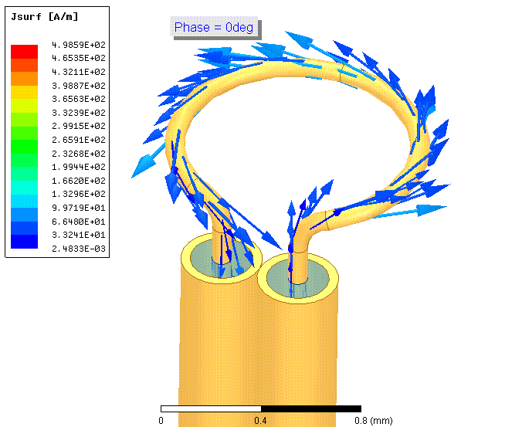
Locust simulates antennas in Transmit and Receive modes
antennas
Pranava has added an ideal magnetic dipole in Locust
This will allow us to normalize Locust with lab measurements
Generates an over-simplified version of CRES field
Notes:
Challenges of free-field

Slide 26
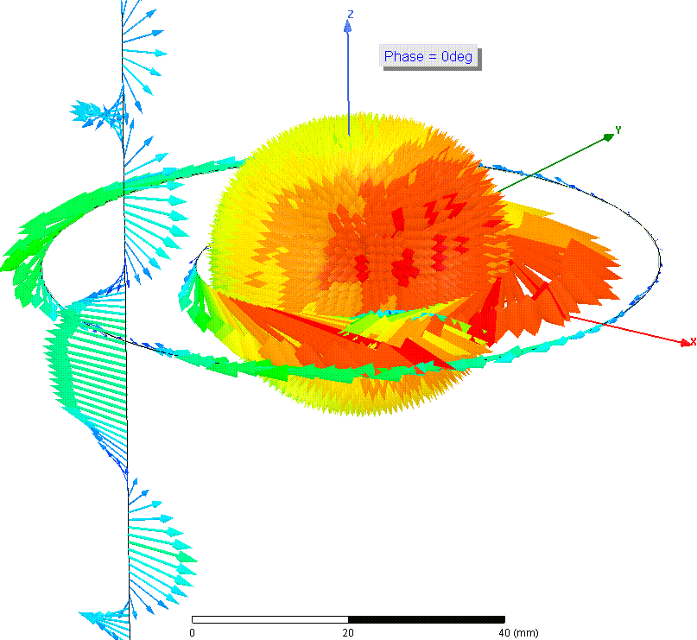
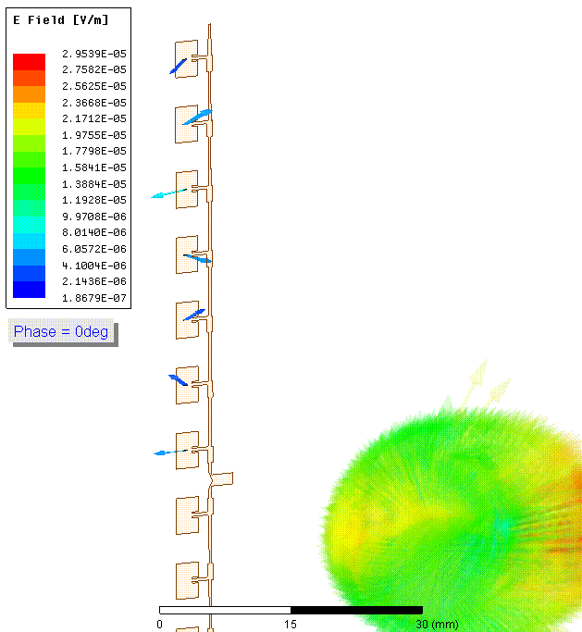
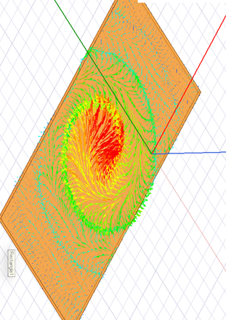

Challenges of Phase III
Electric Field Phasors Shown
CRES Free-fields contain complicated polarizations and time-dependence that is very hard to couple to linearly polarized structures
Elliptical
Motion produces Doppler modulation and Amplitude modulation
$$v$$
linear
Currents on metal
Notes:
Is there a way to R&D in the lab?

Slide 27
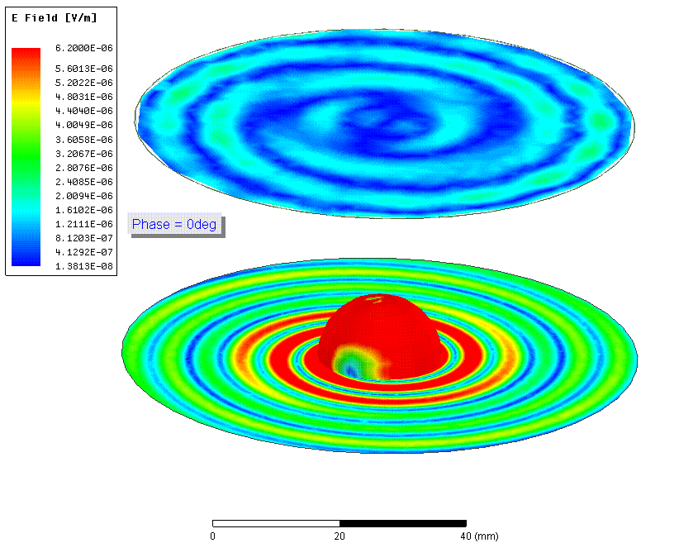
Synthesizing CRES Antenna for Array Tests
E-field Magnitudes in space surrounding CRES
Can we make an antenna that can simulate the radiation off a single electron in a cyclotron state?

Slide 28
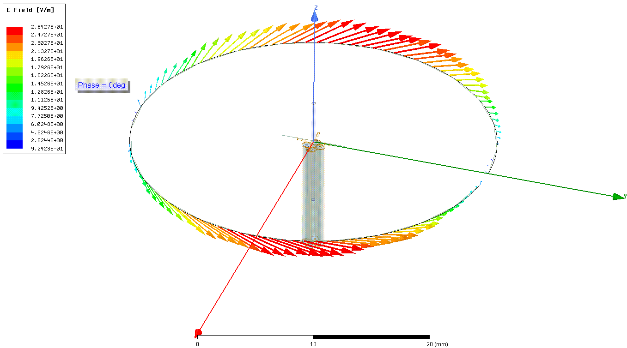
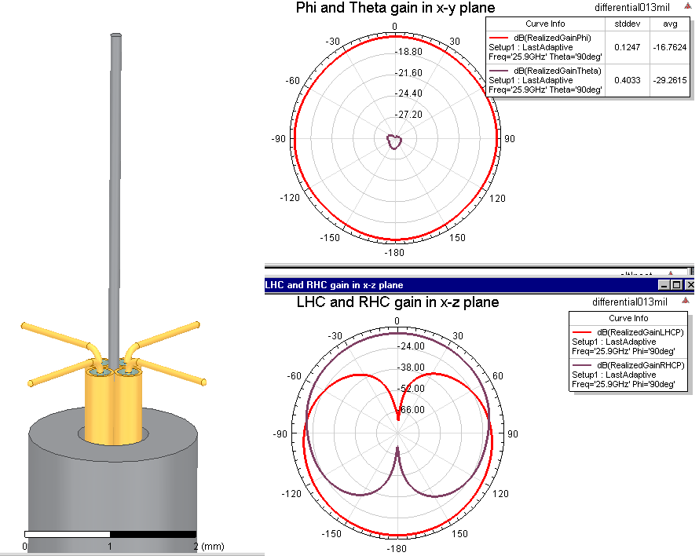



Yes: Turnstile Antenna
Generates full field
Requires 4 single-ended signals
Ferrous Tubes enhance magnetic dipole radiative moment
Turnstile
$$1_{+}$$
Volts
$$1_{−}$$
$$1_{+}$$
$$2_{−}$$
$$2_{+}$$
$$1_{−}$$
CRES
Volts
$$2_{+}$$
$$2_{−}$$
2-differential modes, in quadrature

Slide 29


Synthetic CRES Antenna for Array Tests
Turnstile is essentially a mono-pole moment spinning around at 26 GHz
Current Design for fabrication

Slide 30

The point
Good Coupling over max amount of pitch angles
Good detection volume
High count rate
High statistics
High mass sensitivity

Slide 31
Summary
Phase I and II have demonstrated CRES in a small volume
Phase III is CRES in a large volume and the free-fields are challenging to couple to with conventional antenna engineering
Locust is a powerful simulation package that is aiding us in the design of phase III
Locust now has Antennas FIR filters for transmit and receive
Synthtic CRES Transmitter will aid in the array design and Locust calibration

Slide 32

The End
Thank You Luiz, Penny, Mark, Maurio, and Brent

