Slide 1
CERN Activity Update
Christian Weber
Yale
February 19, 2018

Slide 2
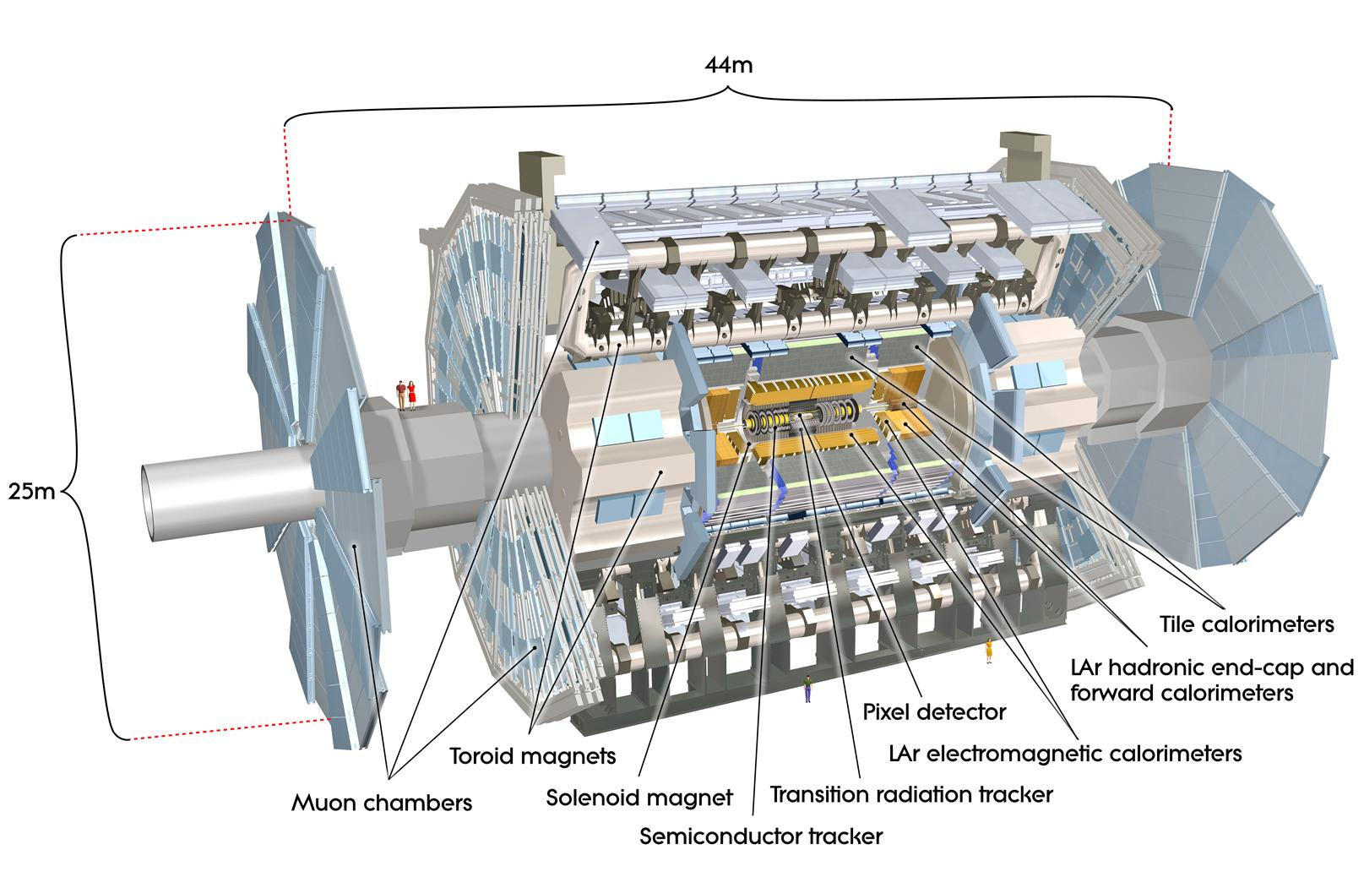
ATLAS detector

Slide 3
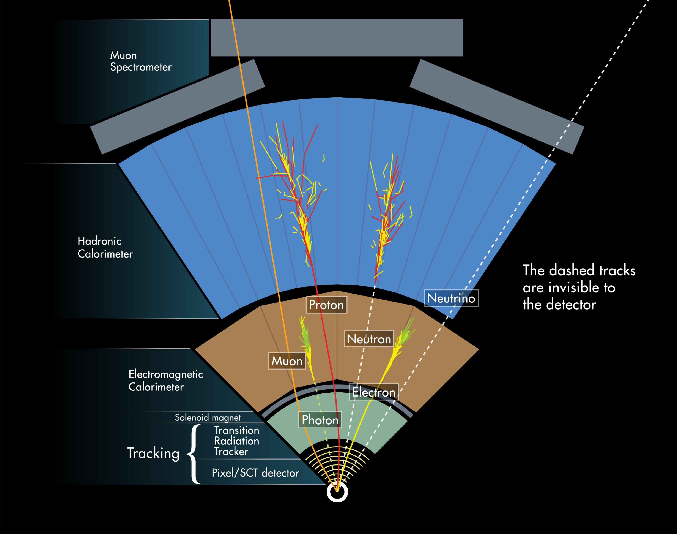
ATLAS detector

Slide 4
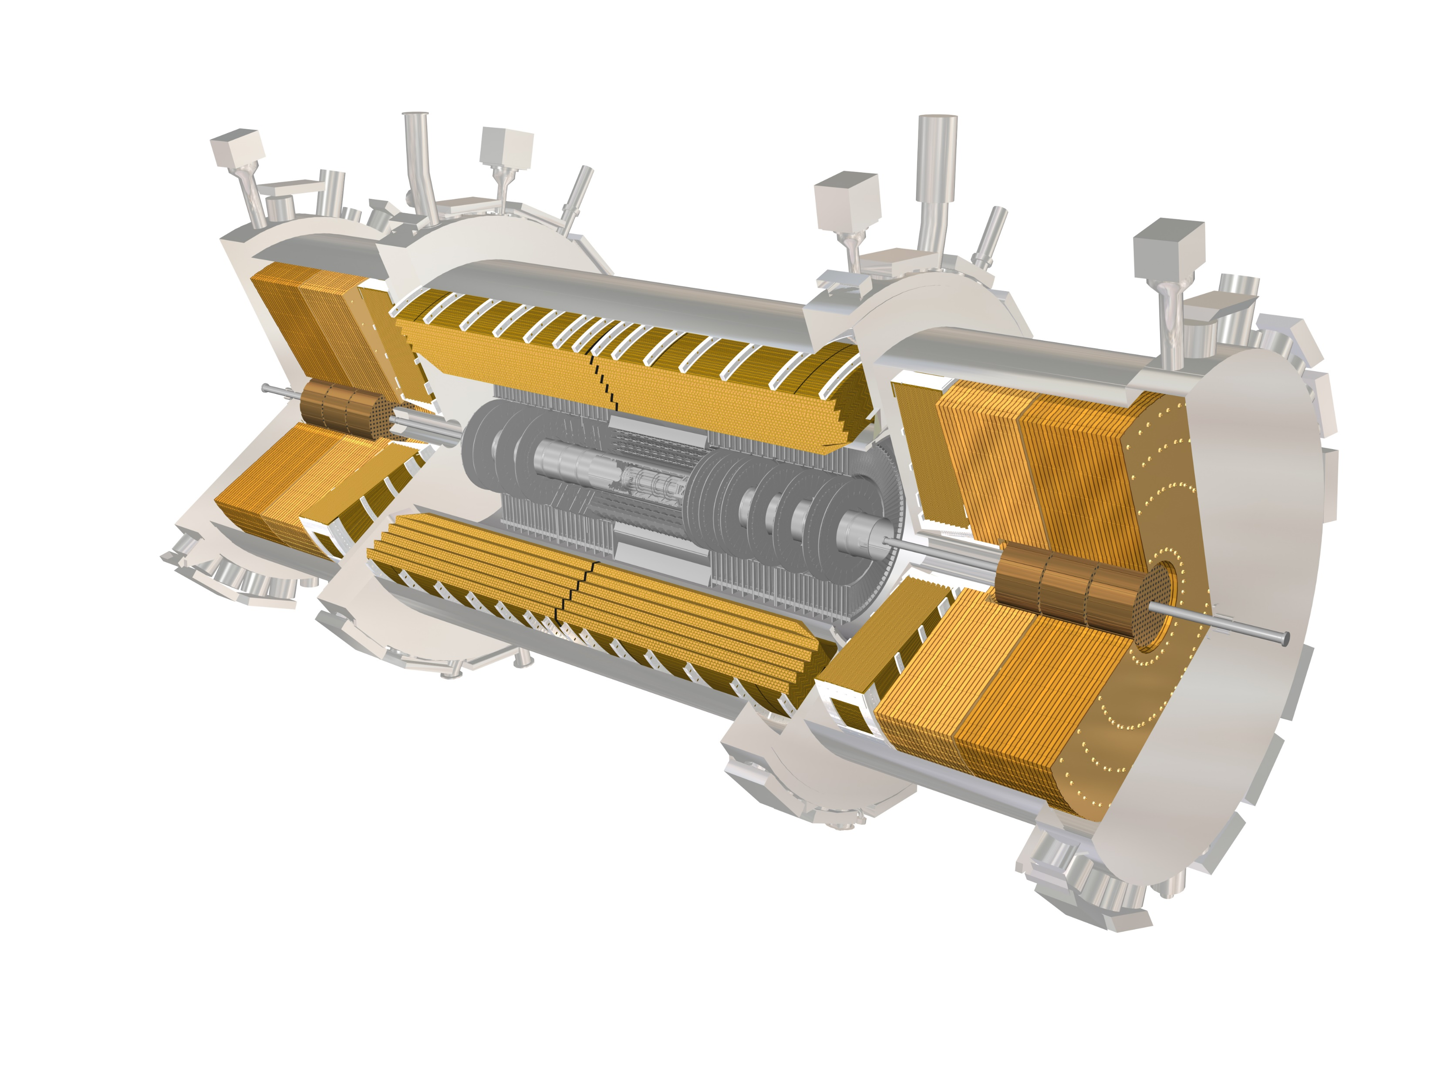

ATLAS detector – Ep Combination idea
For electrons, we have two independent measurements of their energies.
One from Inner Detector and the Liquid Argon Calorimeter. Combining their measurements should yield a measurement with better accuracy and precision: Ep Combination
Inner Detector $\frac{σ_{pT}}{pT} \sim pT$
Liquid Argon Electromagnetic Calorimeter $\frac{σ_{E}}{E}\sim \frac{1}{\sqrt{E}}$

Slide 5
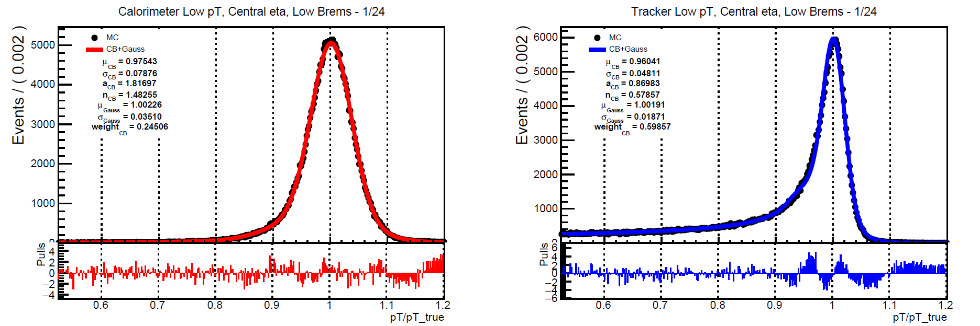
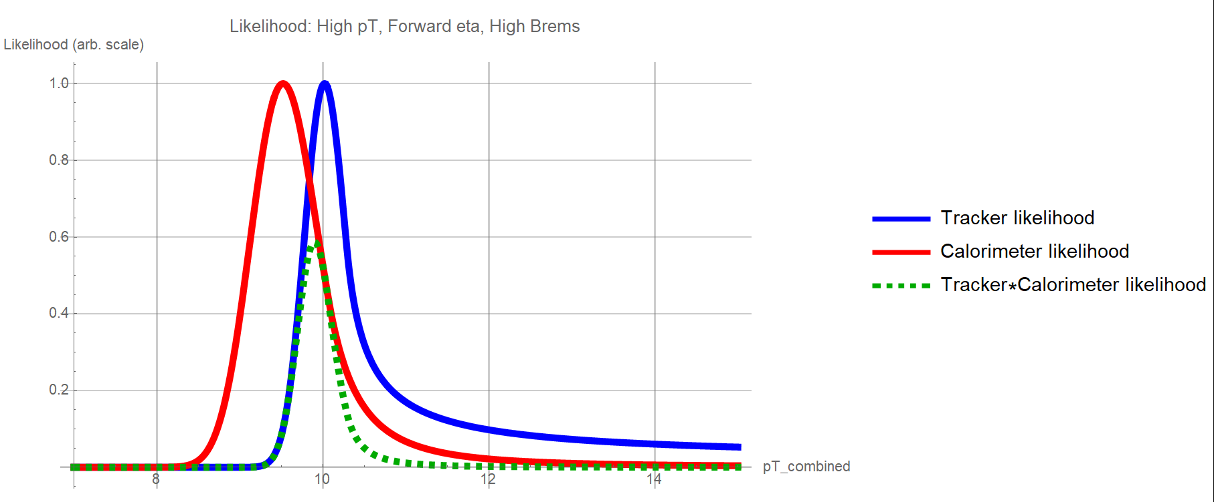


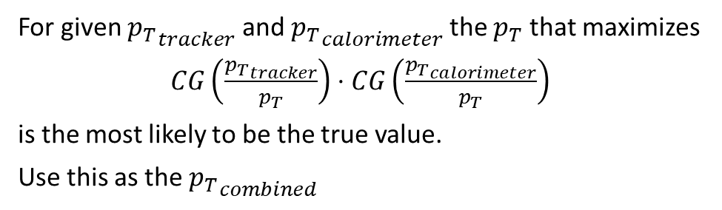
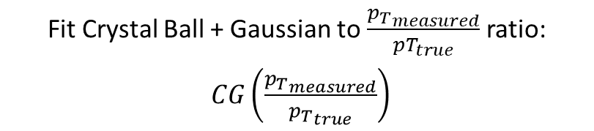

Combination via Maximum Likelihood Method
Determine distribution of ${p_{T}}_{measured} /{p_{T}}_{true}$ ratio and interpret as probability density function
Fit Crystal Ball + Gaussian to $\frac{{p_{T}}_{measured}}{pT_{true}}$ ratio:
$CG\left(\frac{{p_{T}}_{measured}}{{p_{T}}_{true}}\right)$
$$CG\left(\frac{{p_{T}}_{tracker}}{p_{T}}\right)$$
For given ${p_{T}}_{tracker}$ and ${p_{T}}_{calorimeter}$ the $p_{T}$ that maximizes
$CG\left(\frac{{p_{T}}_{tracker}}{p_{T}}\right)⋅CG\left(\frac{{p_{T}}_{calorimeter}}{p_{T}}\right)$
is the most likely to be the true value.
Use this as the ${p_{T}}_{combined}$
$$CG\left(\frac{{p_{T}}_{calorimeter}}{p_{T}}\right)$$
$$CG\left(\frac{{p_{T}}_{tracker}}{p_{T}}\right)⋅CG\left(\frac{{p_{T}}_{calorimeter}}{p_{T}}\right)$$
Train likelihoods on mc16_13TeV.423000.ParticleGun_single_electron_egammaET.deriv.DAOD_EGAM1.e3566_s3113_r9388_r9315_p3282

Slide 6
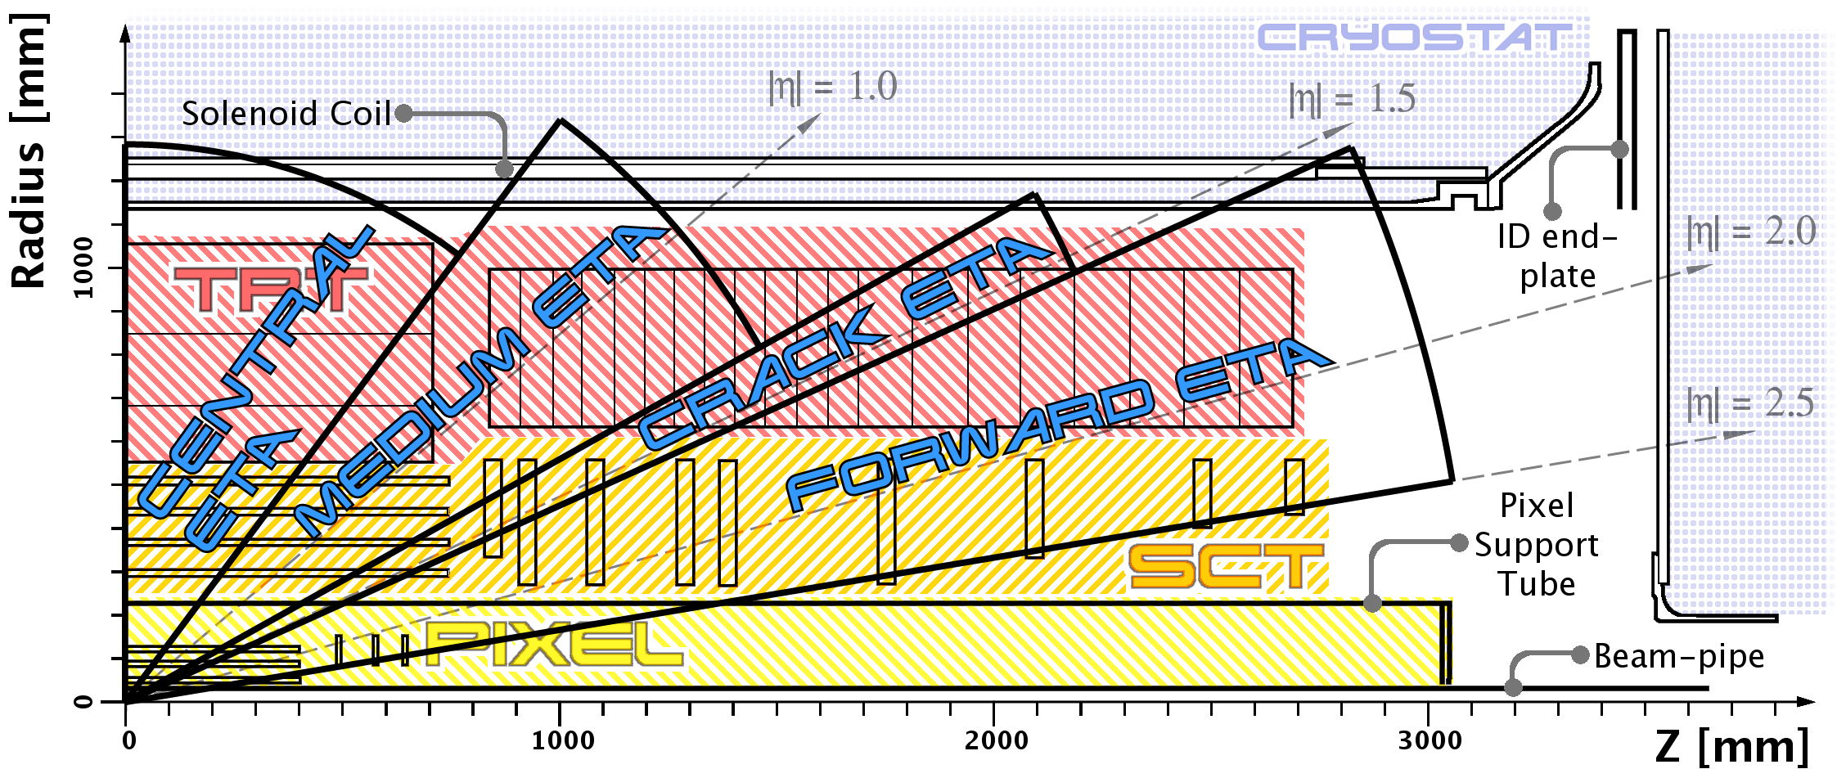
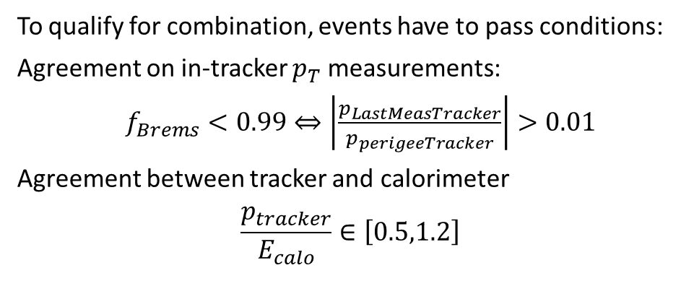
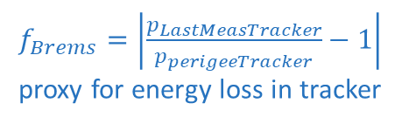
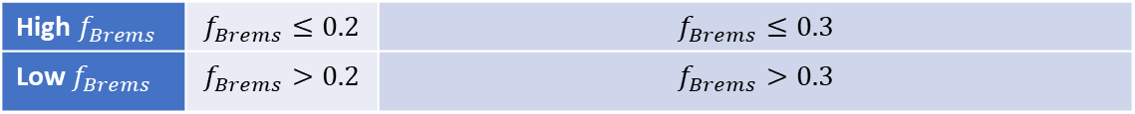
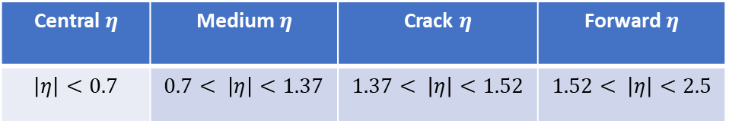
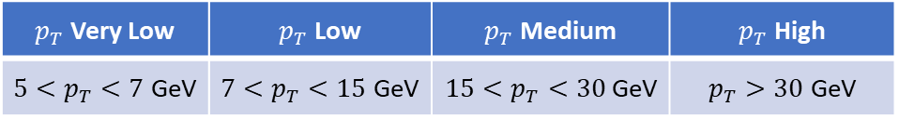
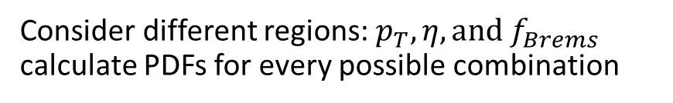
Regions for combinations
$p_{T}$ Very Low | $p_{T}$ Low | $p_{T}$ Medium | $p_{T}$ High
$5<p_{T}<7$ GeV | $7<p_{T}<15$ GeV | $15<p_{T}<30$GeV | $p_{T}>30$ GeV
Consider different regions: $p_{T}, η, and f_{Brems}$
calculate PDFs for every possible combination
Central $η$ | Medium $η$ | Crack $η$ | Forward $η$
$$\left|η\right|<0.7$$ | $$0.7< \left|η\right|<1.37$$ | $$1.37< \left|η\right|<1.52$$ | $$1.52< \left|η\right|<2.5$$
$f_{Brems}=\left|\frac{p_{LastMeasTracker}}{p_{perigeeTracker}}−1\right|$
proxy for energy loss in tracker
High $f_{Brems}$ | $$f_{Brems}≤0.2$$ | $$f_{Brems}≤0.3$$
Low $f_{Brems}$ | $$f_{Brems}>0.2$$ | $$f_{Brems}>0.3$$
To qualify for combination, events have to pass conditions:
Agreement on in-tracker $p_{T}$ measurements:
$f_{Brems}<0.99⇔\left|\frac{p_{LastMeasTracker}}{p_{perigeeTracker}}\right|>0.01$
Agreement between tracker and calorimeter
$$\frac{p_{tracker}}{E_{calo}}∈\left[0.5,1.2\right]$$

Slide 7
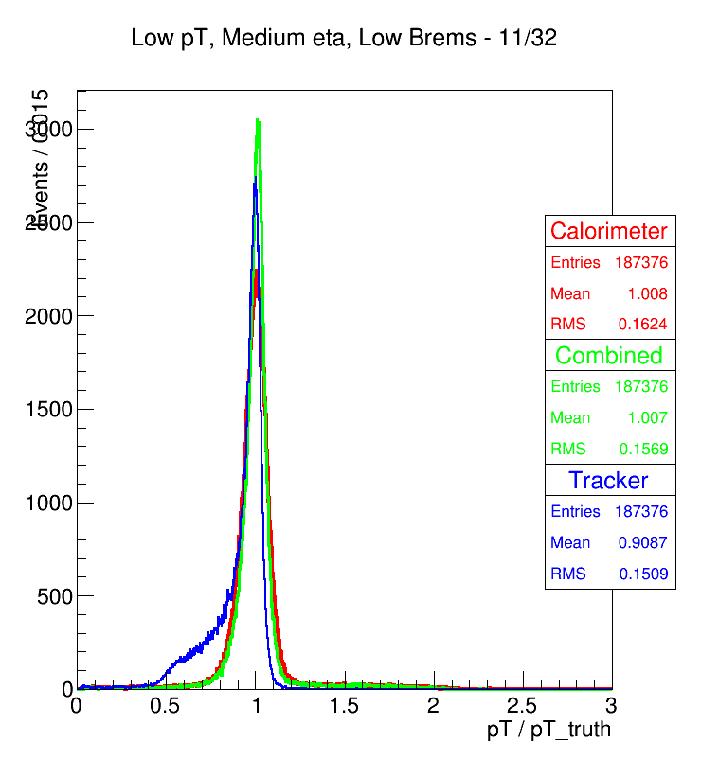
Combination Efficacy

Slide 8
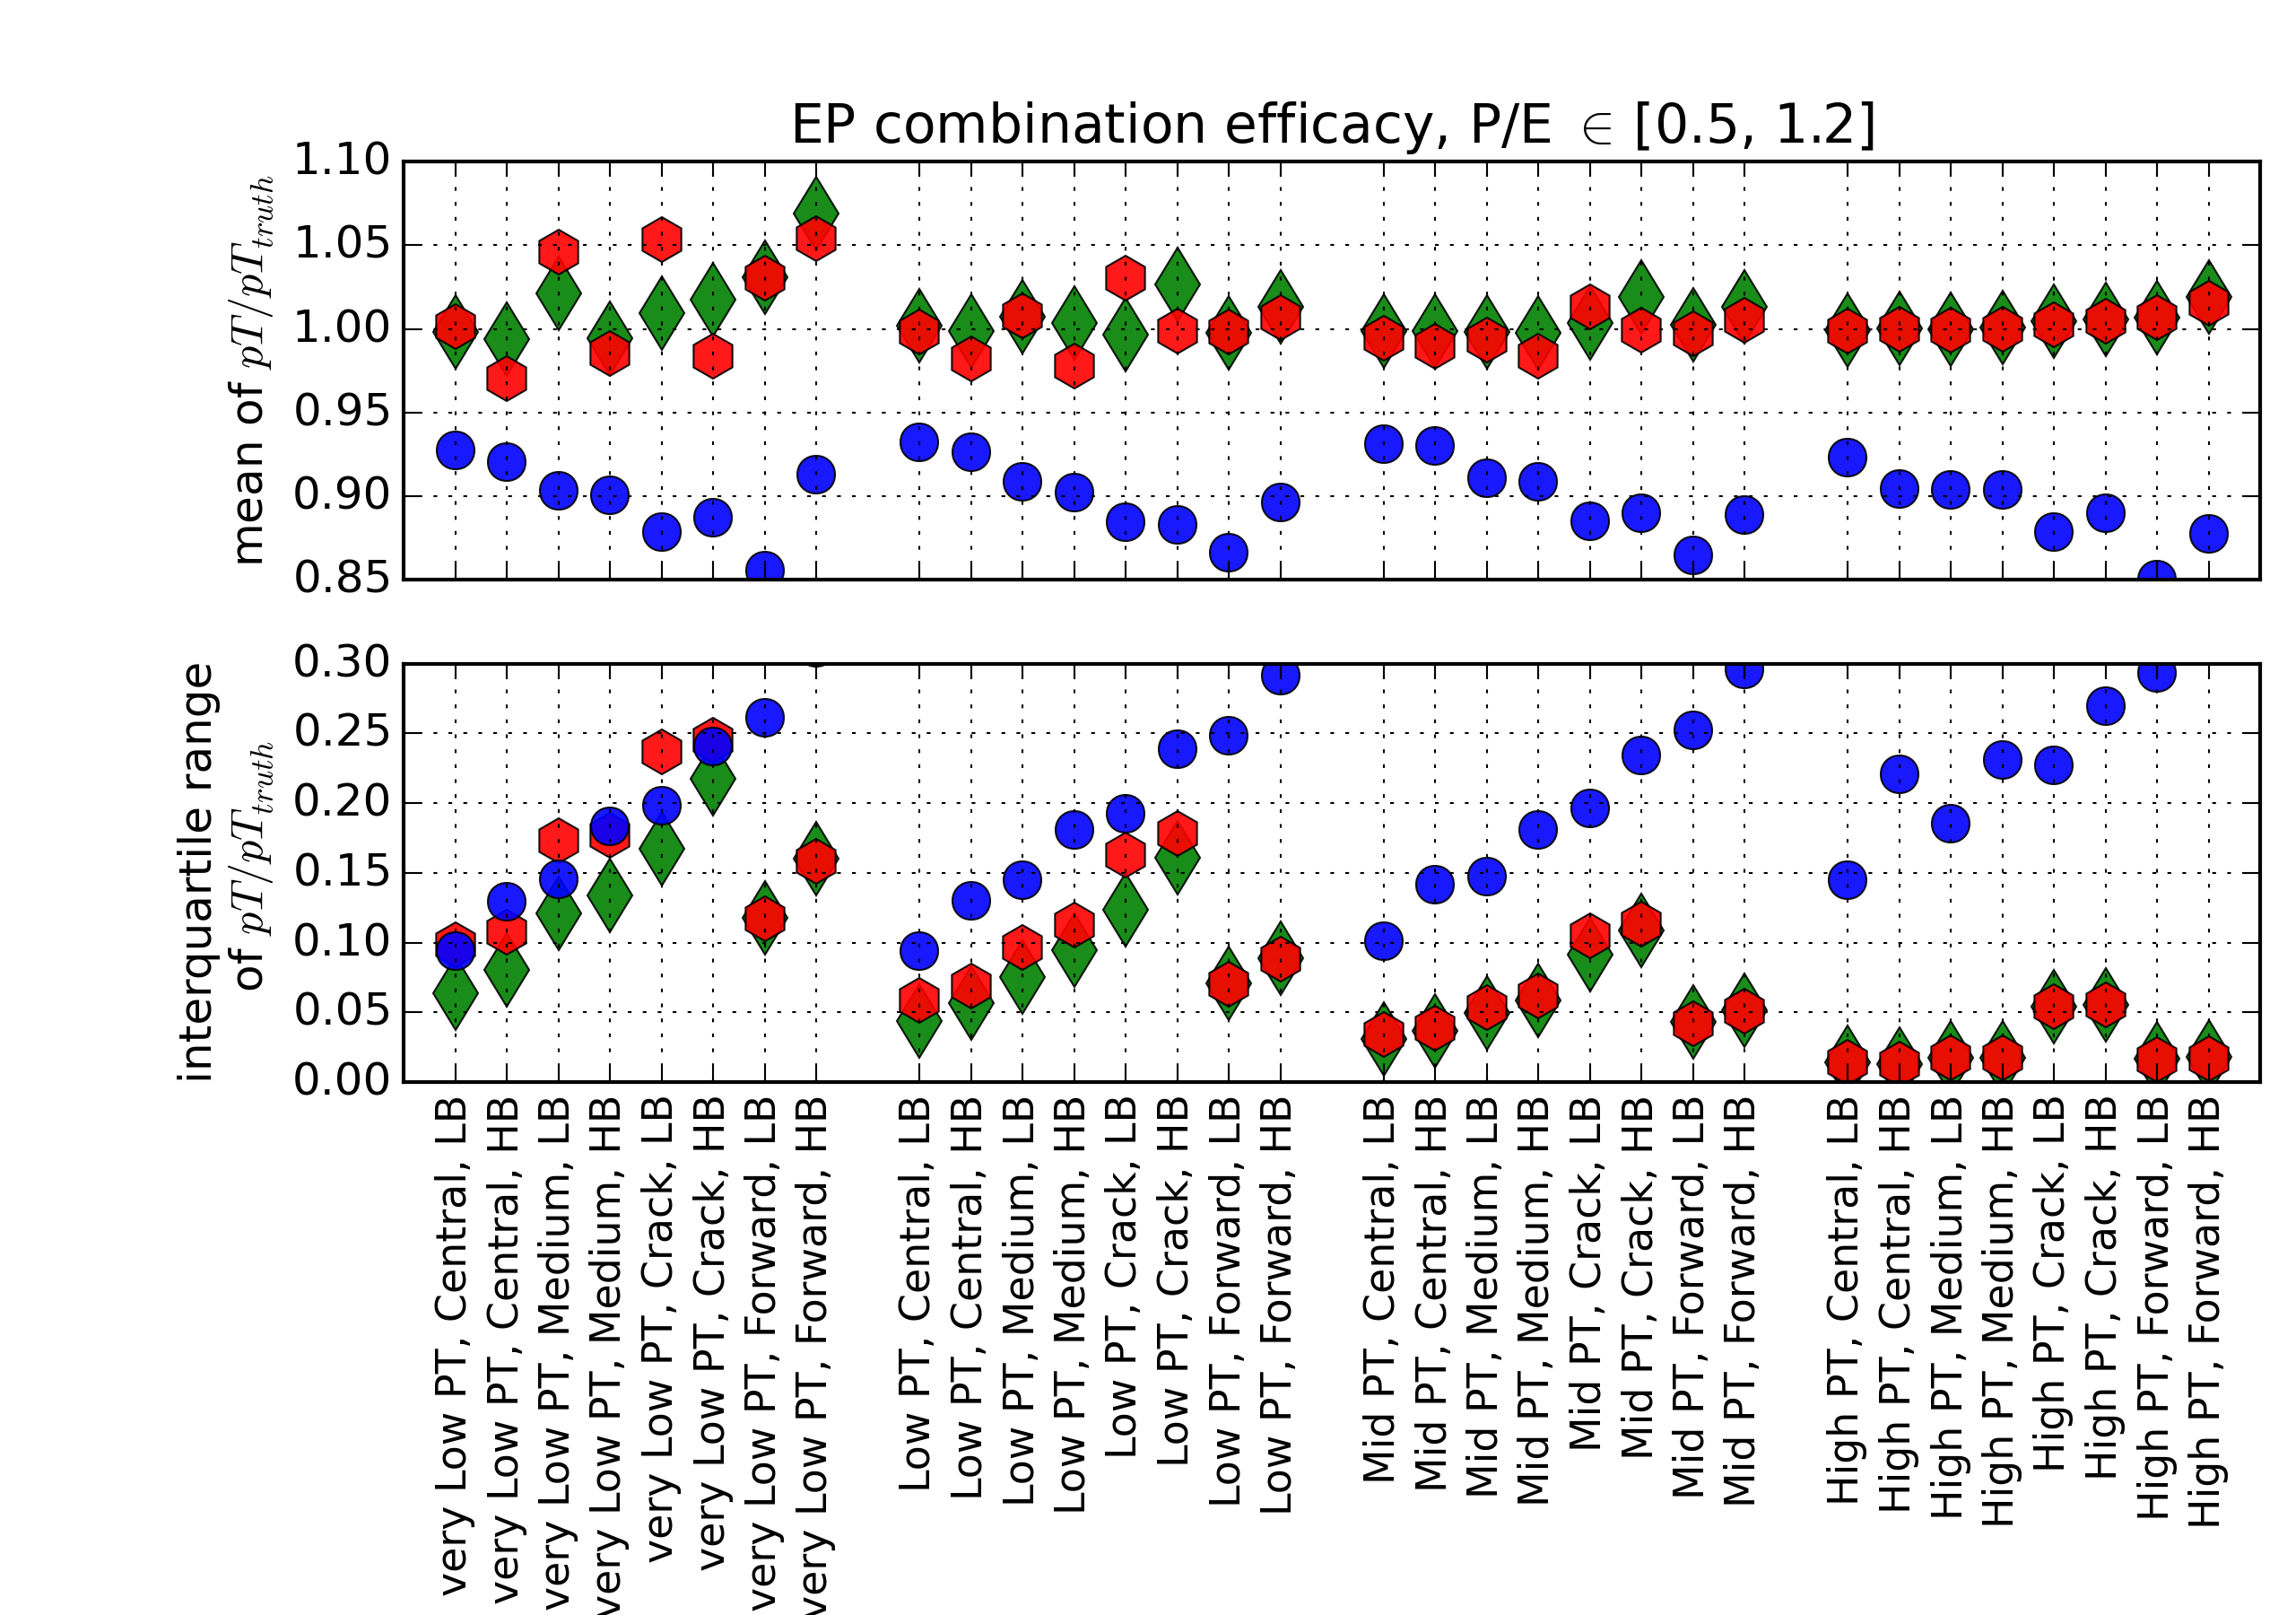
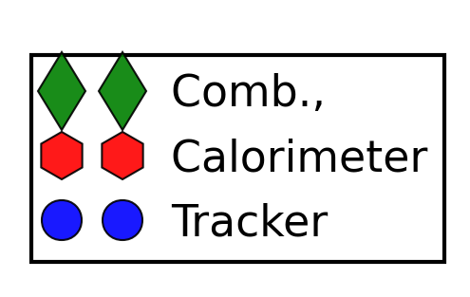
Combination Efficacy
The plot on the left is derived from a set of histograms like the one below.
For the efficacy all histograms are only populated by events that would qualify for combination.

Slide 9
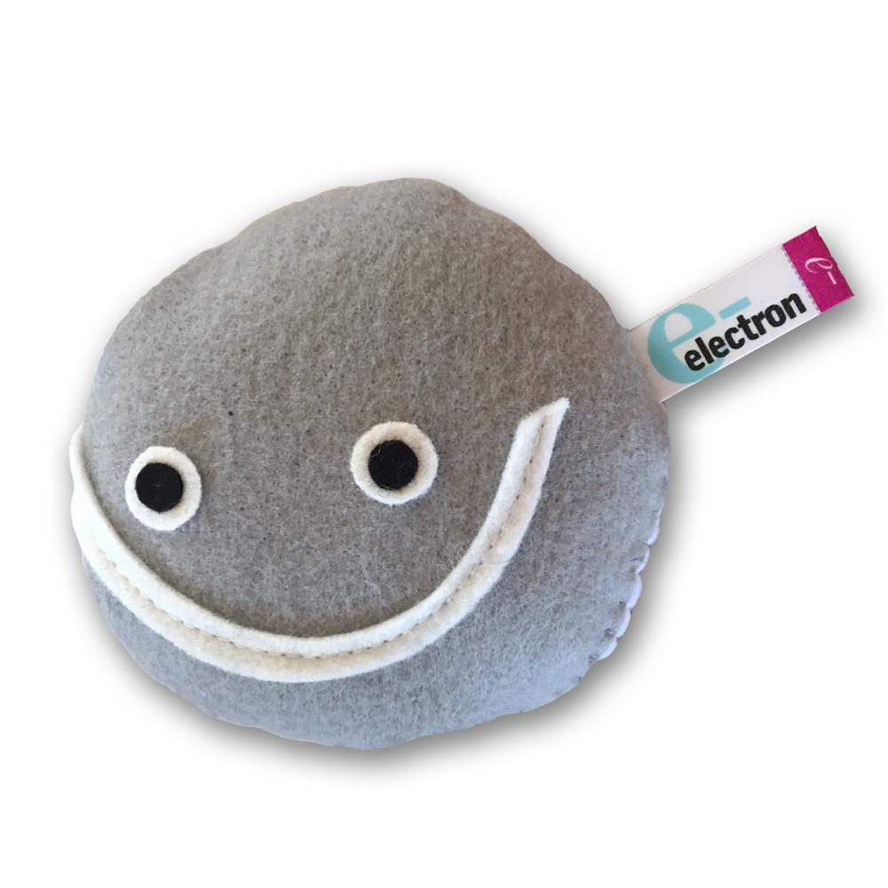

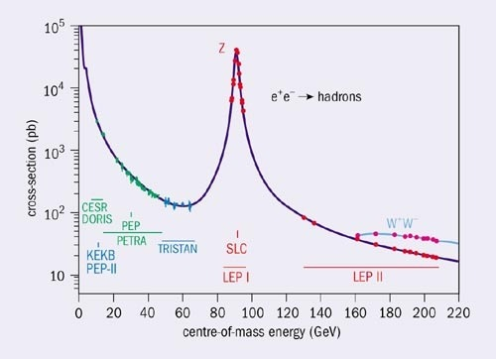
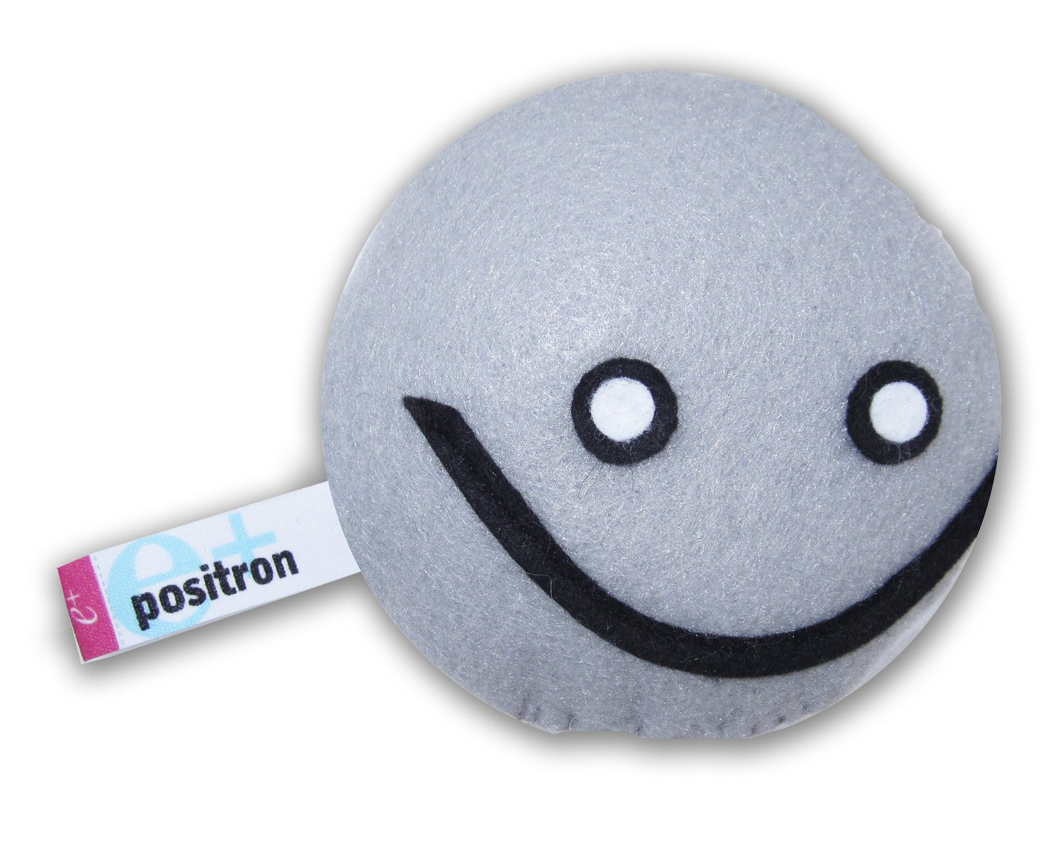
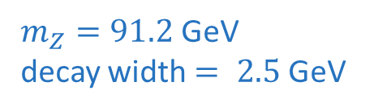
Z as energy reference
$m_{Z}=91.2$ GeV
decay width $= 2.5$GeV

Slide 10
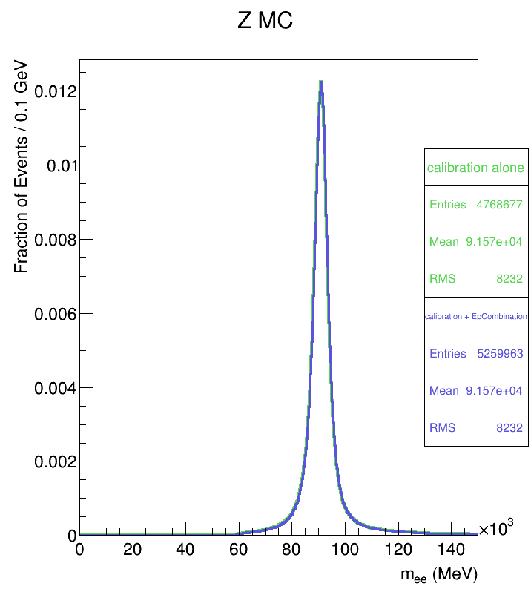
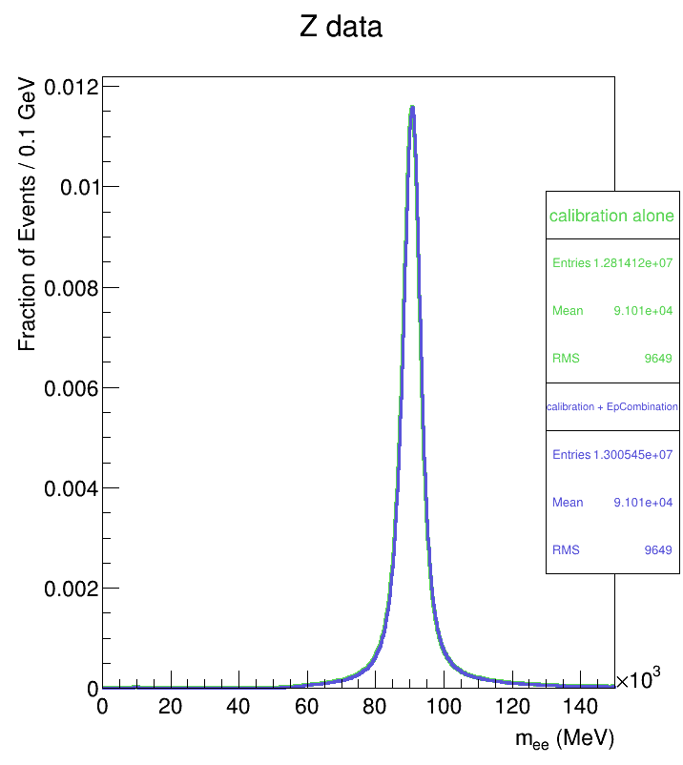
Z MC and Data mass plots
Used InSituCalibration for mass plots
No improvement expected
Electron pT cut for Z plots: pT > 27 GeV
For J/psi plots pT > 4.5 GeV
IQR: 4777.0
IQR: 5028.3
IQR: 4776.3
IQR: 5027.6
IQR –interquartile range
No improvement expected: Electron pT cut for Z plots: pT > 27 GeV

Slide 11
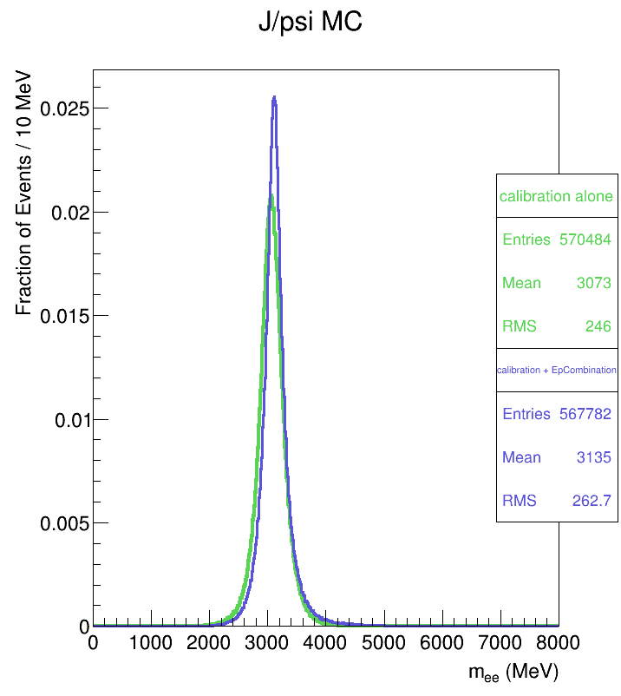
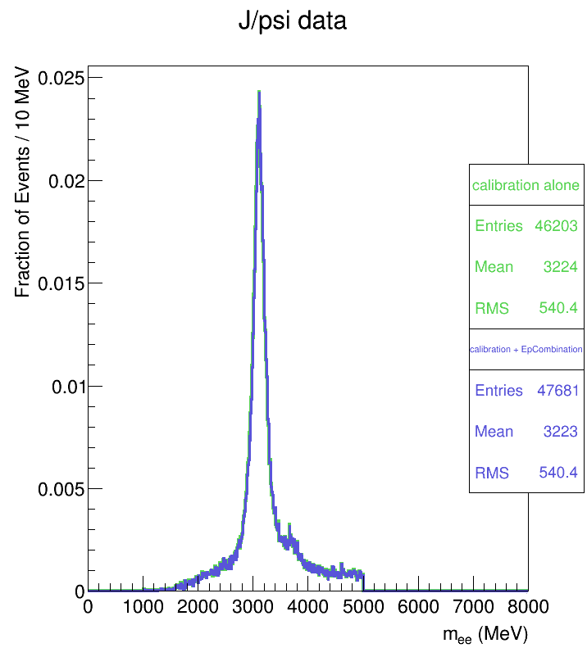
J/psi MC mass plots
IQR: 272
IQR: 331.9
IQR: 232
IQR: 332.1
J/psi mass = 3.1 GeV
IQR –interquartile range
Electron pT cut for J/psi: pT > 4.5 GeV, covers all pT ranges

Slide 12
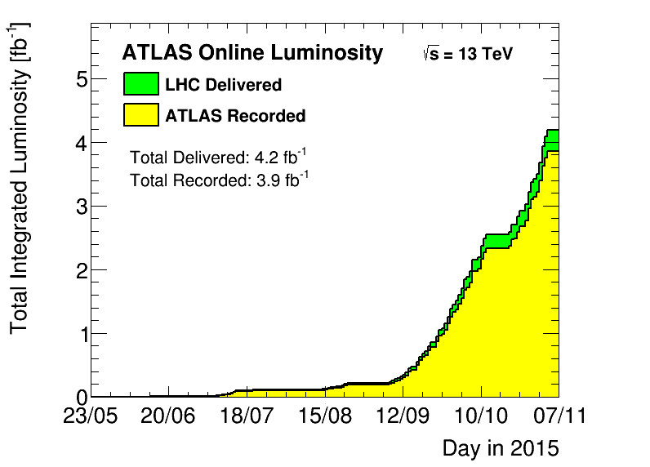
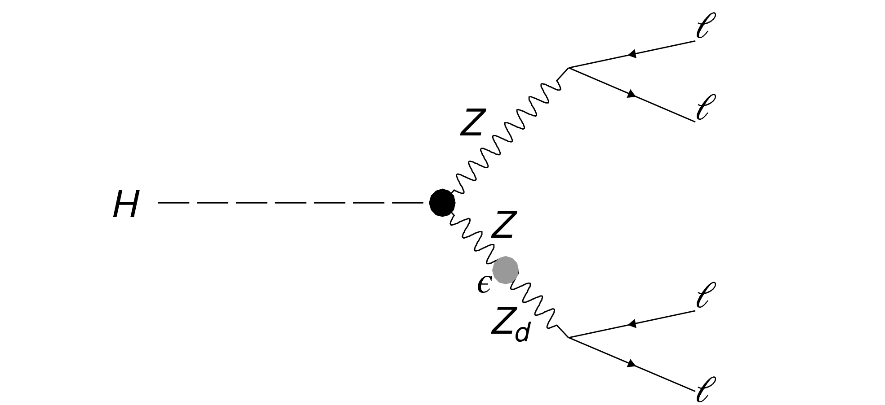
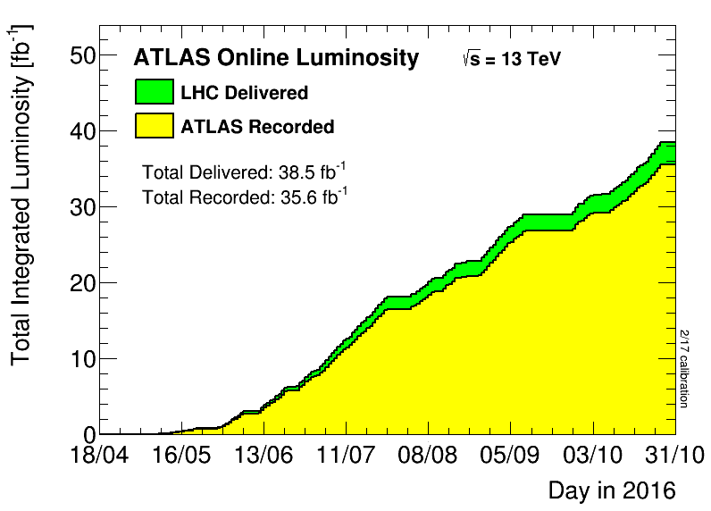
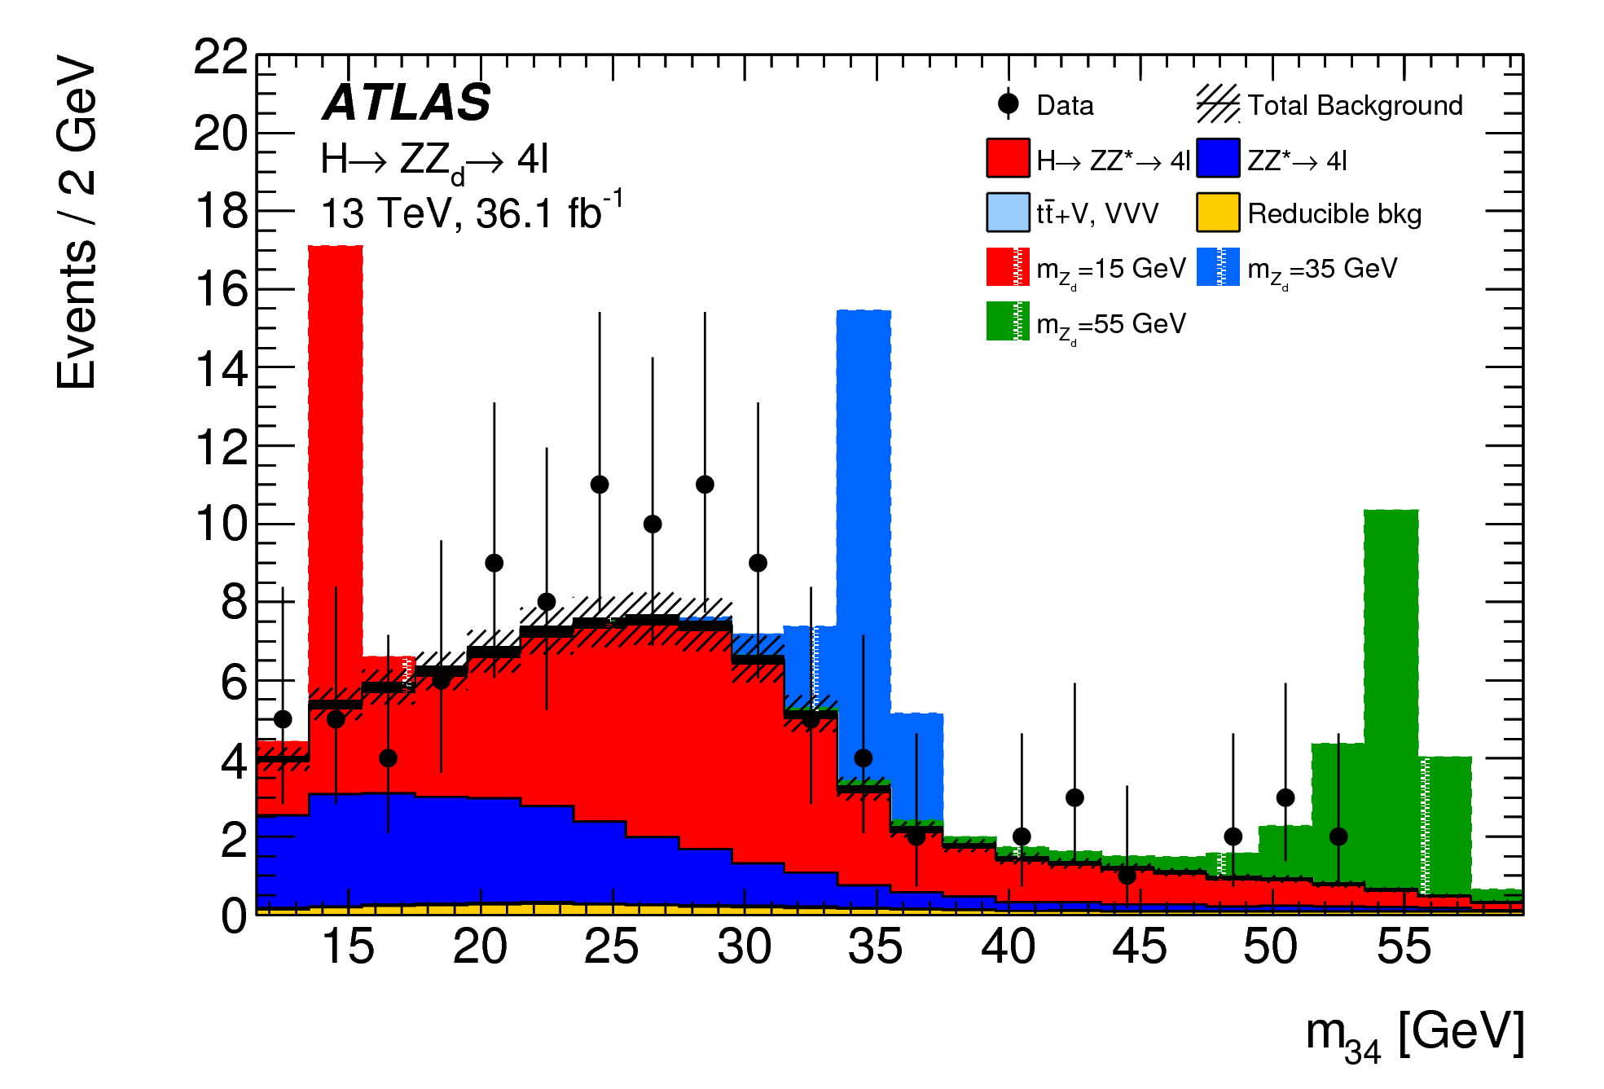
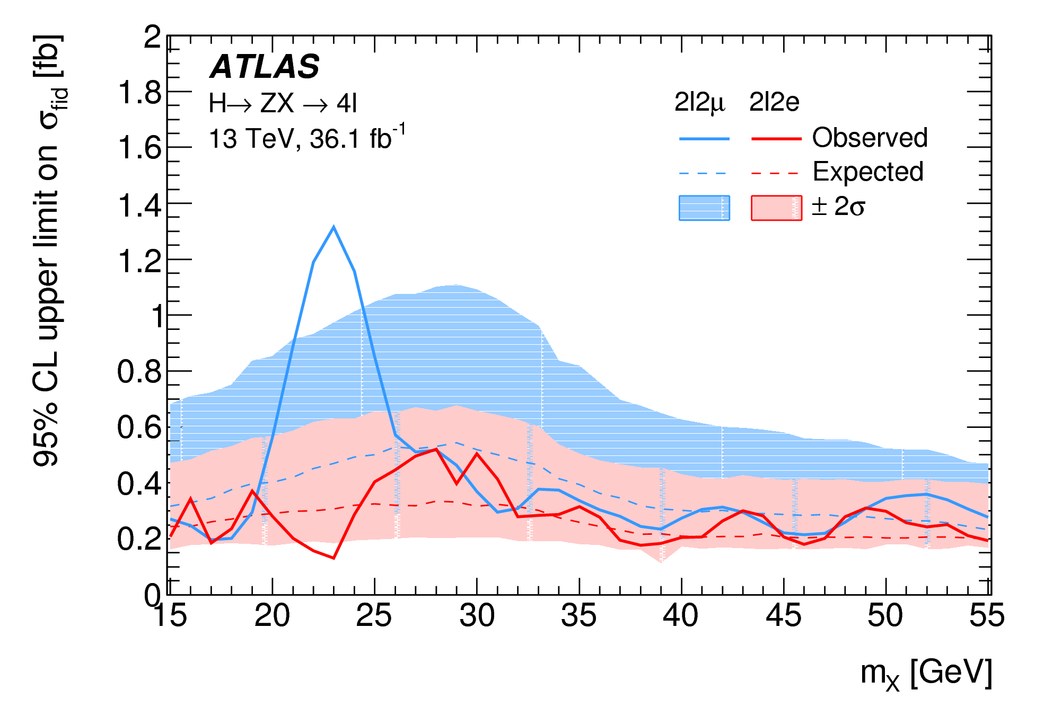
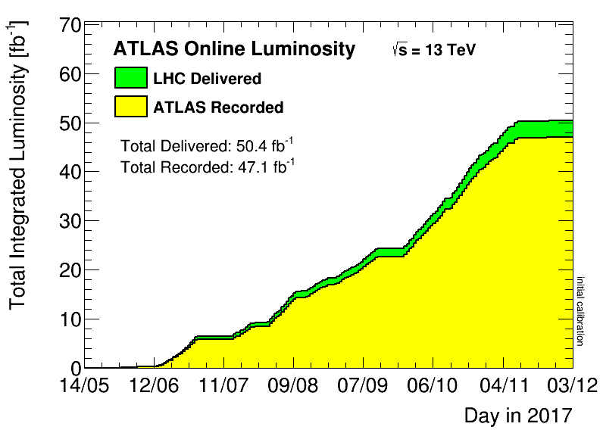
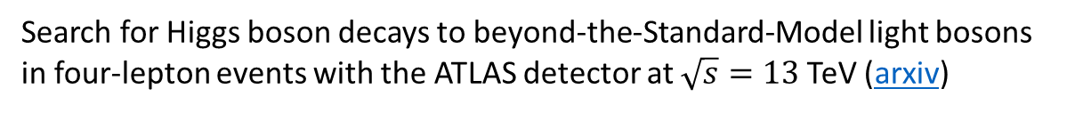


$H→ZZ_{d}→4l$ analysis
Search for Higgs boson decays to beyond-the-Standard-Model light bosons in four-lepton events with the ATLAS detector at $\sqrt{s}=13$ TeV (arxiv)
$$Z$$
$$Z_{d}$$
$$Z$$

Slide 13
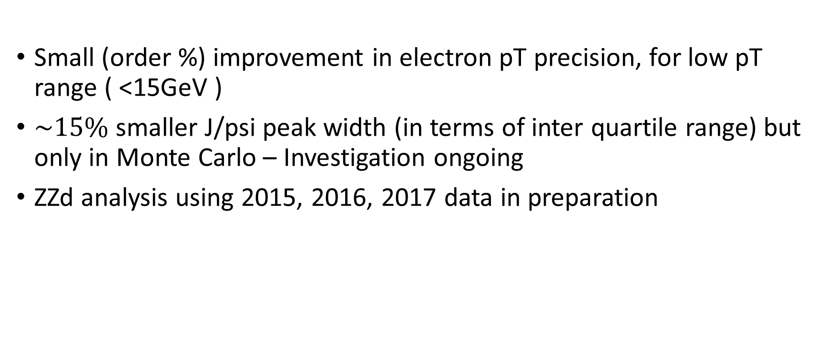
Conclusion
Small (order %) improvement in electron pT precision, for low pT range ( <15GeV )
$\sim 15\%$ smaller J/psi peak width (in terms of inter quartile range) but only in Monte Carlo – Investigation ongoing
ZZd analysis using 2015, 2016, 2017 data in preparation

Slide 14
This is the End.
This is the End. This is the End. This is the End. This is the End. This is the End. This is the End. This is the End. This is the End. This is the End. This is the End. This is the End. This is the End. This is the End. This is the End. This is the End. This is the End. This is the End. This is the End. This is the End. This is the End. This is the End. This is the End. This is the End. This is the End. This is the End. This is the End. This is the End. This is the End. This is the End. This is the End. This is the End. This is the End. This is the End. This is the End. This is the End. This is the End. This is the End. This is the End. This is the End. This is the End. This is the End. This is the End. This is the End. This is the End. This is the End. This is the End. This is the End. This is the End. This is the End. This is the End. This is the End. This is the End. This is the End. This is the End. This is the End. This is the End. This is the End. This is the End. This is the End. This is the End. This is the End. This is the End. This is the End. This is the End. This is the End. This is the End. This is the End. This is the End. This is the End. This is the End. This is the End. This is the End. This is the End. This is the End. This is the End. This is the End. This is the End. This is the End. This is the End. This is the End. This is the End. This is the End. This is the End. This is the End. This is the End. This is the End. This is the End. This is the End. This is the End. This is the End. This is the End. This is the End. This is the End. This is the End. This is the End. This is the End. This is the End. This is the End. This is the End. This is the End. This is the End. This is the End. This is the End. This is the End. This is the End. This is the End. This is the End. This is the End. This is the End. This is the End. This is the End. This is the End. This is the End. This is the End. This is the End. This is the End. This is the End. This is the End. This is the End. This is the End. This is the End. This is the End. This is the End. This is the End. This is the End. This is the End. This is the End. This is the End. This is the End. This is the End. This is the End. This is the End. This is the End. This is the End. This is the End. This is the End. This is the End. This is the End. This is the End. This is the End. This is the End. This is the End. This is the End. This is the End. This is the End. This is the End. This is the End. This is the End. This is the End. This is the End. This is the End. This is the End. This is the End. This is the End. This is the End. This is the End. This is the End. This is the End. This is the End. This is the End. This is the End. This is the End. This is the End. This is the End. This is the End. This is the End. This is the End. This is the End. This is the End. This is the End. This is the End. This is the End. This is the End. This is the End. This is the End. This is the End. This is the End. This is the End. This is the End. This is the End. This is the End. This is the End. This is the End. This is the End. This is the End. This is the End. This is the End. This is the End. This is the End. This is the End. This is the End. This is the End. This is the End. This is the End. This is the End. This is the End. This is the End. This is the End. This is the End. This is the End. This is the End. This is the End. This is the End. This is the End. This is the End. This is the End. This is the End. This is the End. This is the End. This is the End. This is the End. This is the End. This is the End. This is the End. This is the End. This is the End. This is the End. This is the End. This is the End. This is the End. This is the End. This is the End. This is the End. This is the End. This is the End. This is the End. This is the End. This is the End. This is the End. This is the End. This is the End. This is the End. This is the End. This is the End. This is the End. This is the End. This is the End. This is the End. This is the End. This is the End. This is the End. This is the End. This is the End. This is the End. This is the End. This is the End. This is the End. This is the End. This is the End. This is the End. This is the End. This is the End. This is the End. This is the End. This is the End. This is the End. This is the End. This is the End. This is the End. This is the End. This is the End. This is the End. This is the End. This is the End. This is the End. This is the End. This is the End. This is the End. This is the End. This is the End. This is the End. This is the End. This is the End. This is the End. This is the End. This is the End. This is the End. This is the End. This is the End. This is the End. This is the End. This is the End. This is the End. This is the End. This is the End. This is the End. This is the End. This is the End. This is the End. This is the End. This is the End. This is the End. This is the End. This is the End. This is the End. This is the End. This is the End. This is the End. This is the End. This is the End. This is the End. This is the End. This is the End. This is the End. This is the End. This is the End. This is the End. This is the End. This is the End. This is the End. This is the End. This is the End. This is the End. This is the End. This is the End. This is the End. This is the End. This is the End. This is the End. This is the End. This is the End. This is the End. This is the End. This is the End. This is the End. This is the End. This is the End. This is the End. This is the End. This is the End. This is the End. This is the End. This is the End. This is the End. This is the End. This is the End. This is the End. This is the End. This is the End. This is the End. This is the End. This is the End. This is the End. This is the End. This is the End. This is the End. This is the End. This is the End. This is the End. This is the End. This is the End.

Slide 15
Backup Backup Backup Backup Backup Backup Backup Ba
Backup Backup Backup Backup Backup Backup Backup Backup Backup Backup Backup Backup Backup Backup Backup Backup Backup Backup Backup Backup Backup Backup Backup Backup Backup Backup Backup Backup Backup Backup Backup Backup Backup Backup Backup Backup Backup Backup Backup Backup Backup Backup Backup Backup Backup Backup Backup Backup Backup Backup Backup Backup Backup Backup Backup Backup Backup Backup Backup Backup Backup Backup Backup Backup Backup Backup Backup Backup Backup Backup Backup Backup Backup Backup Backup Backup Backup Backup Backup Backup Backup Backup Backup Backup Backup Backup Backup Backup Backup Backup Backup Backup Backup Backup Backup Backup Backup Backup Backup Backup Backup Backup Backup Backup Backup Backup Backup Backup Backup Backup Backup Backup Backup Backup Backup Backup Backup Backup Backup Backup Backup Backup Backup Backup Backup Backup Backup Backup Backup Backup Backup Backup Backup Backup Backup Backup Backup Backup Backup Backup Backup Backup Backup Backup Backup Backup Backup Backup Backup Backup Backup Backup Backup Backup Backup Backup Backup Backup Backup Backup Backup Backup Backup Backup Backup Backup Backup Backup Backup Backup Backup Backup Backup Backup Backup Backup Backup Backup Backup Backup Backup Backup Backup Backup Backup Backup Backup Backup Backup Backup Backup Backup Backup Backup Backup Backup Backup Backup Backup Backup Backup Backup Backup Backup Backup Backup Backup Backup Backup Backup Backup Backup Backup Backup Backup Backup Backup Backup Backup Backup Backup Backup Backup Backup Backup Backup Backup Backup Backup Backup Backup Backup Backup Backup Backup Backup Backup Backup Backup Backup Backup Backup Backup Backup Backup Backup Backup Backup Backup Backup Backup Backup Backup Backup Backup Backup Backup Backup Backup Backup Backup Backup Backup Backup Backup Backup Backup Backup Backup Backup Backup Backup Backup Backup Backup Backup Backup Backup Backup Backup Backup Backup Backup Backup Backup Backup Backup Backup Backup Backup Backup Backup Backup Backup Backup Backup Backup Backup Backup Backup Backup Backup Backup Backup Backup Backup Backup Backup Backup Backup Backup Backup Backup Backup Backup Backup Backup Backup Backup Backup Backup Backup Backup Backup Backup Backup Backup Backup Backup Backup Backup Backup Backup Backup Backup Backup Backup Backup Backup Backup Backup Backup Backup Backup Backup Backup Backup Backup Backup Backup Backup Backup Backup Backup Backup Backup Backup Backup Backup Backup Backup Backup Backup Backup Backup Backup Backup Backup Backup Backup Backup Backup Backup Backup Backup Backup Backup Backup Backup Backup Backup Backup Backup Backup Backup Backup Backup Backup Backup Backup Backup Backup Backup Backup Backup Backup Backup Backup Backup Backup Backup Backup Backup Backup Backup Backup Backup Backup Backup Backup Backup Backup Backup Backup Backup Backup Backup Backup Backup Backup Backup Backup Backup Backup Backup Backup Backup Backup Backup Backup Backup Backup Backup Backup Backup Backup Backup Backup Backup Backup Backup Backup Backup Backup Backup Backup Backup Backup Backup Backup Backup Backup Backup Backup Backup Backup Backup Backup Backup Backup Backup Backup Backup Backup Backup Backup Backup Backup Backup Backup Backup Backup Backup Backup Backup Backup Backup Backup Backup Backup Backup Backup Backup Backup Backup Backup Backup Backup Backup Backup Backup Backup Backup Backup Backup Backup Backup Backup Backup Backup Backup Backup Backup Backup Backup Backup Backup Backup Backup Backup Backup Backup Backup Backup Backup Backup Backup Backup Backup Backup Backup Backup Backup Backup Backup Backup Backup Backup Backup Backup Backup Backup Backup Backup Backup Backup Backup Backup Backup Backup Backup Backup Backup Backup Backup Backup Backup Backup Backup Backup Backup Backup Backup Backup Backup Backup Backup Backup Backup Backup Backup Backup Backup Backup Backup Backup Backup Backup Backup Backup Backup Backup Backup Backup Backup Backup Backup Backup Backup Backup Backup Backup Backup Backup Backup Backup Backup Backup Backup Backup Backup Backup Backup Backup Backup Backup Backup Backup Backup Backup Backup Backup Backup Backup Backup Backup Backup Backup Backup Backup Backup Backup Backup Backup Backup Backup Backup Backup Backup Backup Backup Backup Backup Backup Backup Backup Backup Backup Backup Backup Backup Backup Backup Backup Backup Backup Backup Backup Backup Backup Backup Backup Backup Backup Backup Backup Backup Backup Backup Backup Backup Backup Backup Backup Backup Backup Backup Backup Backup Backup Backup Backup Backup Backup Backup Backup Backup Backup Backup Backup Backup Backup Backup Backup Backup Backup Backup Backup Backup Backup Backup Backup Backup Backup Backup Backup Backup Backup Backup Backup Backup Backup Backup Backup Backup Backup Backup Backup Backup Backup Backup Backup Backup Backup Backup Backup Backup Backup Backup Backup Backup Backup Backup Backup Backup Backup Backup Backup Backup Backup Backup Backup Backup Backup Backup Backup Backup Backup Backup Backup Backup Backup Backup Backup Backup Backup Backup Backup Backup Backup Backup Backup Backup Backup Backup Backup Backup Backup Backup Backup Backup Backup Backup Backup Backup Backup Backup Backup Backup Backup Backup Backup Backup Backup Backup Backup Backup Backup Backup Backup Backup Backup Backup Backup Backup Backup Backup Backup Backup Backup Backup Backup Backup Backup Backup Backup Backup Backup Backup Backup Backup Backup Backup Backup Backup Backup Backup Backup

Slide 16
# events in efficacy plots
 | # events Single particle | # events Pileup
very Low PT, Central, LB | 70317 | 1721
very Low PT, Central, HB | 25596 | 529
very Low PT, Medium, LB | 52817 | 1332
very Low PT, Medium, HB | 32889 | 710
very Low PT, Crack, LB | 5303 | 142
very Low PT, Crack, HB | 3987 | 96
very Low PT, Forward, LB | 45113 | 1163
very Low PT, Forward, HB | 62559 | 1550
Low PT, Central, LB | 261800 | 6632
Low PT, Central, HB | 112175 | 2467
Low PT, Medium, LB | 187376 | 4736
Low PT, Medium, HB | 154361 | 3476
Low PT, Crack, LB | 24760 | 616
Low PT, Crack, HB | 29441 | 675
Low PT, Forward, LB | 160745 | 4114
Low PT, Forward, HB | 238671 | 5720
Mid PT, Central, LB | 474719 | 11854
Mid PT, Central, HB | 202263 | 5048
Mid PT, Medium, LB | 325020 | 8259
Mid PT, Medium, HB | 297434 | 7133
Mid PT, Crack, LB | 53167 | 1361
Mid PT, Crack, HB | 71635 | 1751
Mid PT, Forward, LB | 280646 | 6948
Mid PT, Forward, HB | 421008 | 10181
High PT, Central, LB | 5344965 | 131433
High PT, Central, HB | 2348481 | 61000
High PT, Medium, LB | 3081628 | 75109
High PT, Medium, HB | 3716272 | 94021
High PT, Crack, LB | 480833 | 11391
High PT, Crack, HB | 881543 | 21819
High PT, Forward, LB | 2041606 | 50034
High PT, Forward, HB | 4649815 | 116245

Slide 17
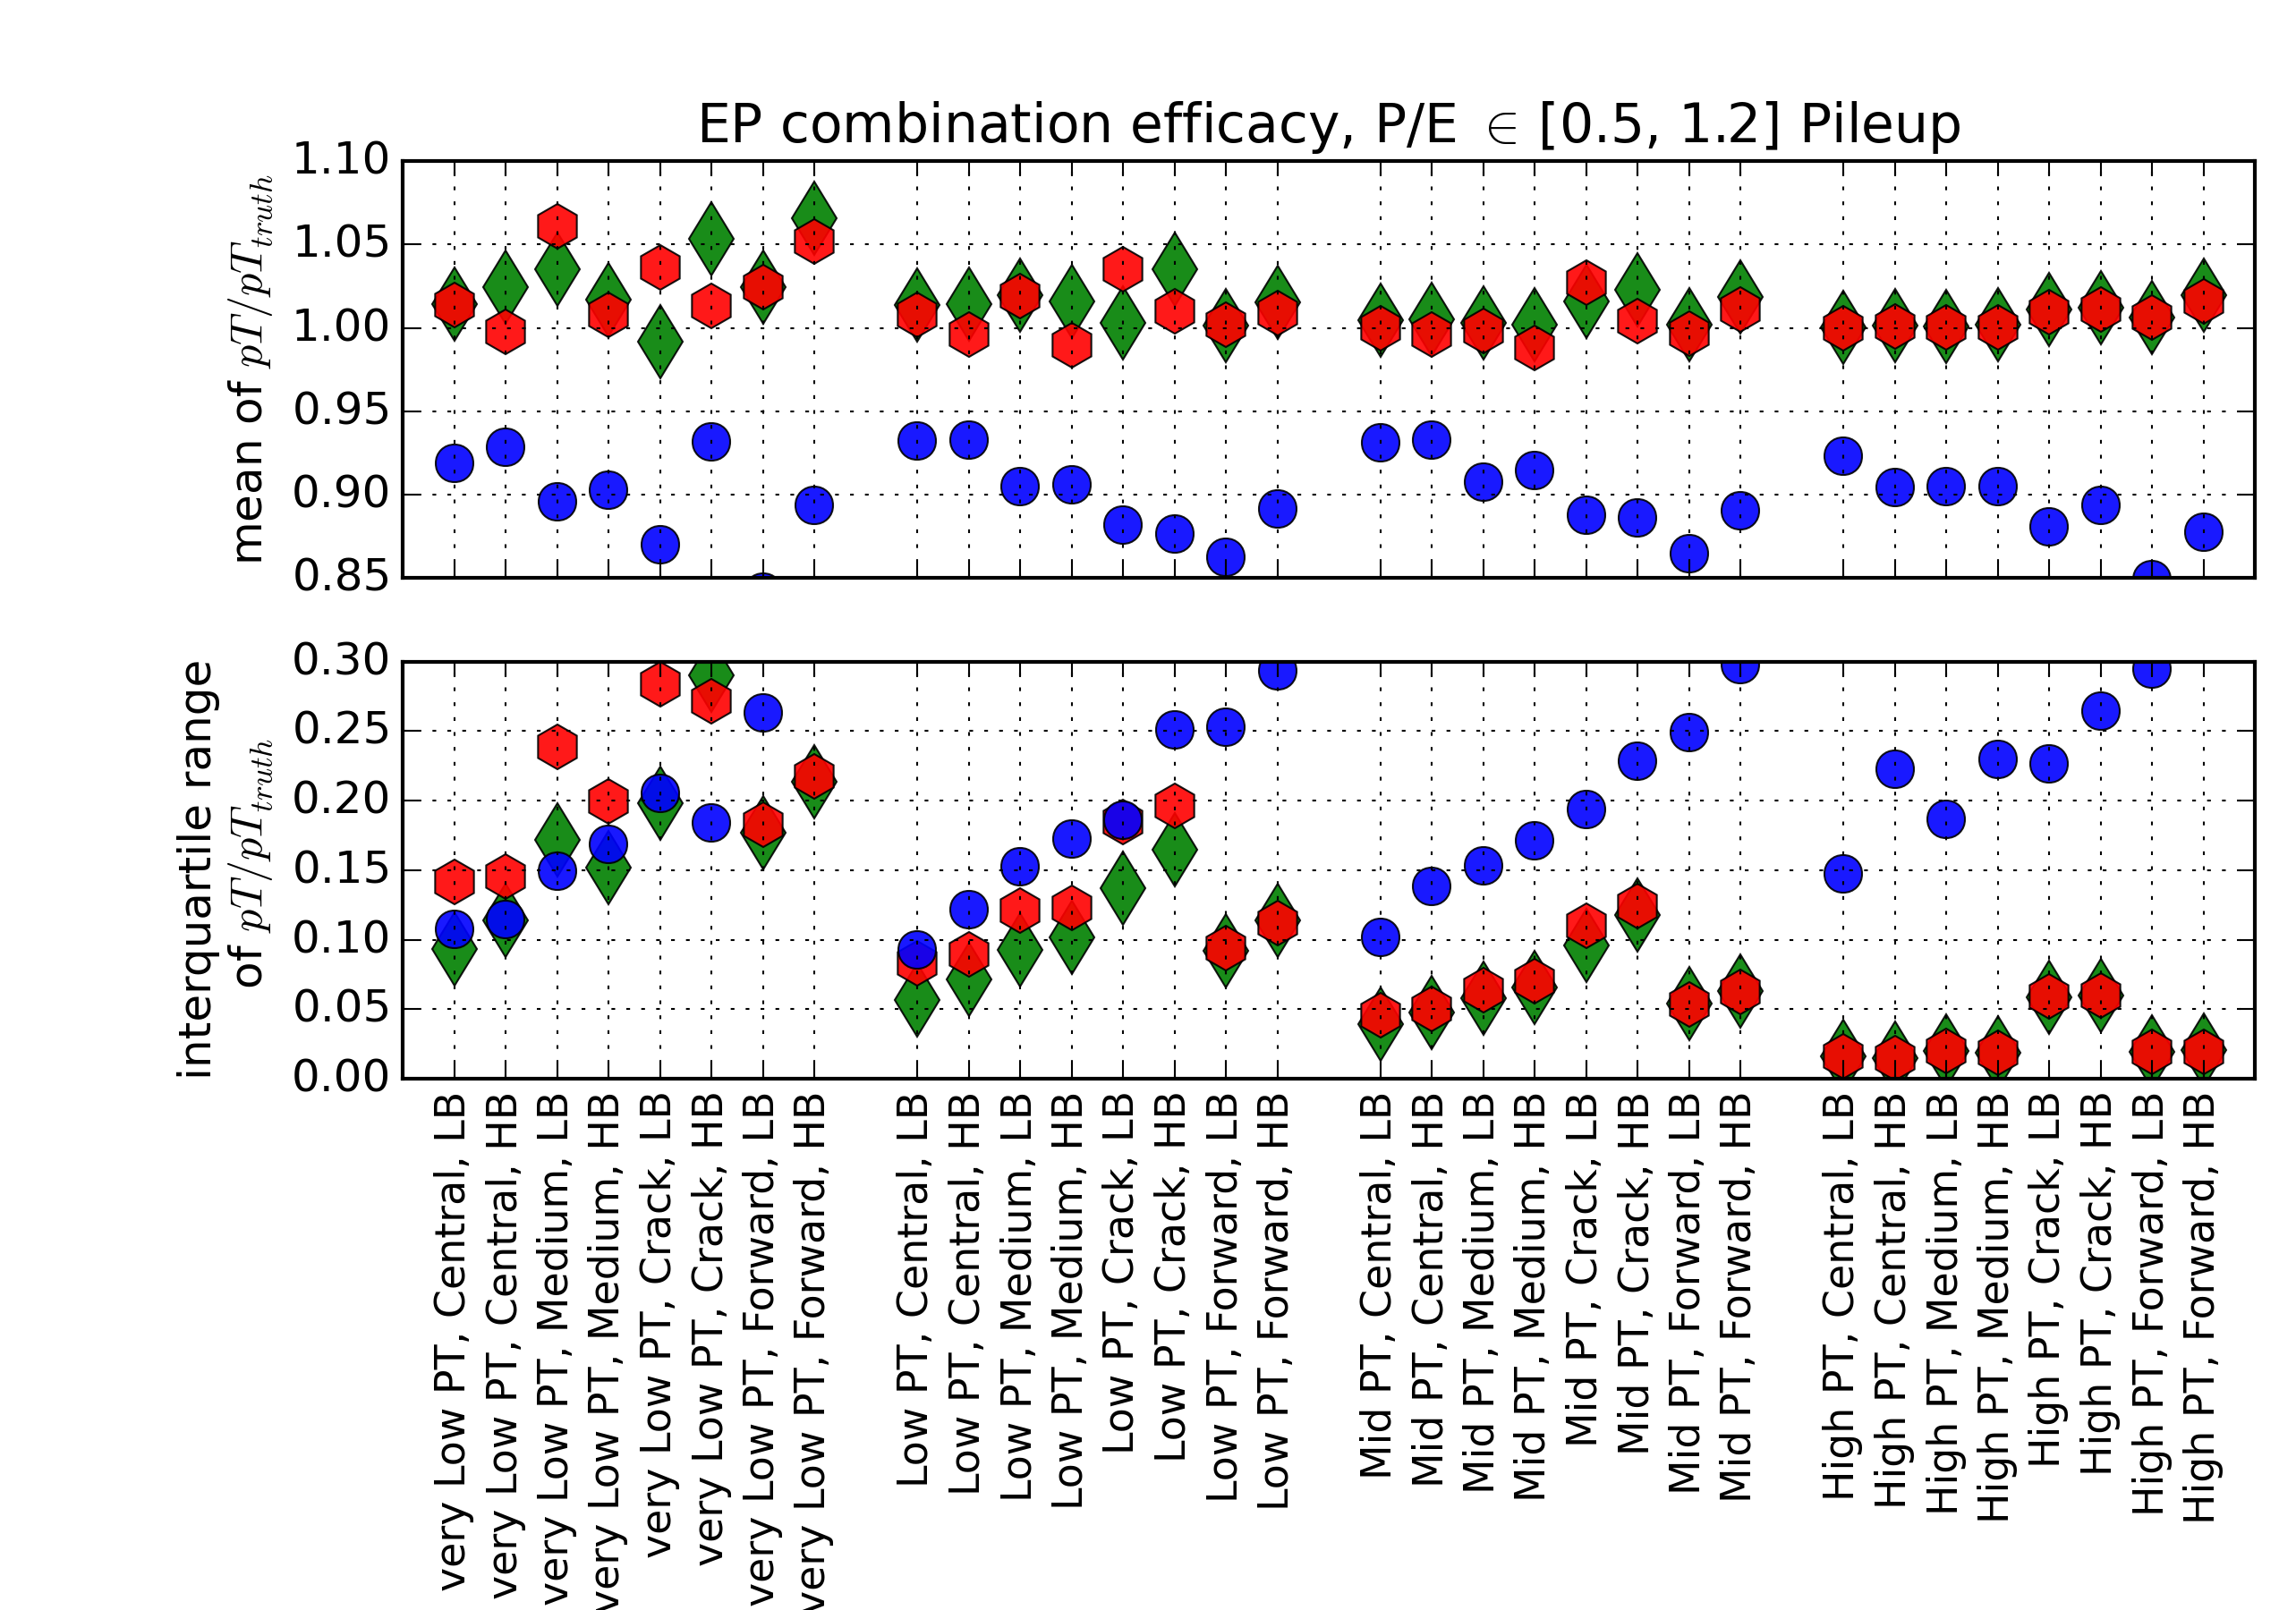
Combination Efficacy single electrons, vs pileup
single electrons
pileup
No actual pile-up. Nominal calo noise threshold mu ~<40>
mc16_13TeV.423000.ParticleGun_single_electron_egammaET.deriv.DAOD_EGAM1.e3566_s3113_r9388_r9315_p3282
Nominal MC16a Pileup Profile . Nominal calo noise threshold mu ~<40>
mc16_13TeV.423000.ParticleGun_single_electron_egammaET.merge.AOD.e3566_s3113_r9641_r9315

Slide 18
Single Electrons
Four slides of pT/pT_true histograms

Slide 19
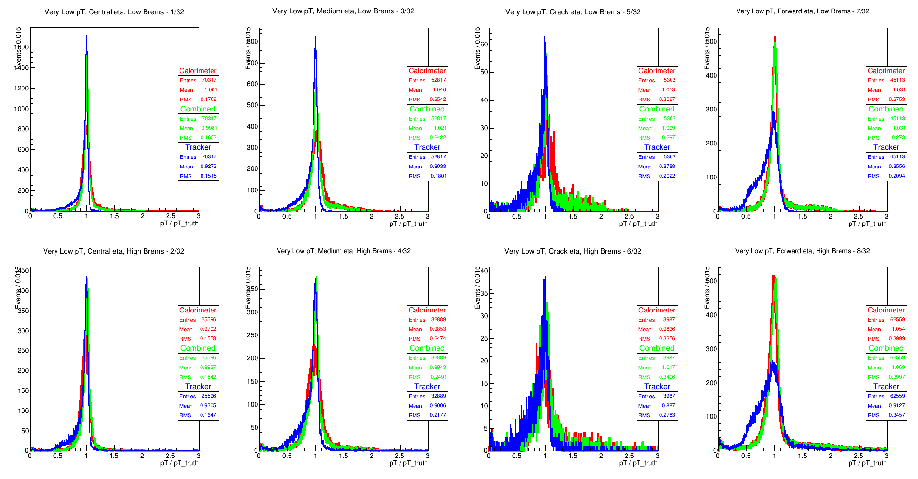

Slide 20
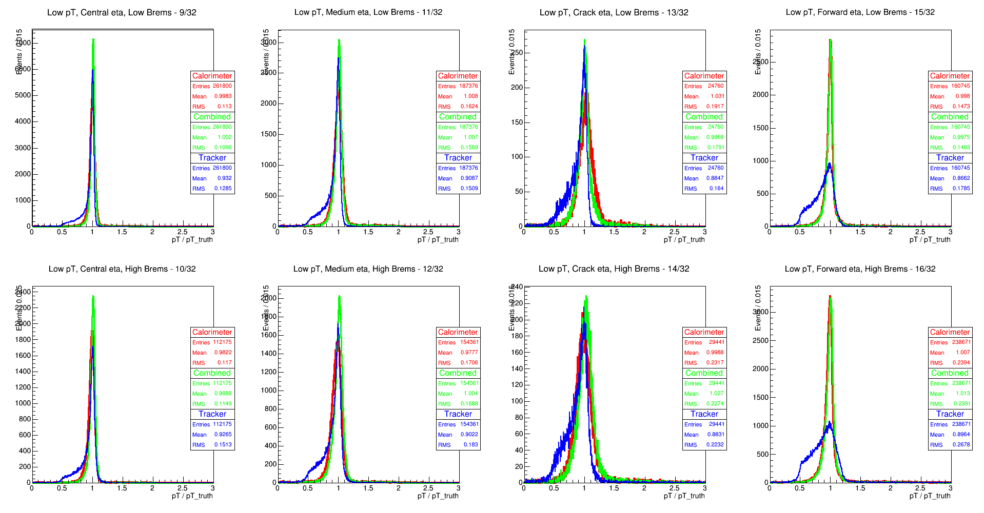

Slide 21
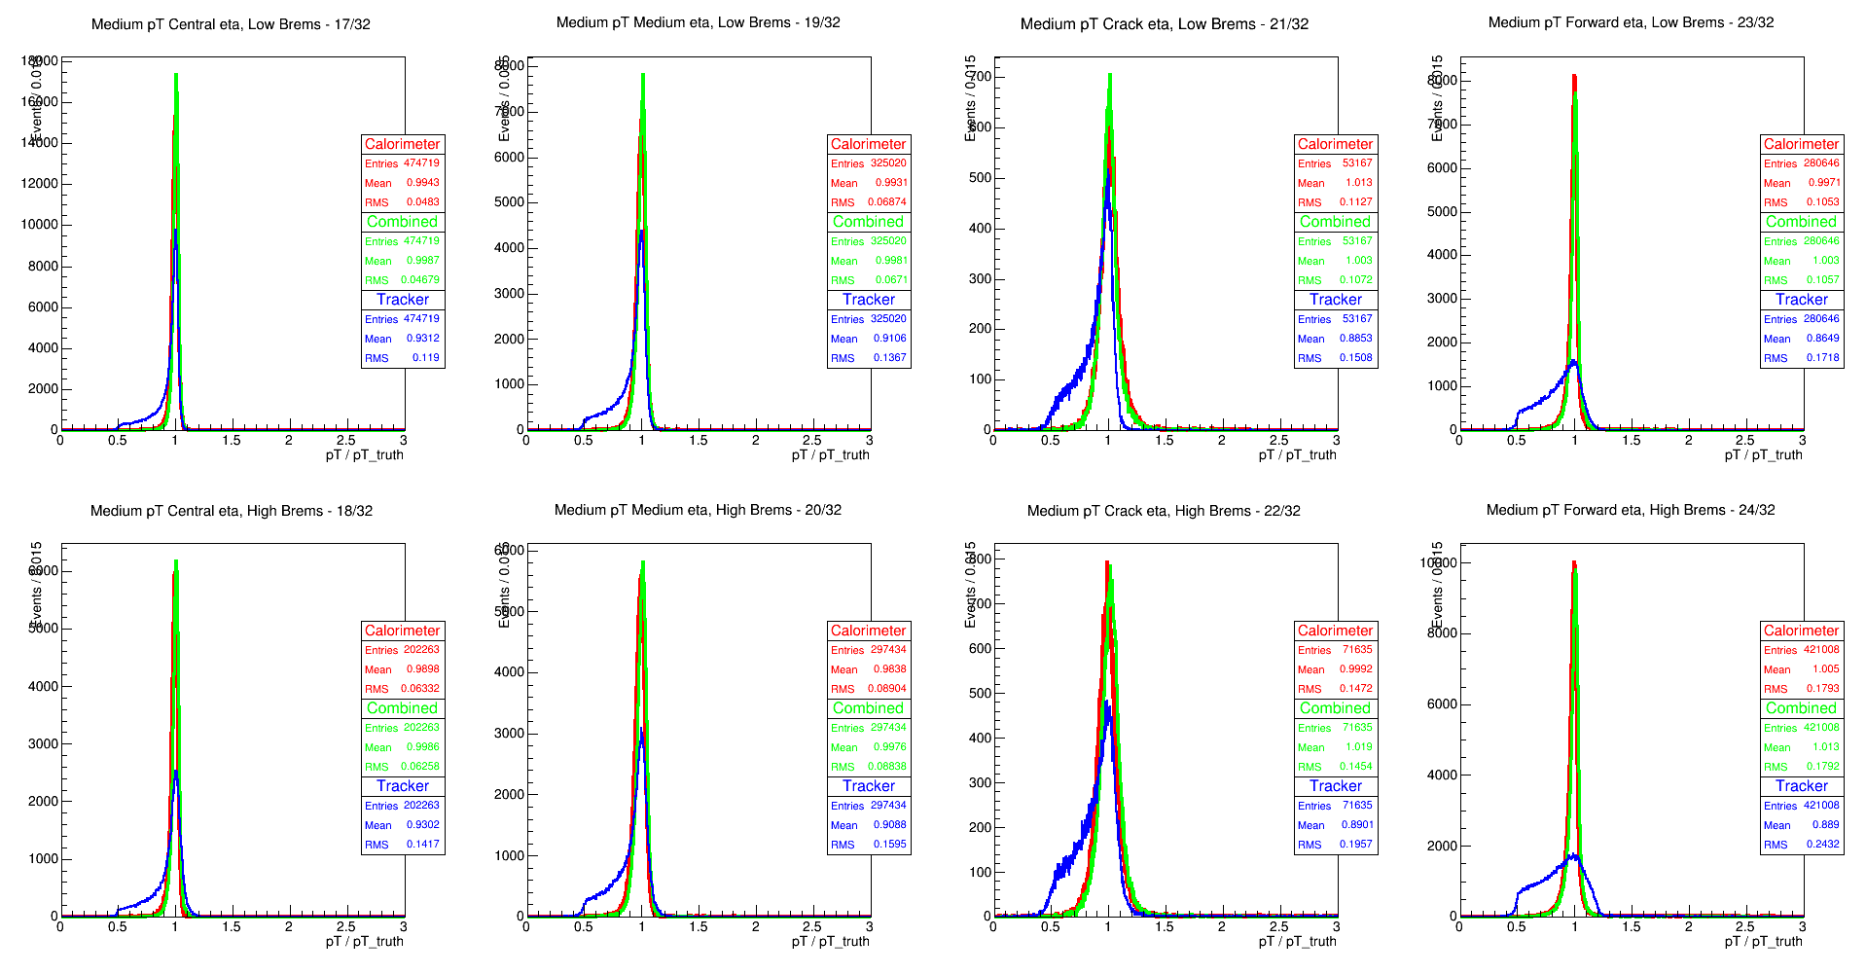

Slide 22
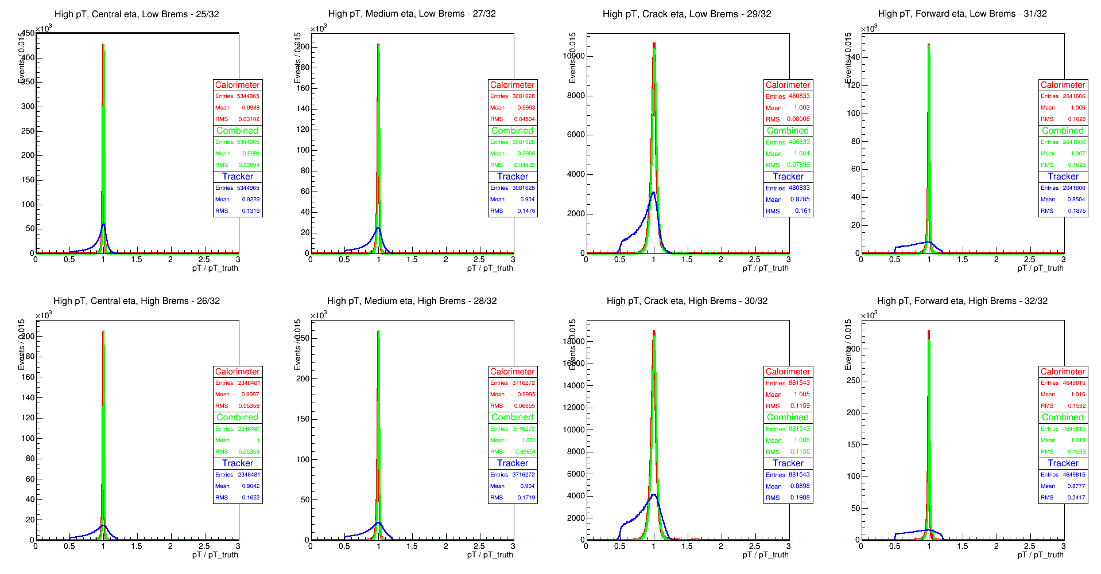

Slide 23
Pileup Electrons
Four slides of pT/pT_true histograms

Slide 24
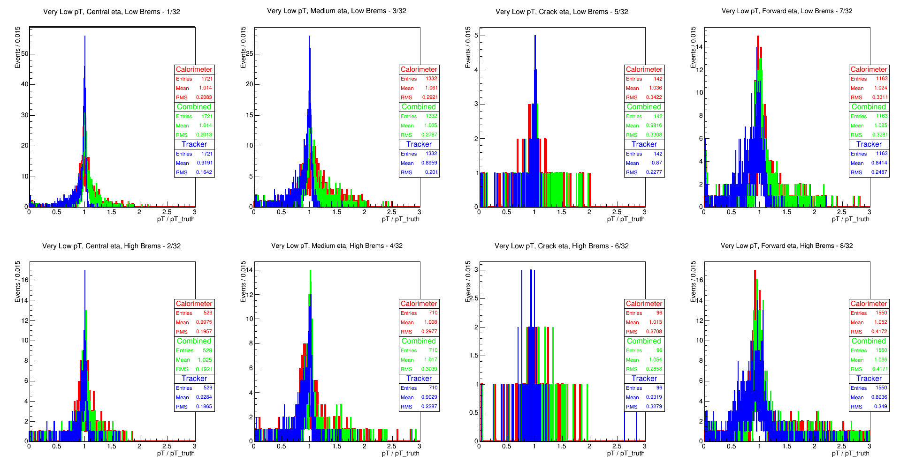

Slide 25
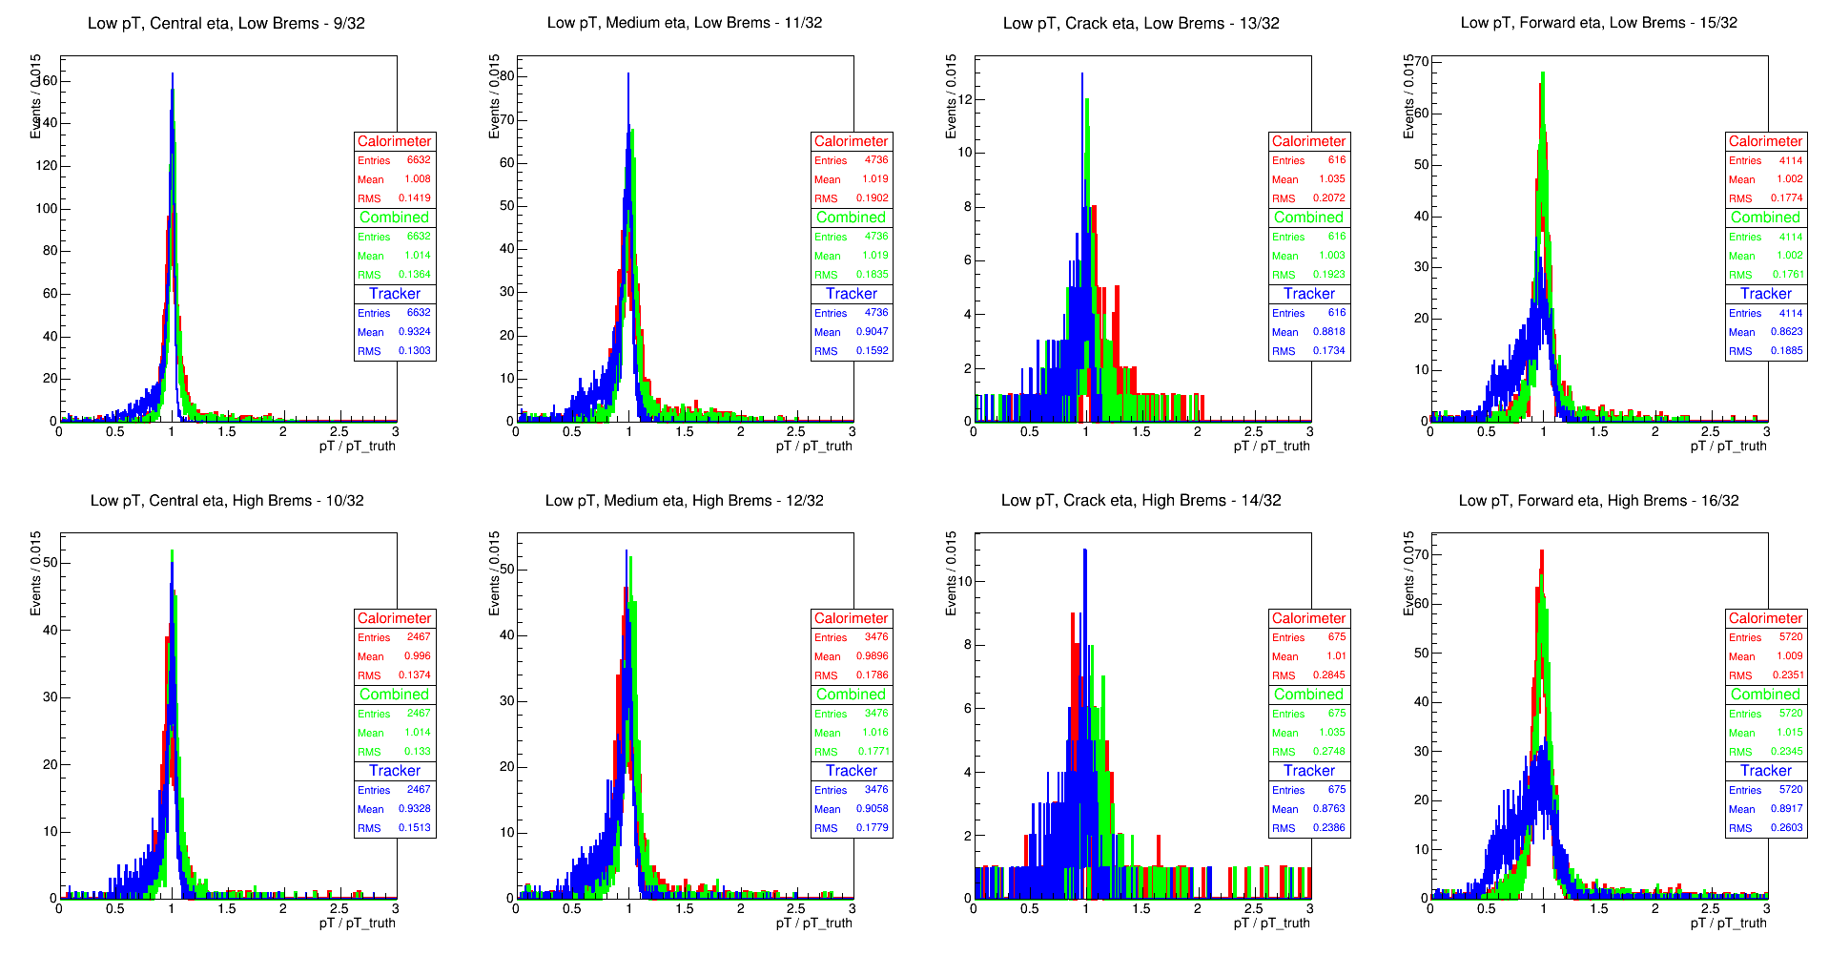

Slide 26
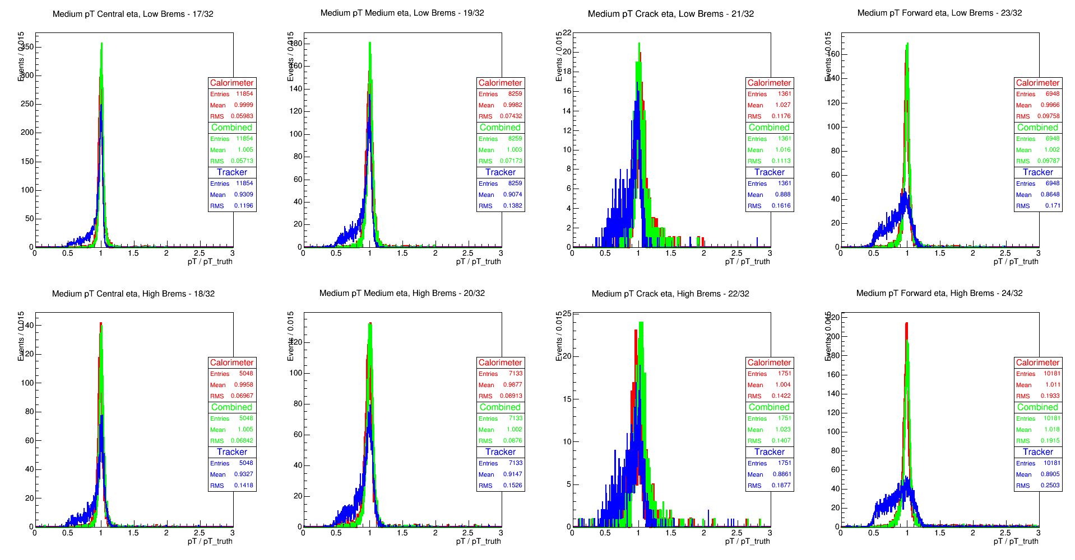

Slide 27
