Slide 1
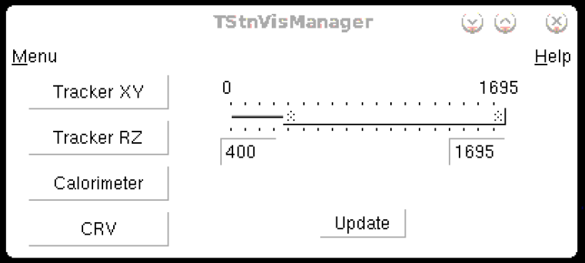
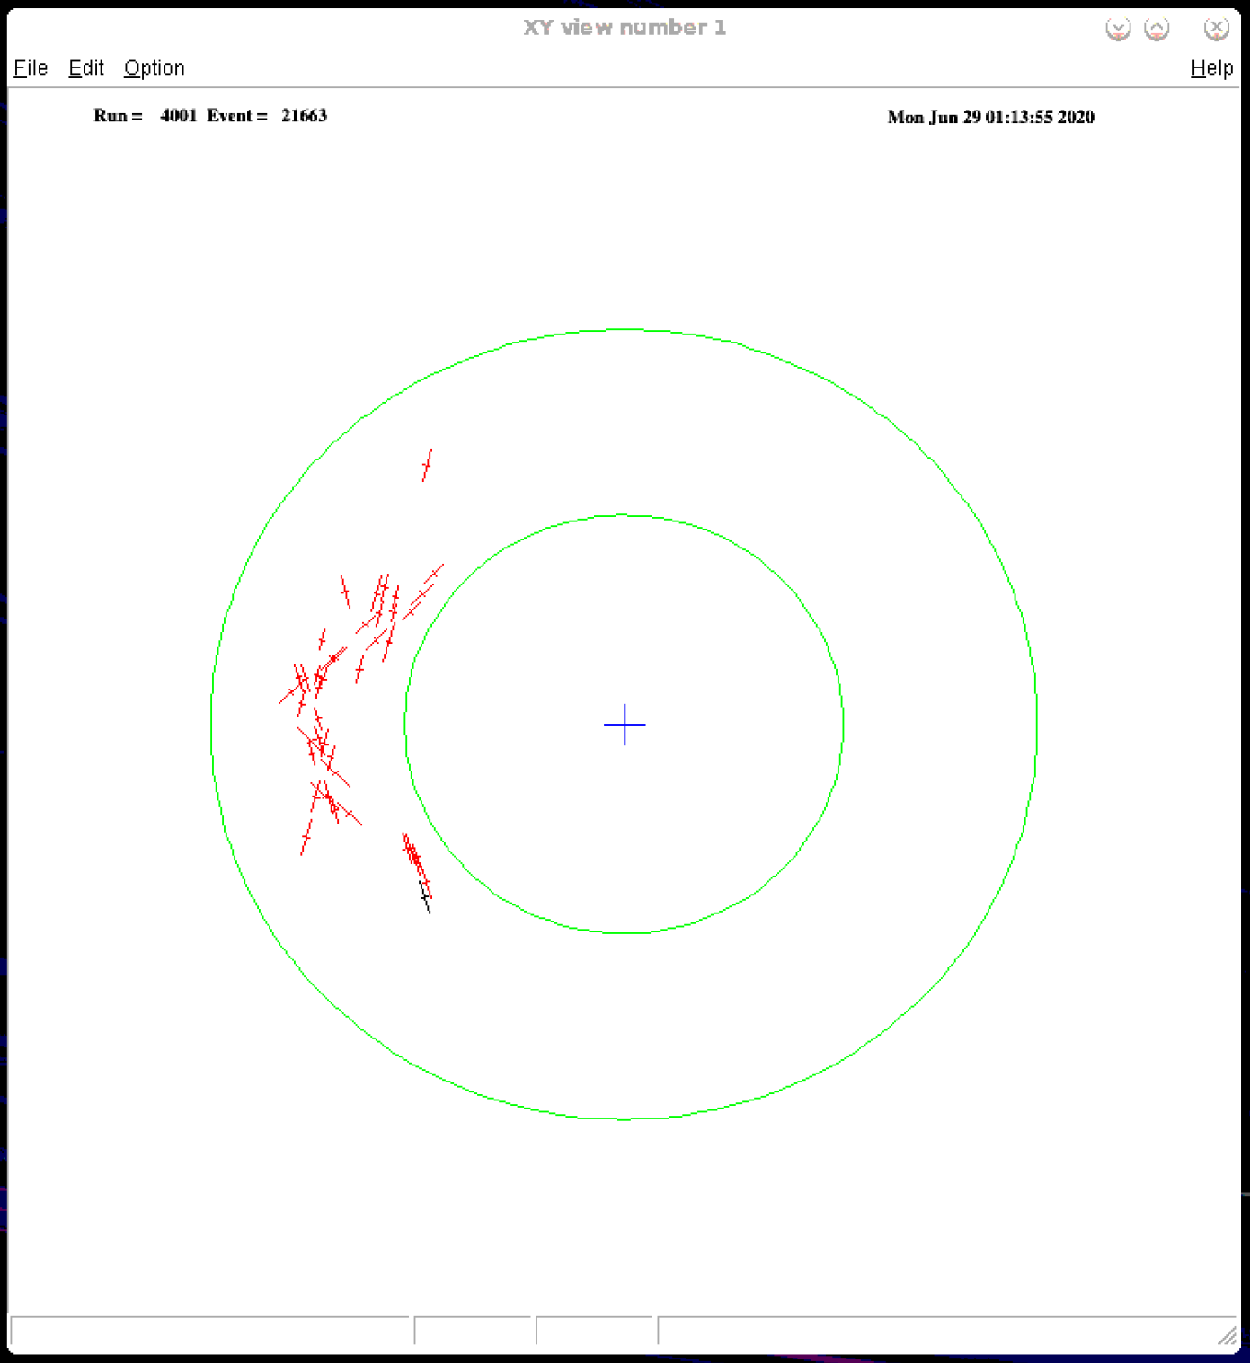
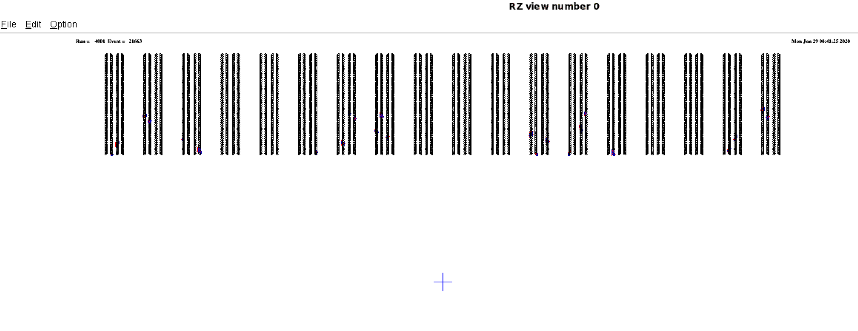
Notes:
Different view buttons show projections of the hits onto different planes and corresponding detectors

Slide 2
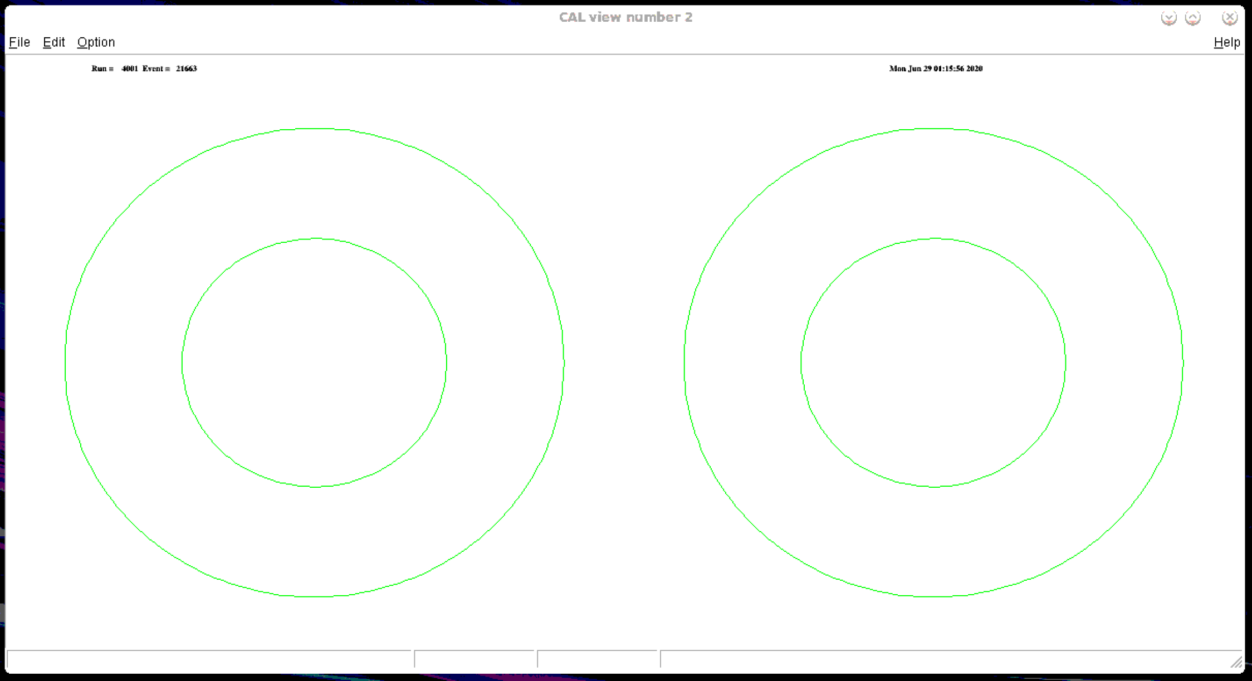
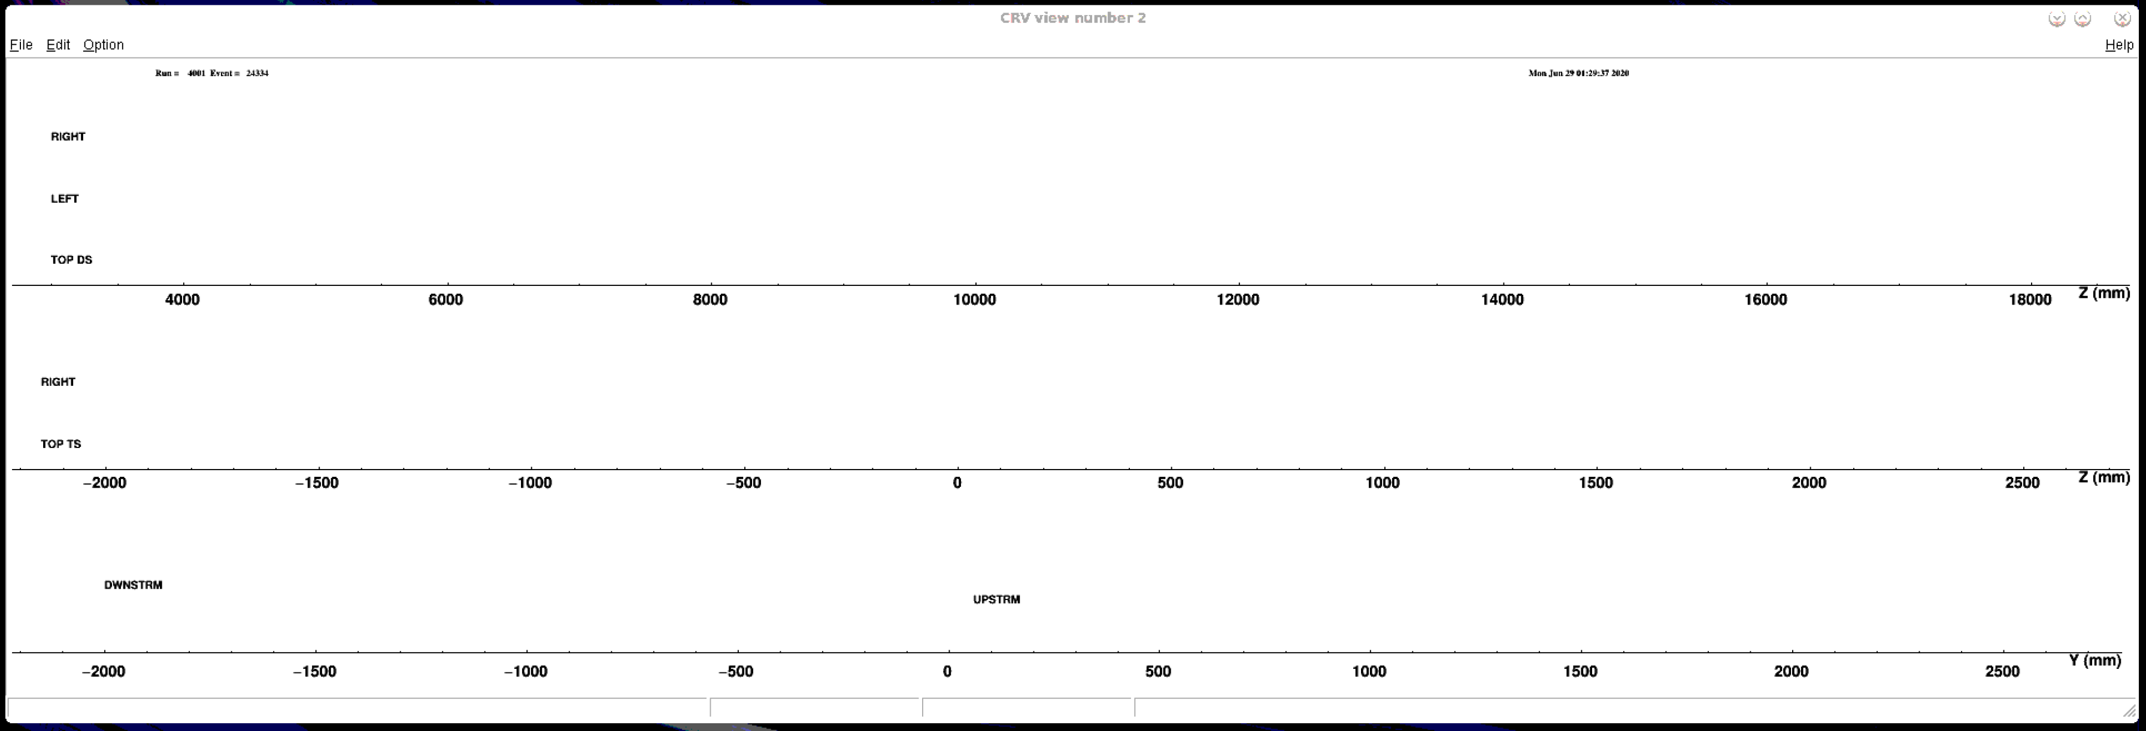
Notes:
Different view buttons show projections of the hits onto different planes and corresponding detectors

Slide 3
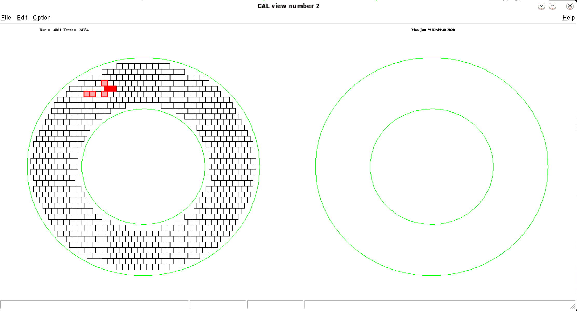
Notes:
When a calorimeter disk gets hit, the specific crystals that see something light up with colors according to signal strength
???? – I assume the one on the left is the one closer to the tracker and the one on the right is on the end???

Slide 4
Notes:
If neither gets hit, they’re both blank

Slide 5
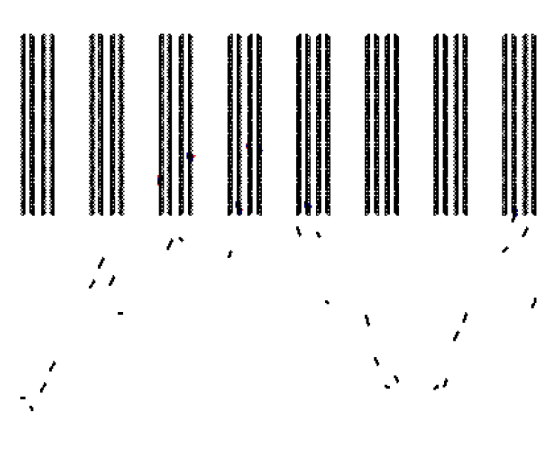
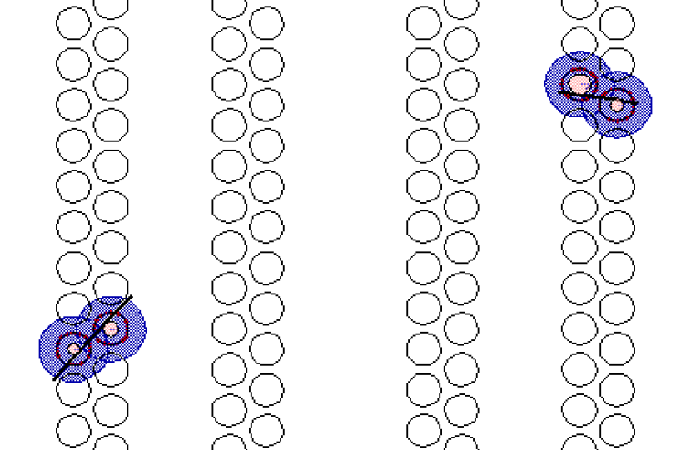
Notes:
If helixes can be reconstructed then you can see guesses of where particles flew through straws

Slide 6
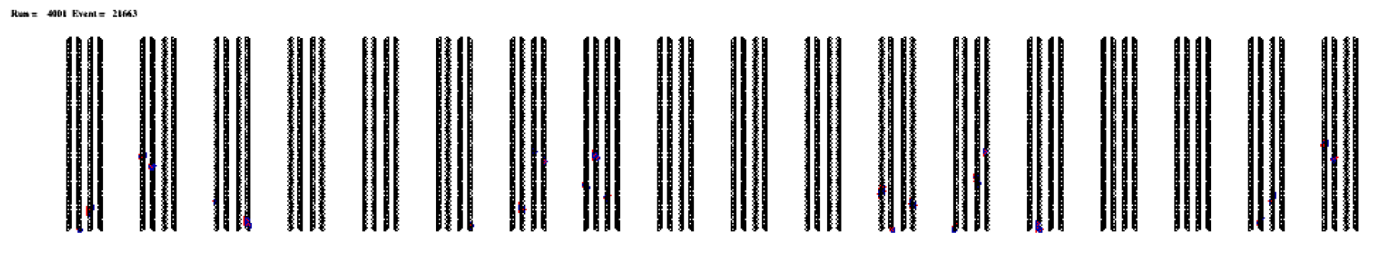
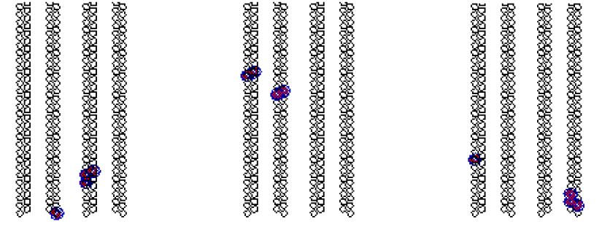
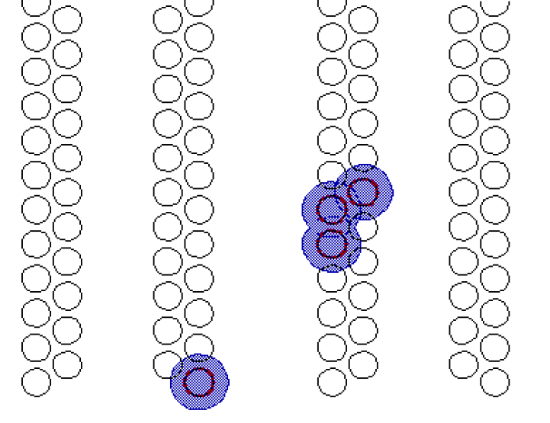
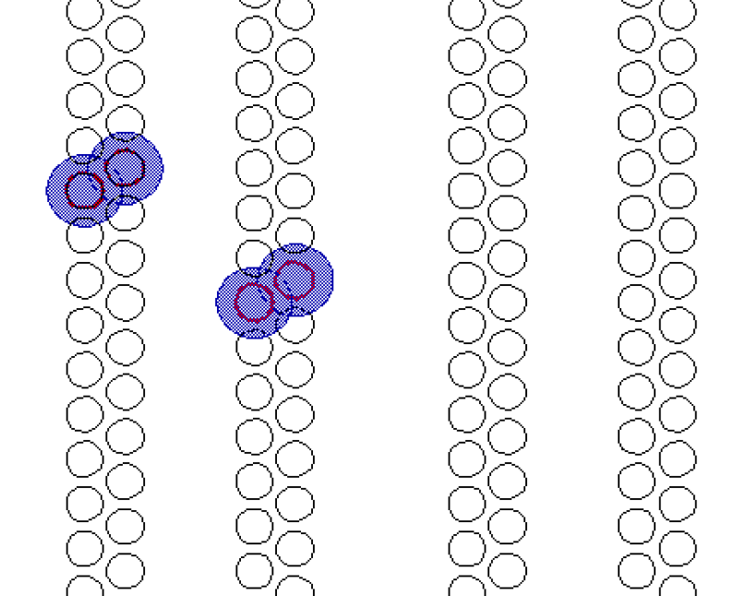
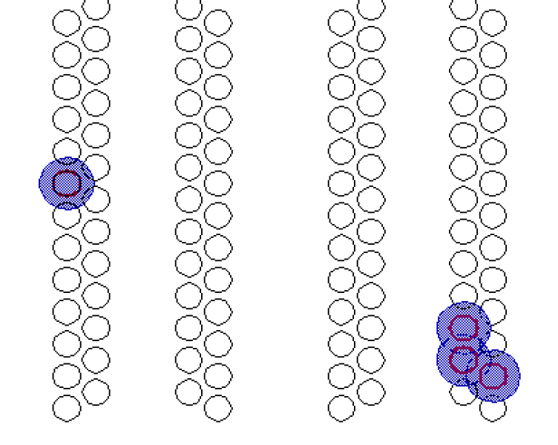
Notes:
Really hard to see anything unless you zoom in
To zoom in you select a rectangular region you’re interested in and it opens a new window with your area
You can keep on selecting and it keeps making new windows and naming them consecutively in the order you created them in
Benefit: if there’s somewhere you’re interested in (not sure why you’d want this because paths are random each time) you can keep your little selected popup region open and hit the update button

Slide 7
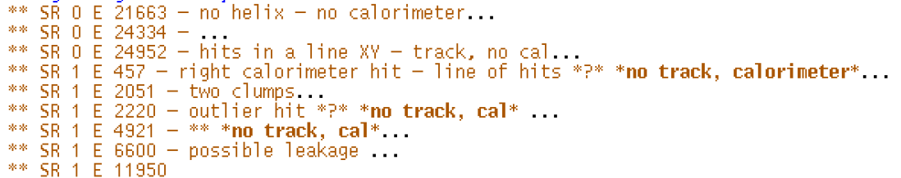
What I’ve been up to
Looking through events, flagging interesting ones where one or both reconstruction methods fail
Especially instances where calorimeter seeded works, track-seeded fails
Beginning to read through reconstruction code
Learning how to use the debugger

Slide 8
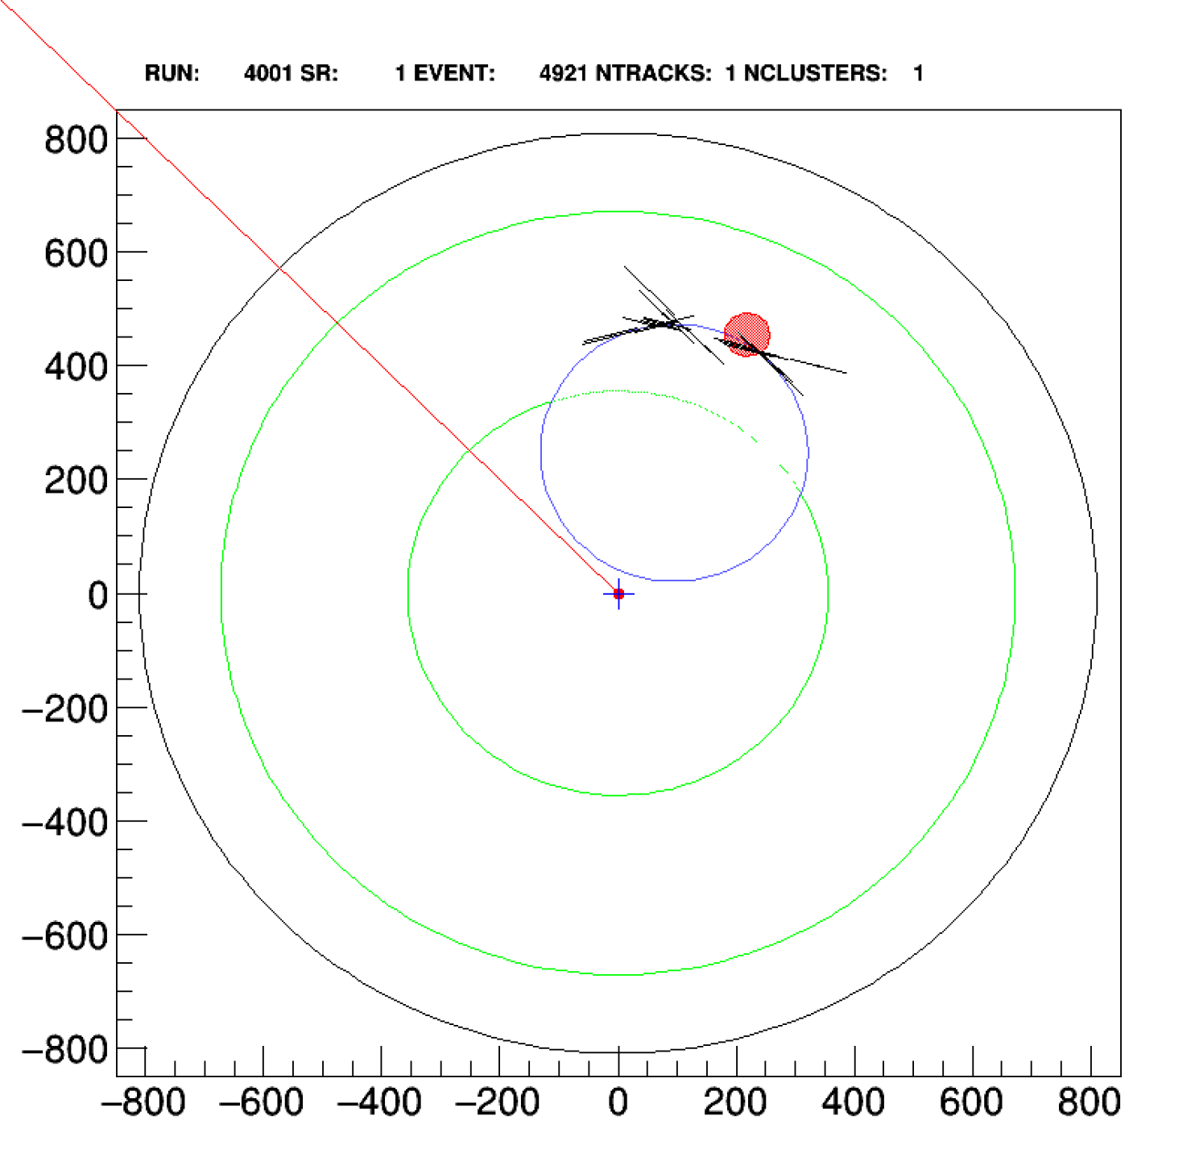
First debugged event: 4921!
Most tracker hits were clustered together
Minimum distance between hits was too big and caused most triplets to be discarded

Slide 9
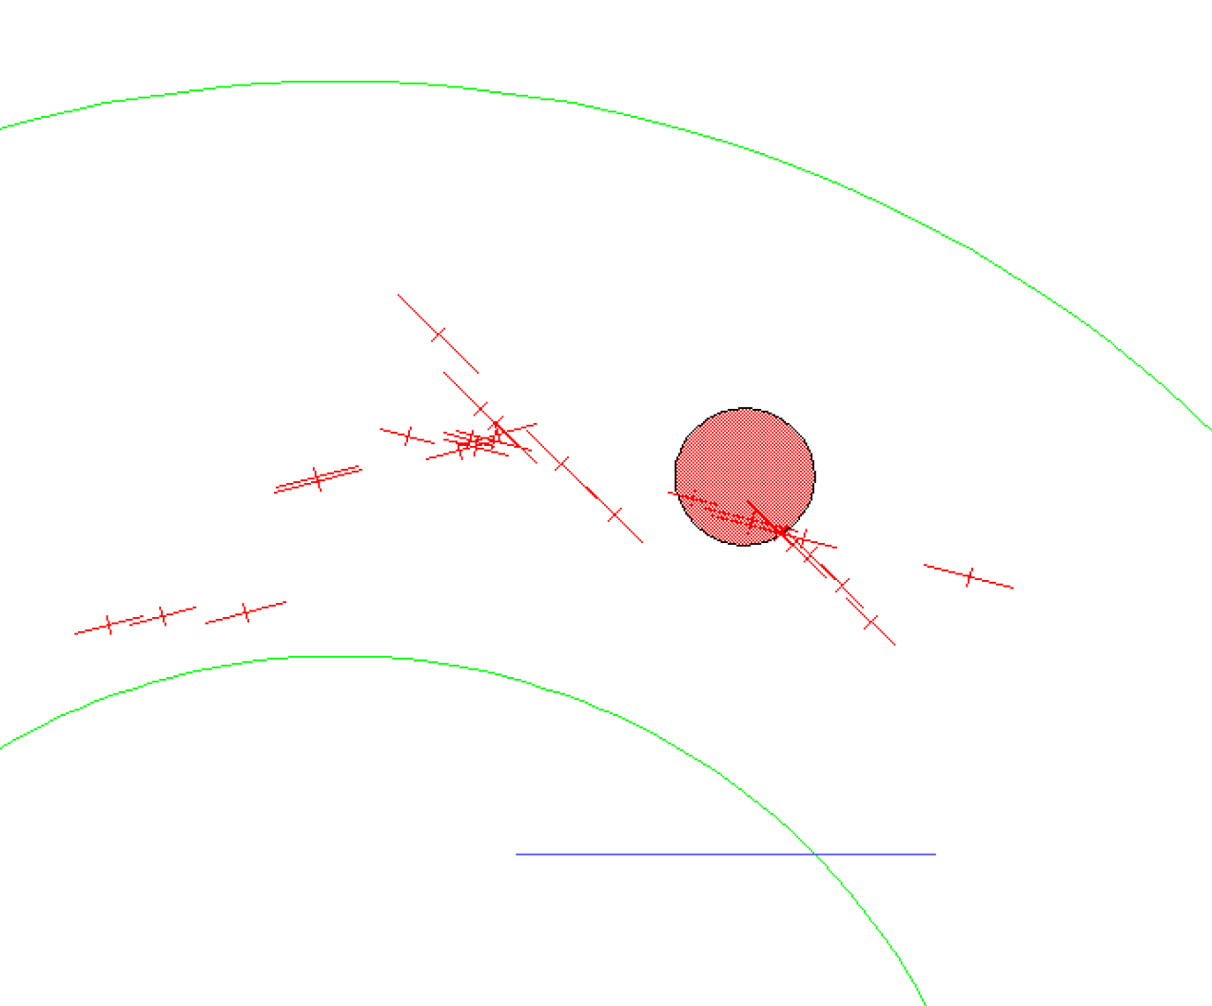

Slide 10
Next steps
Find documentation on relevant topics and reading through and understanding it (GitHub?)
Get a better understanding of how the simulations (Mu2e Offline) works
This will require reading and understanding the code, learning the specific methods used, glancing at the big .txt file
Finding and analyzing discrepancies
Attempt to find similarities between discrepancies
Use the debugger to step through the methods, find where it fails
Change some parameters in attempt to fix failed instances

