Slide 1
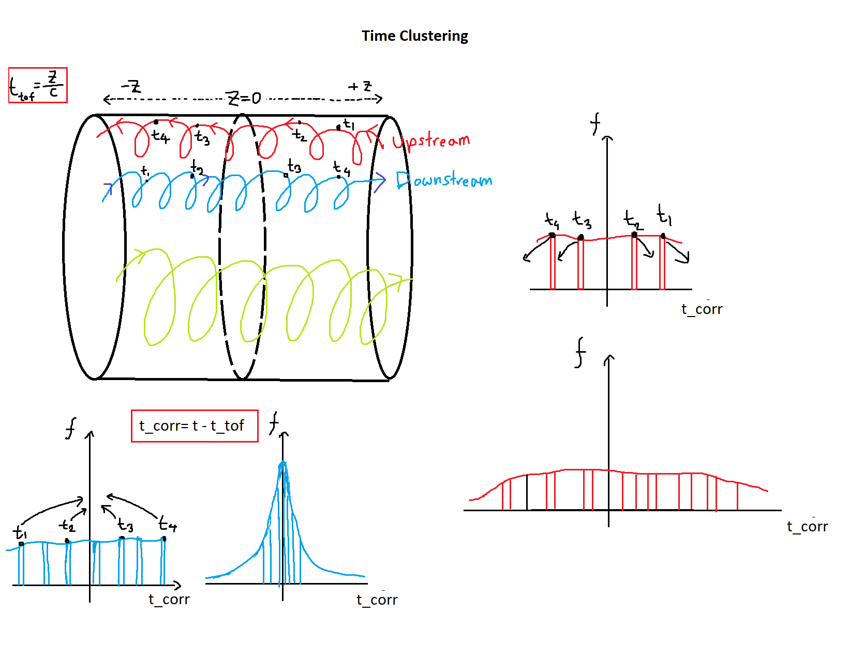

For downstream particles the clustering makes sharper peaks.
However, for upstream particles it makes the peaks wider!
Magnitude of t_tof $≈20 ns$

Slide 2
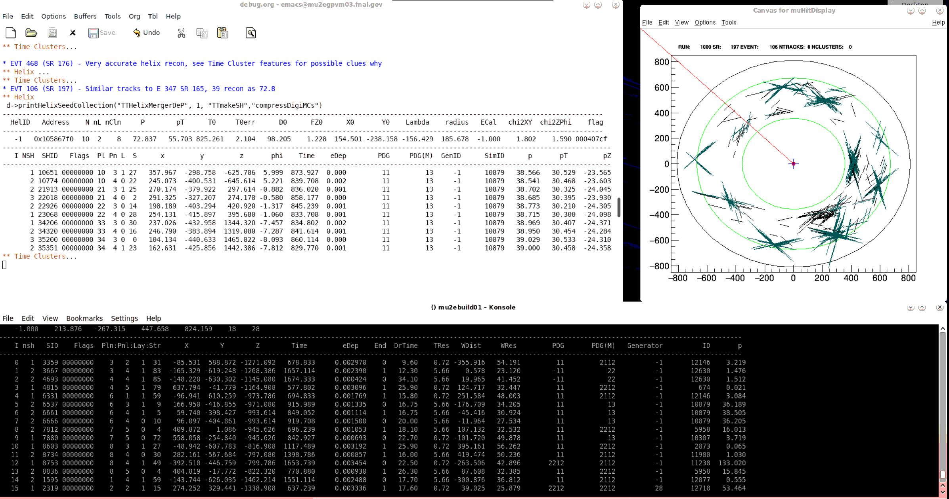
Issues with Anomalous Particles in Time Clustering

Slide 3
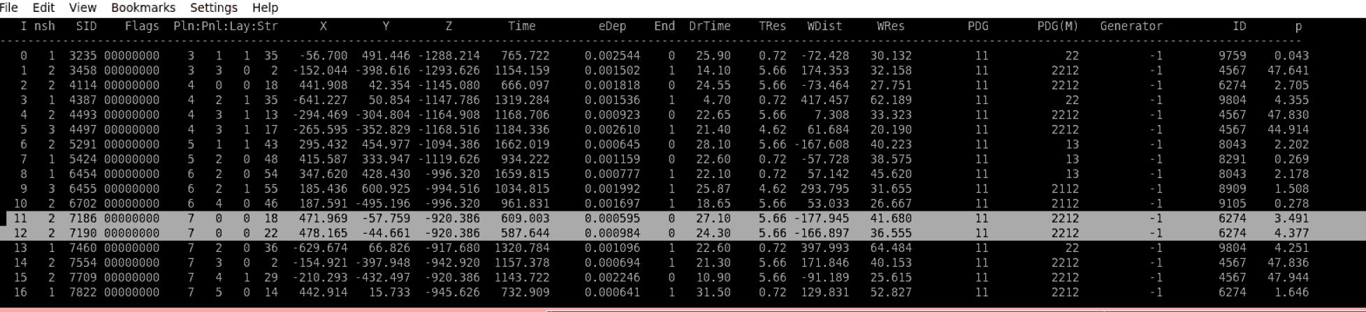
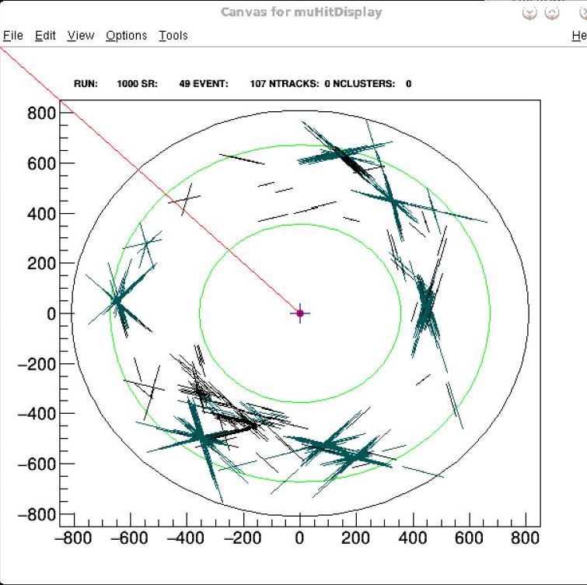
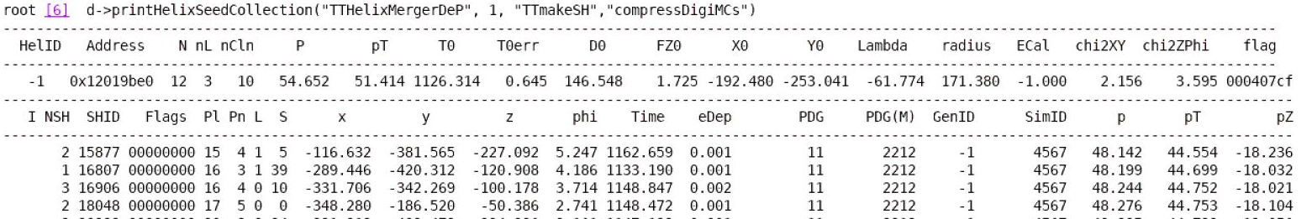
Particles from very different times present in a cluster, time discrepancies beyond possible error from time of flight corrections

Slide 4
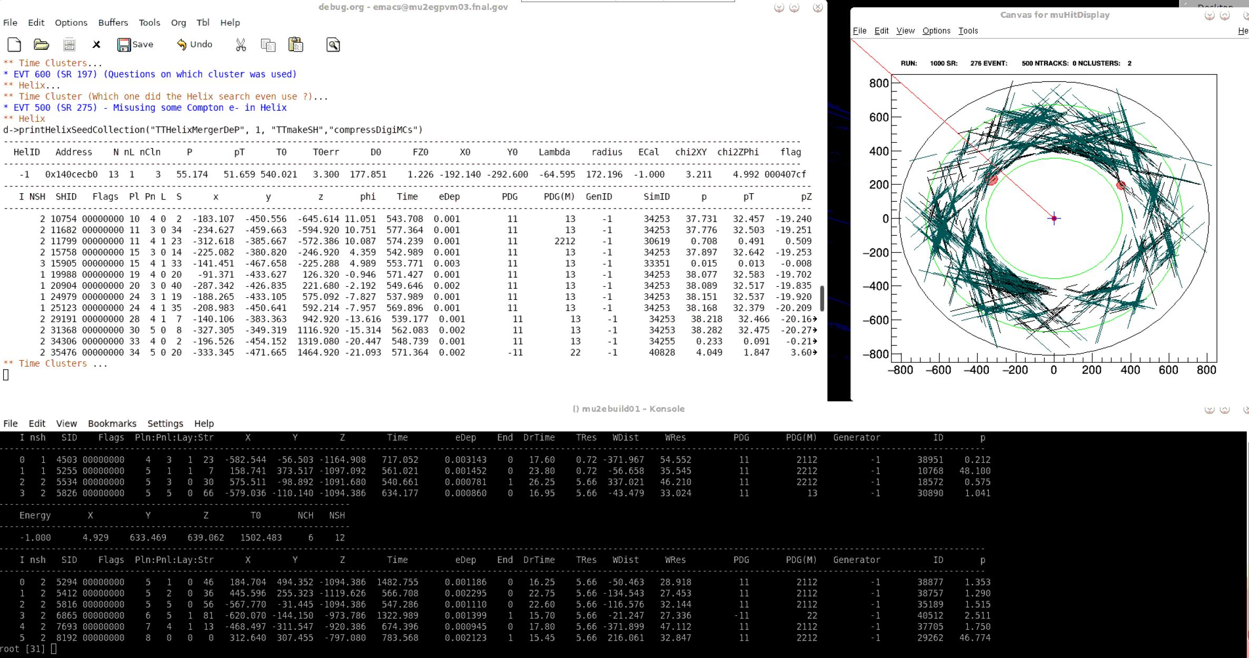

Slide 5
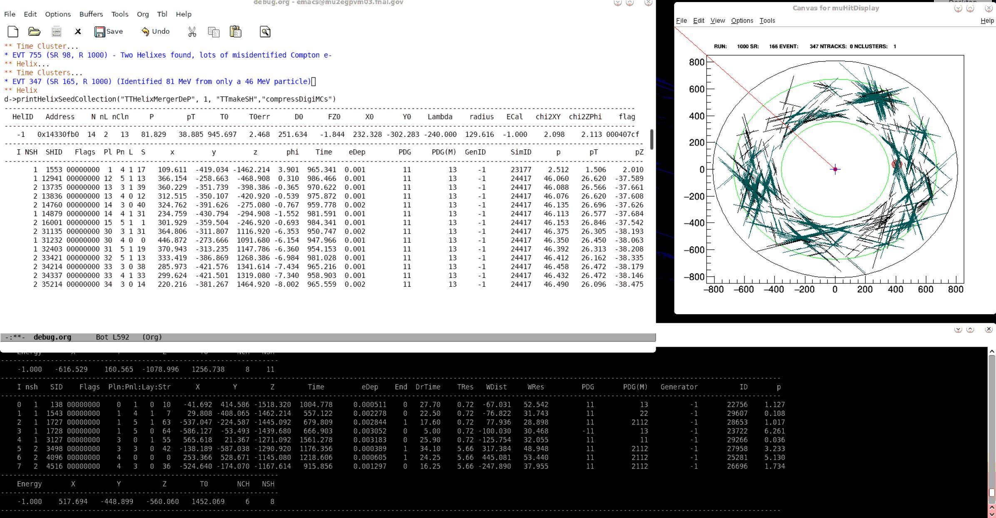
Possible Issues with High Error in Helix Fit when a lot of time clusters and Compton electrons are present

