Slide 1
Living Through a Revolution
50 Years in Astrophysics
A Travelogue

Slide 2
Starting Grad School
”Welcome to the U. of C. We are happy to have you, and think you will do well here. However, we must warn you that it is unlikely that will ever find a job in this field.”

Slide 3
My Days with LST
Yes, the Large Space Telescope (now Hubble)
I was the grad student supporting studies of doing precision astrometry with LST, later to be Hubble.
End of my second year, after a brief stay at to Yale with my professor, Bill van Altena, I joined the Far Infrared Astronomy group at Chicago.

Slide 4
Airborne Astronomy
Al Harper had started a far infrared astronomy group at Chicago, mostly working on the NASA Lear Jet, but transitioning to the Kuiper Airborne Observatory in early 1974. I joined the group (with students Harley Thronson and Charlie Telesco (now at U. Florida)
We were able to build instruments for the KAO to enable a range in exciting science (mostly far IR imaging, later polarimetery with Roger Hildebrand’s group (Stan Whitcomb and Jocelyn Keene))

Slide 5
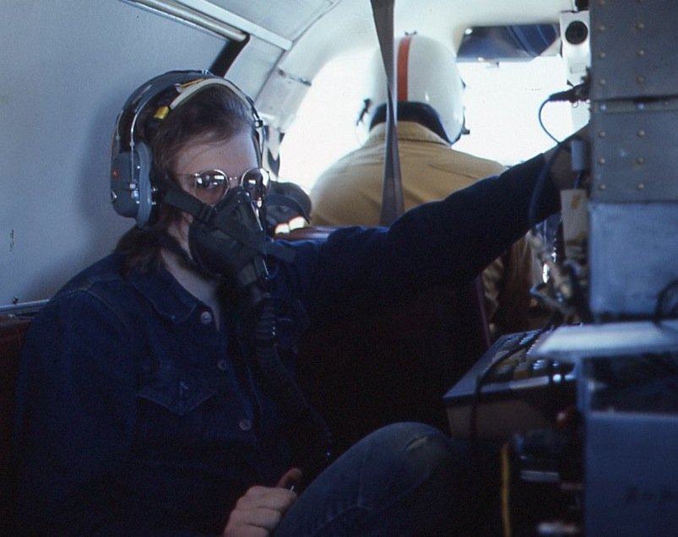
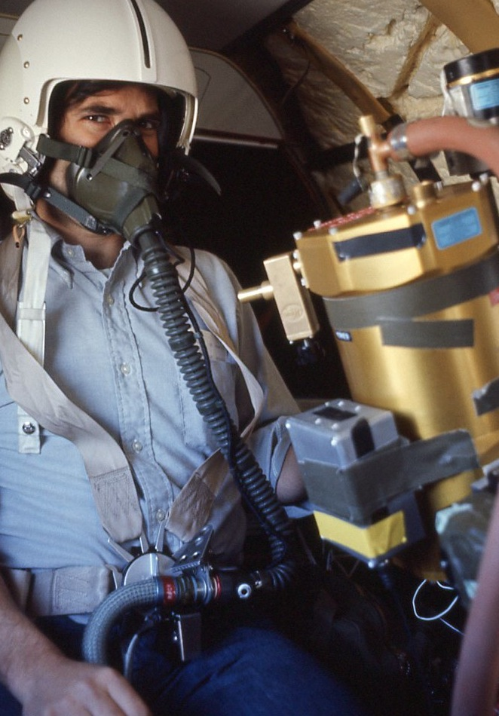
Squeezing into the Lear Jet

Slide 6
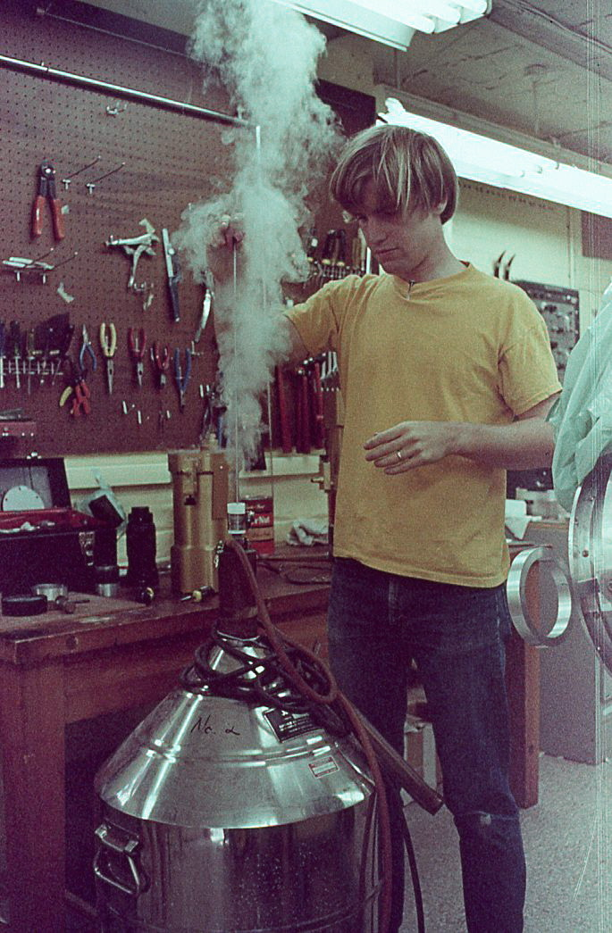
Building the Instruments
In the 1970s, we developed several generations of FIR photometers/imagers
Computer technologies went from interfaces on desk calculators to microcomuters. We had them all and had to program them in assembly and build the interfaces.

Slide 7
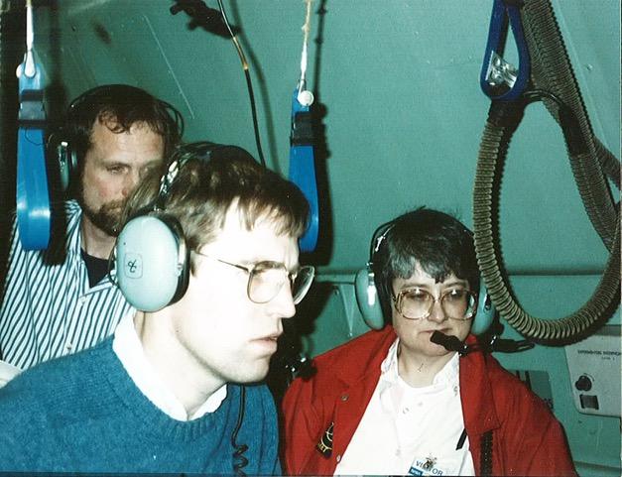
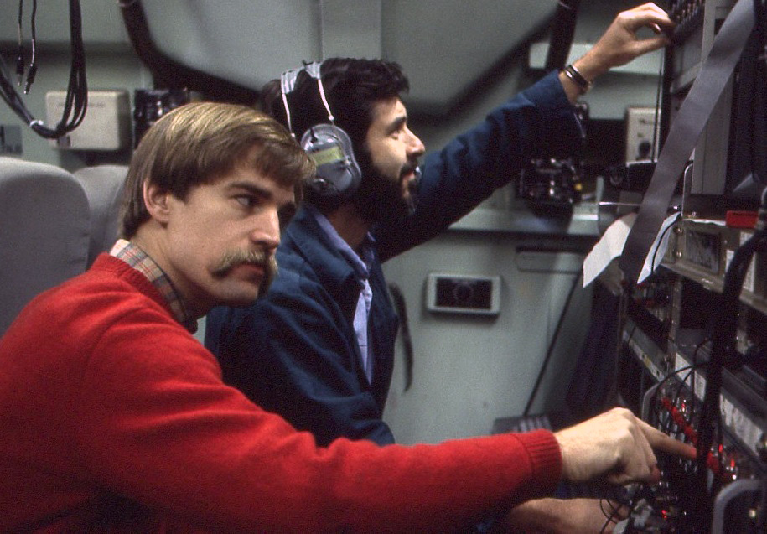
Getting Data on the KAO

Slide 8
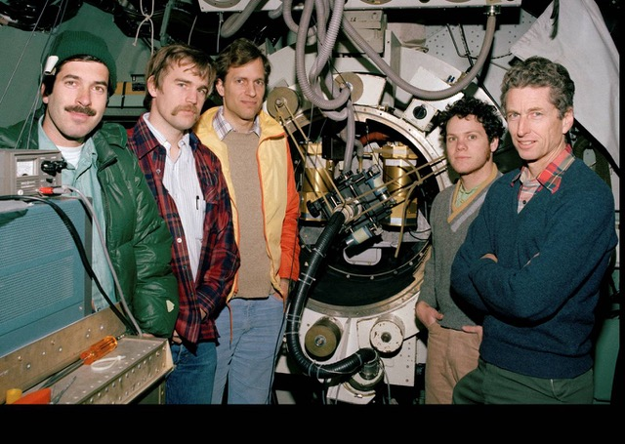
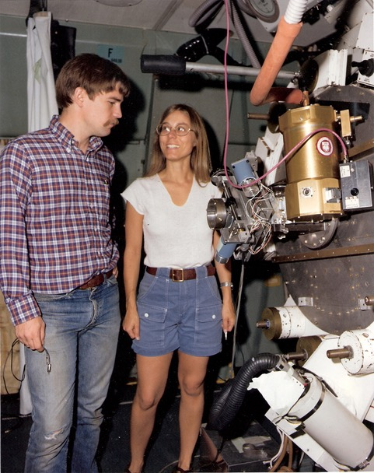
The Team on the KAO

Slide 9
Lots of Discovery Space
Internal energy production in Uranus and Neptune
First far infrared and mm studies of the Galactic Center
First studies of H II regions in the far IR
Discovery of ultraluminous IR galaxies
First studies of dust in planetary nebulae

Slide 10
Arriving at GSFC
I arrived at GSFC as an NRC postdoc on Oct. 10, 1979 to 3” of snow.
I was looking forward to the temperate mid-Atlantic climate
I had a grant to build a spectrometer for the KAO, and started to work on COBE
Much of the infrastructure we developed for the KAO (detector production, testing, etc) fed directly into COBE FIRAS and DIRBE

Slide 11
Spectrophotometers at GSFC
Vertical temperature profiles in Uranus and Neptune
We got it before Voyager!
FIR (43 µm) water ice emission feature
Crystalline ice in stellar outflows
Newly synthesized elements and thermal evolution in SN1987a
Exotic dust in the Galactic Center

Slide 12
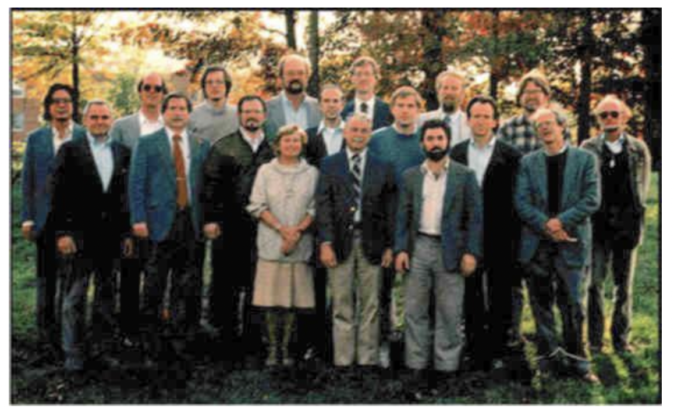
Joining the COBE Team

Slide 13
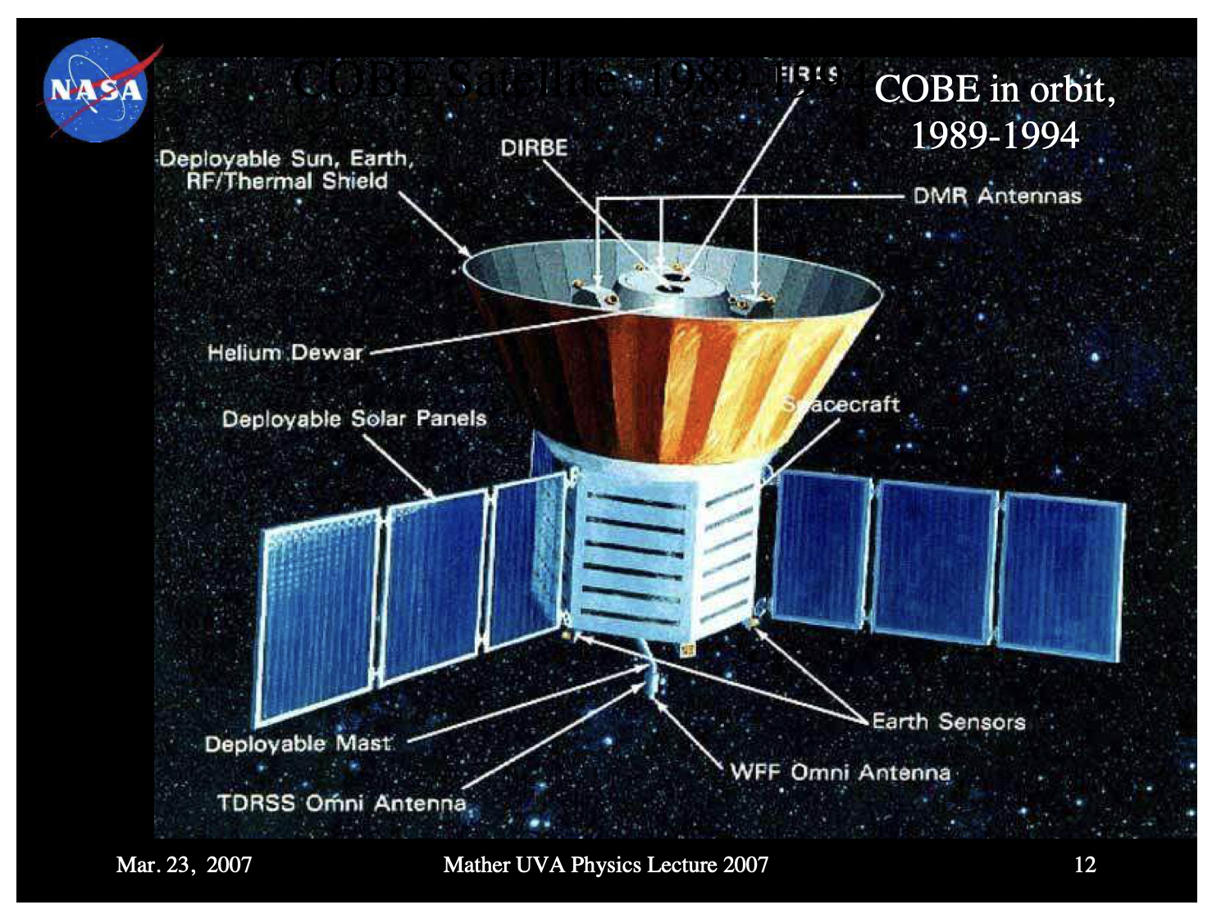
COBE

Slide 14
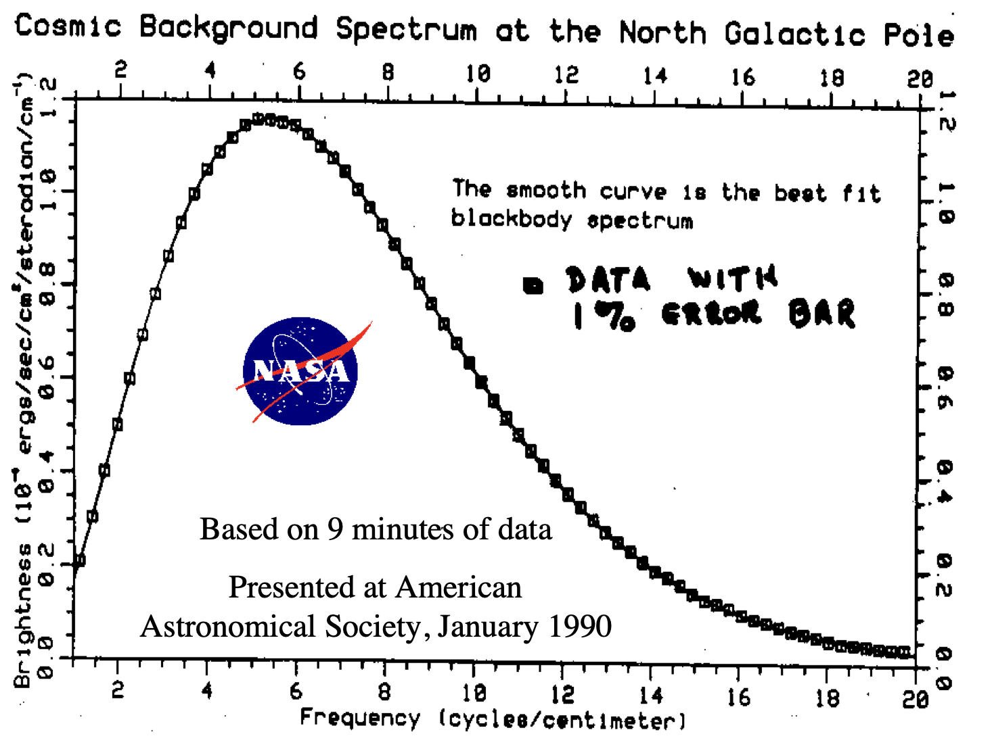
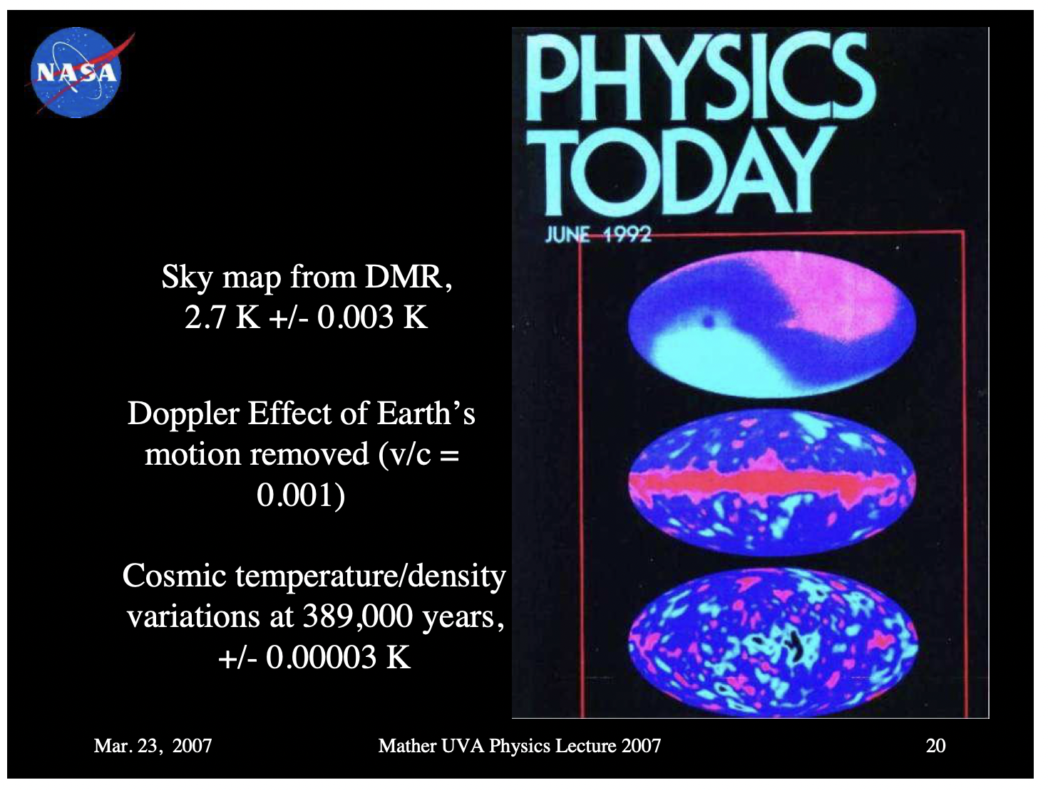
COBE

Slide 15
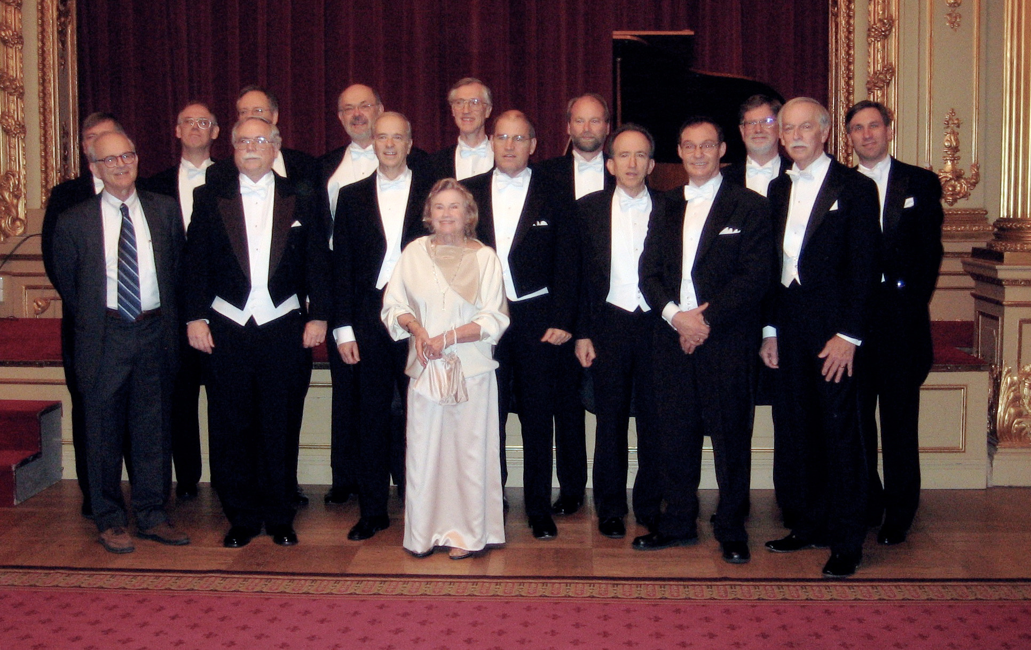
Stockholm 2006

Slide 16
One Person’s Noise is Another’s Signal
In Aug 1982, Frank McDonald challenged the X-ray groupat Goddard to look for ways to improve non-dispersive spectroscopy above the performance of Si diodes (130 eV FWHM at 6 keV)
He explained the problem and I already had worked it out and knew the answer
I asked if 1 eV would be good. He said it would be. The rest is history, mostly made by the X-ray team at NASA along with Dan McCammon at UW

Slide 17
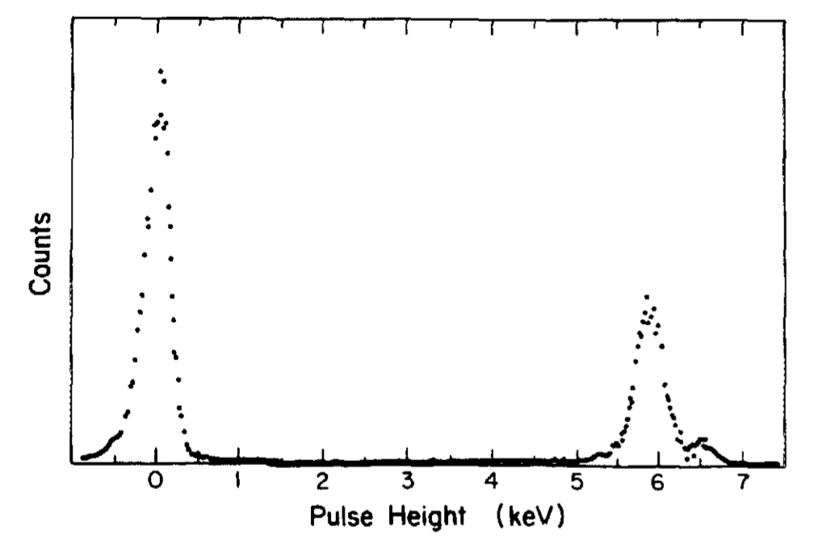
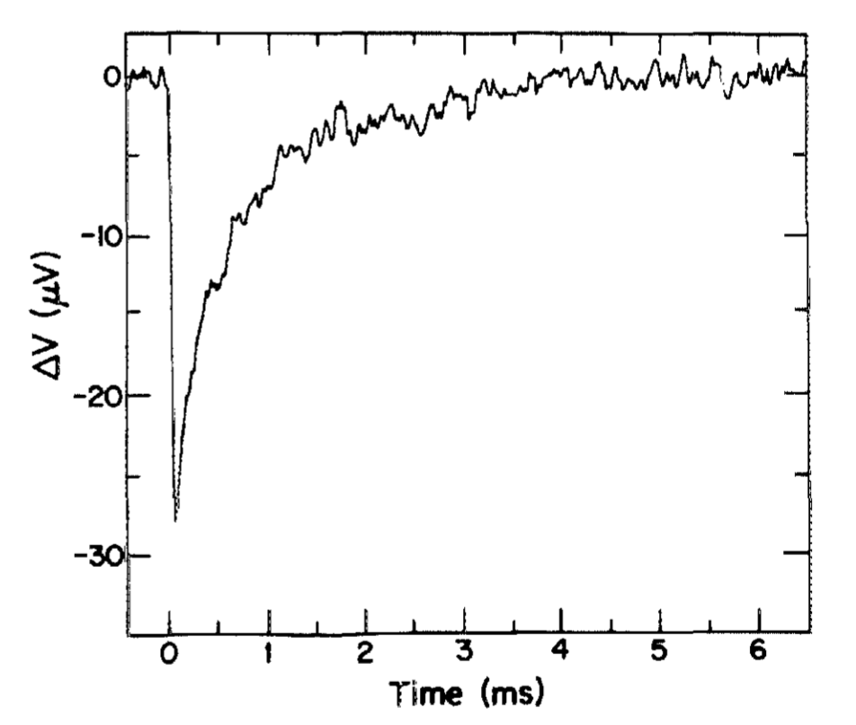
The Beginning

Slide 18
Development of Microcalorimeters
During the 1980s, Rich Kelley, Andy Szymkowiak, Dan McCammon, and Rob Schoelkopf (for a while) worked on engineering the calorimeters for flight.

Slide 19
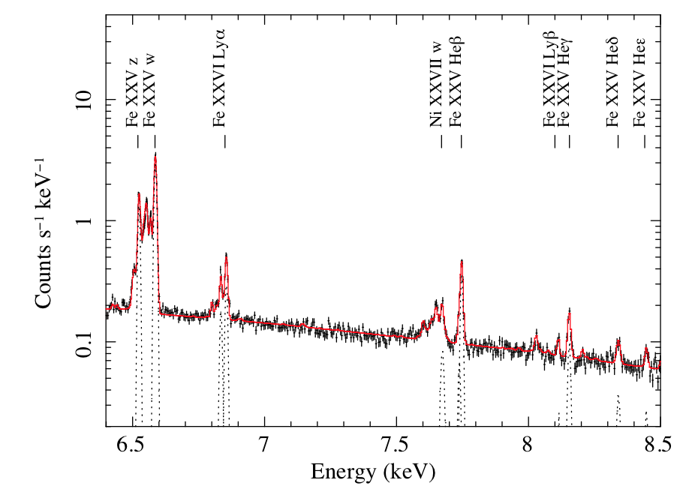
X-ray Spectroscopy in the Modern Age!

Slide 20
Envisioning JWST
In 1998, a call went out for instrument concepts for JWST, and I proposed for a near IR multi-object spectrometer
With exposures of 24 hours for the most distant galaxies, the ability to target large numbers of objects simultaneously was essential if we were to do systematic studies of the early universe.
Ultimately, that instrument was assigned to ESA, but the multi-object technology we had developed was essential, so we became team members and produced the system.

Slide 21
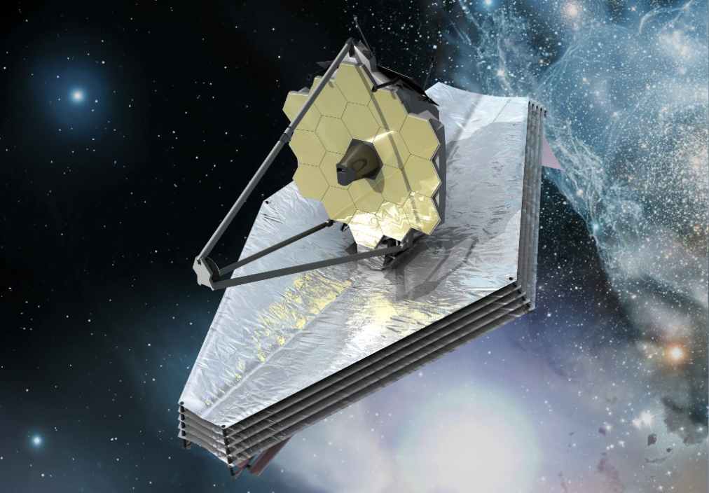

Slide 22
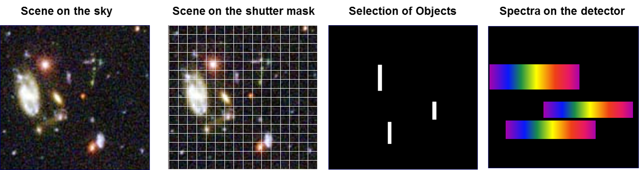
Multi-Object Spectrosopy

Slide 23
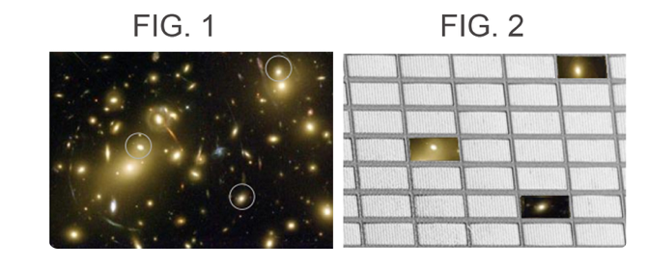
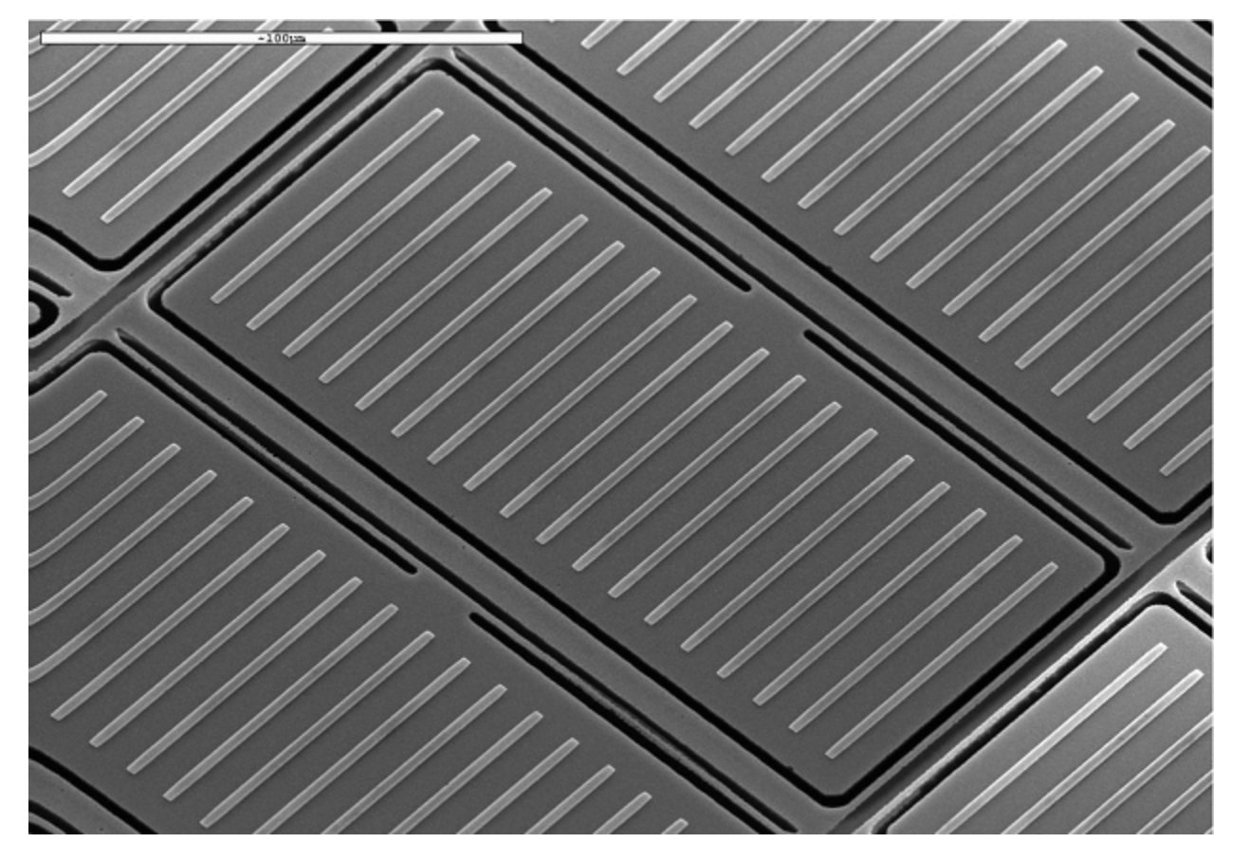
The Idea

Slide 24
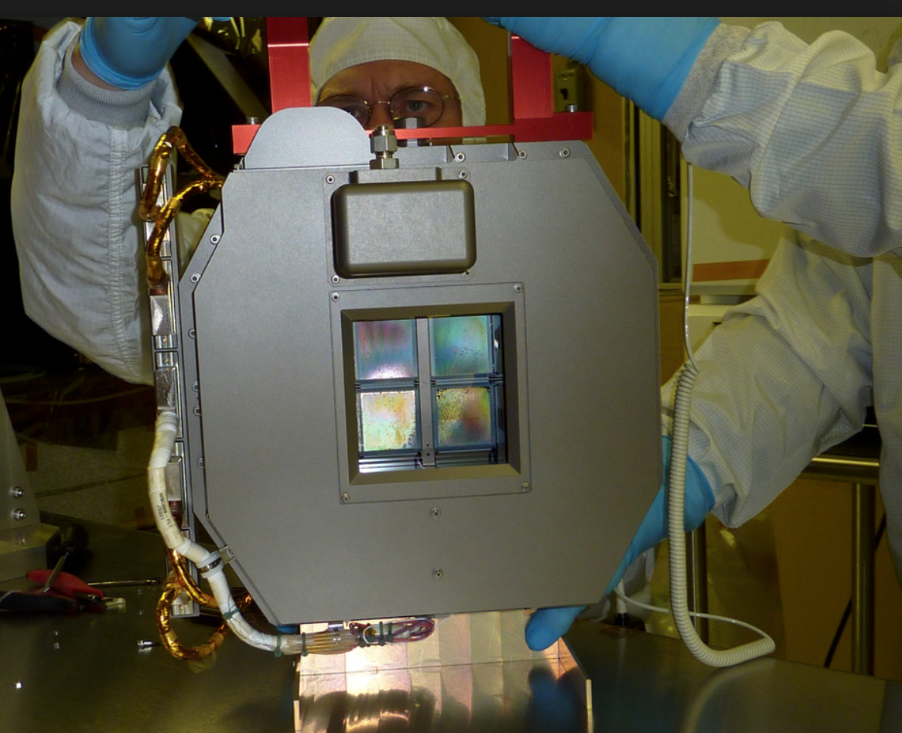
The System

Slide 25
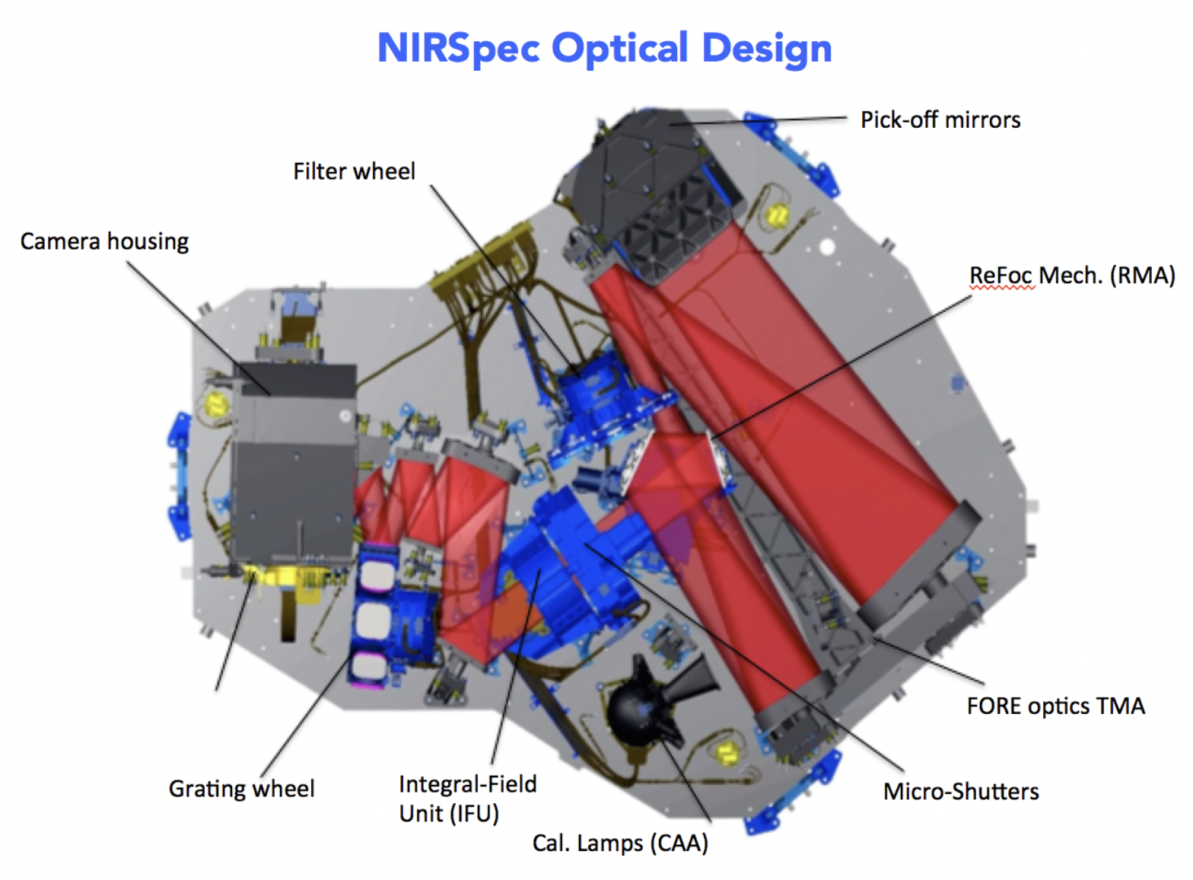
ESA’s NIRSpec

Slide 26
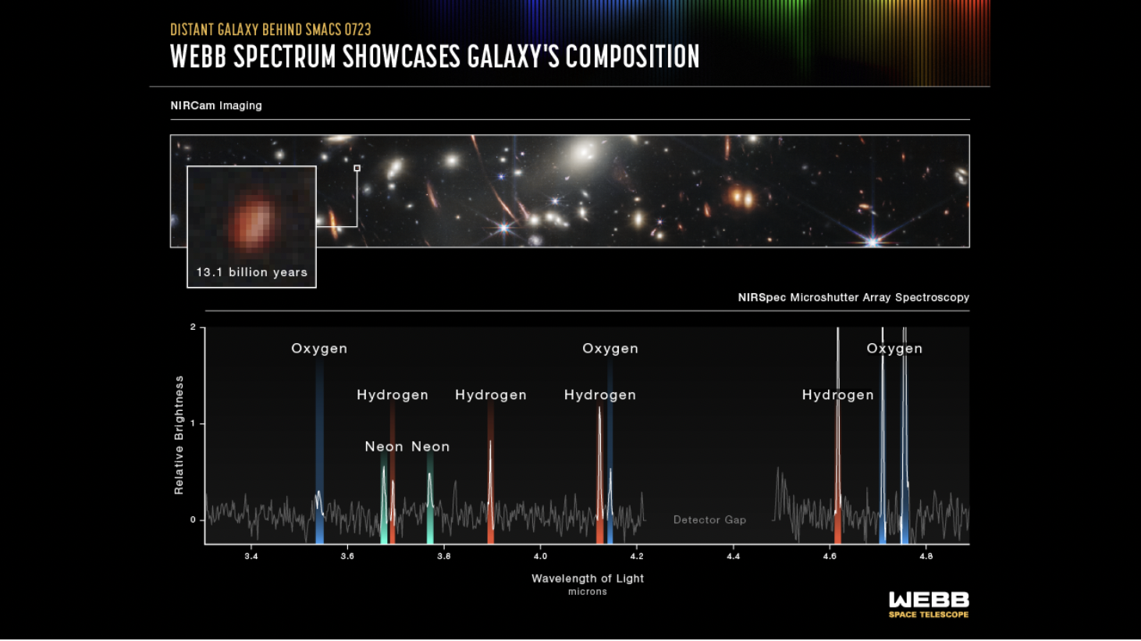
First Light!

Slide 27
A Look Ahead
NIRSpec’s MOS will open the era of initial galaxy formation to detailed study for the first time
We will learn:
When did the earliest galaxies form?
When do black holes become important in galaxies?
What is the story of nucleosynthesis?
How and when was the universe reionized?
….. And many more

