Slide 1


The ATLAS Project: Phase II Upgrade
In collaboration with ATLAS members
at Yale University

Slide 2

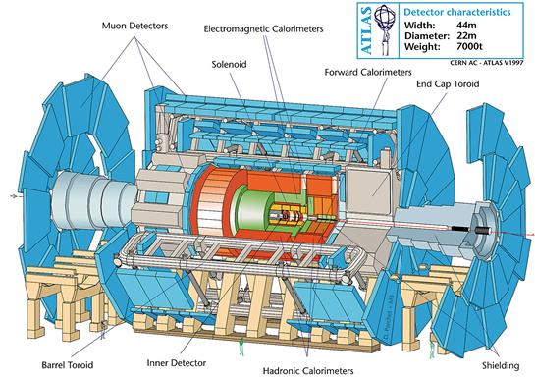
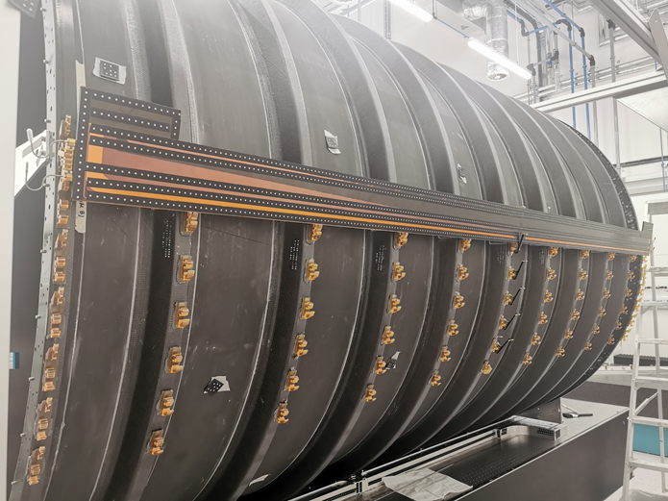
A Toroidal LHC ApparatuS
High Luminosity Upgrade (HL-LHC):
ATLAS Inner Detector will be replaced with a new all-silicon Inner Tracker (ITk).
ITk design:
Barrel System: 4 layers comprised of 392 Staves (14 modules per stave side)
End Caps: 6 disks comprised of 32 wedge shaped petals.
Yale WL will procure 227 Stave Cores:
4 different types of staves: Long Strip | Short Strip
A – Side | C - Side
Stave Barrel Dressing: Insertion + Bow Studies

Slide 3
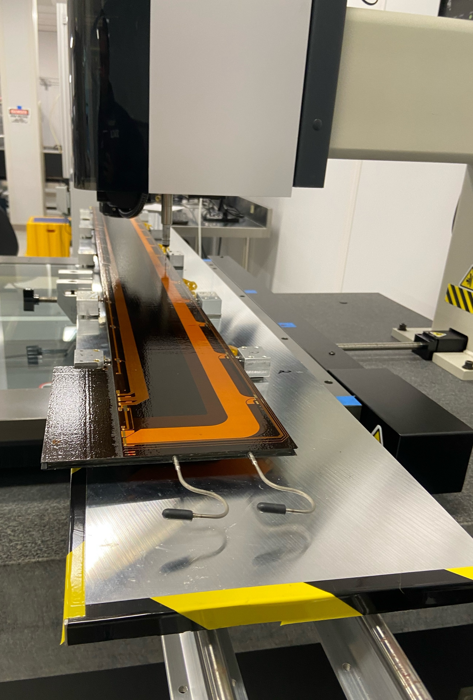
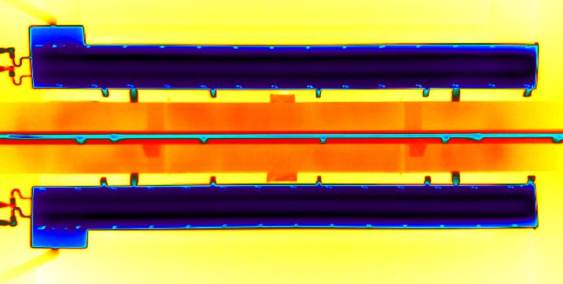
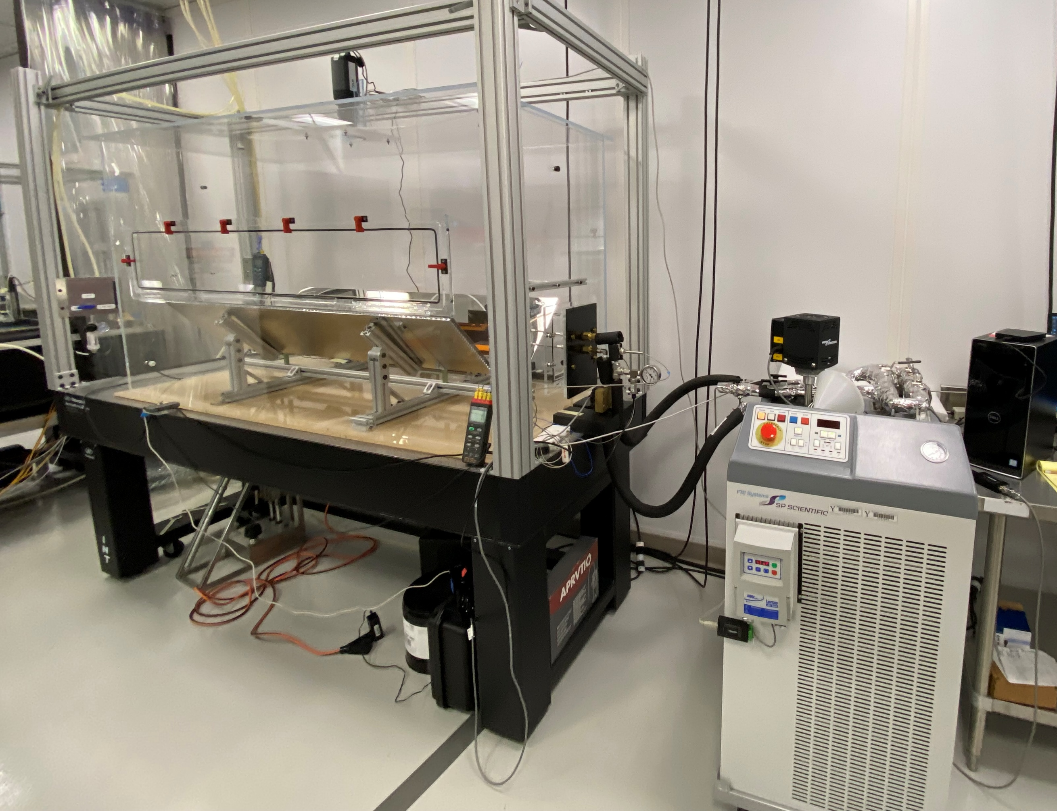
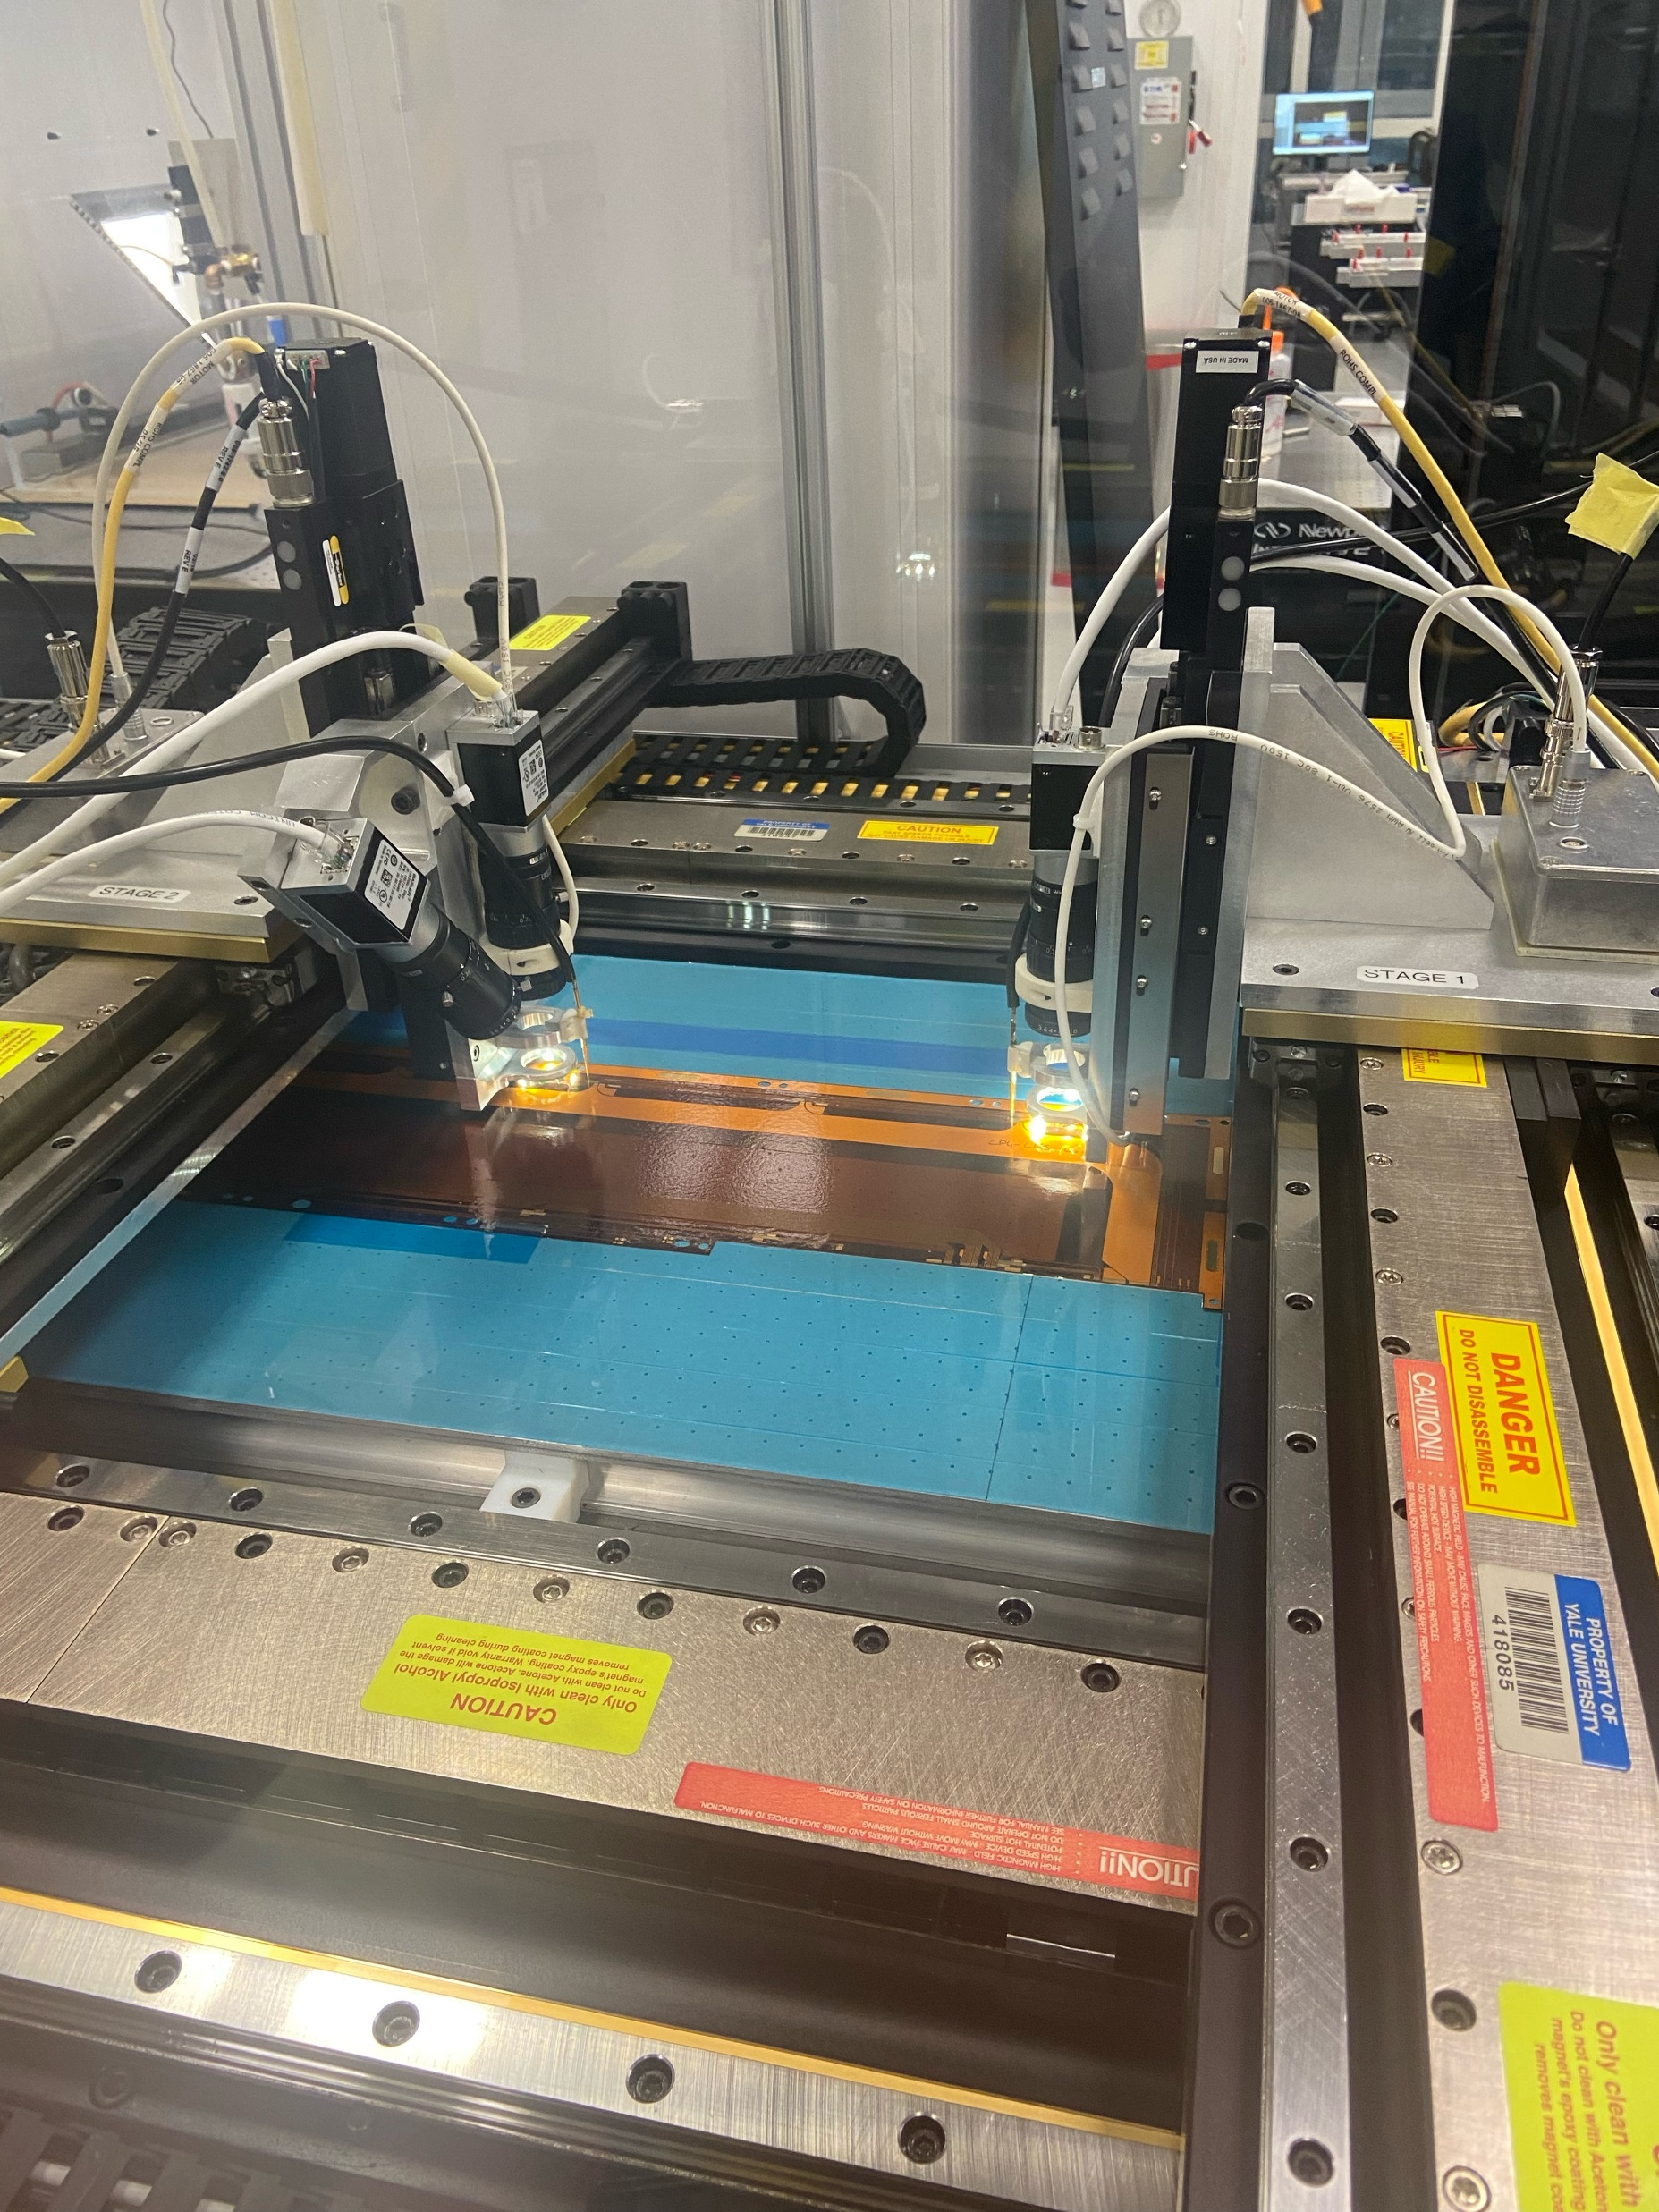
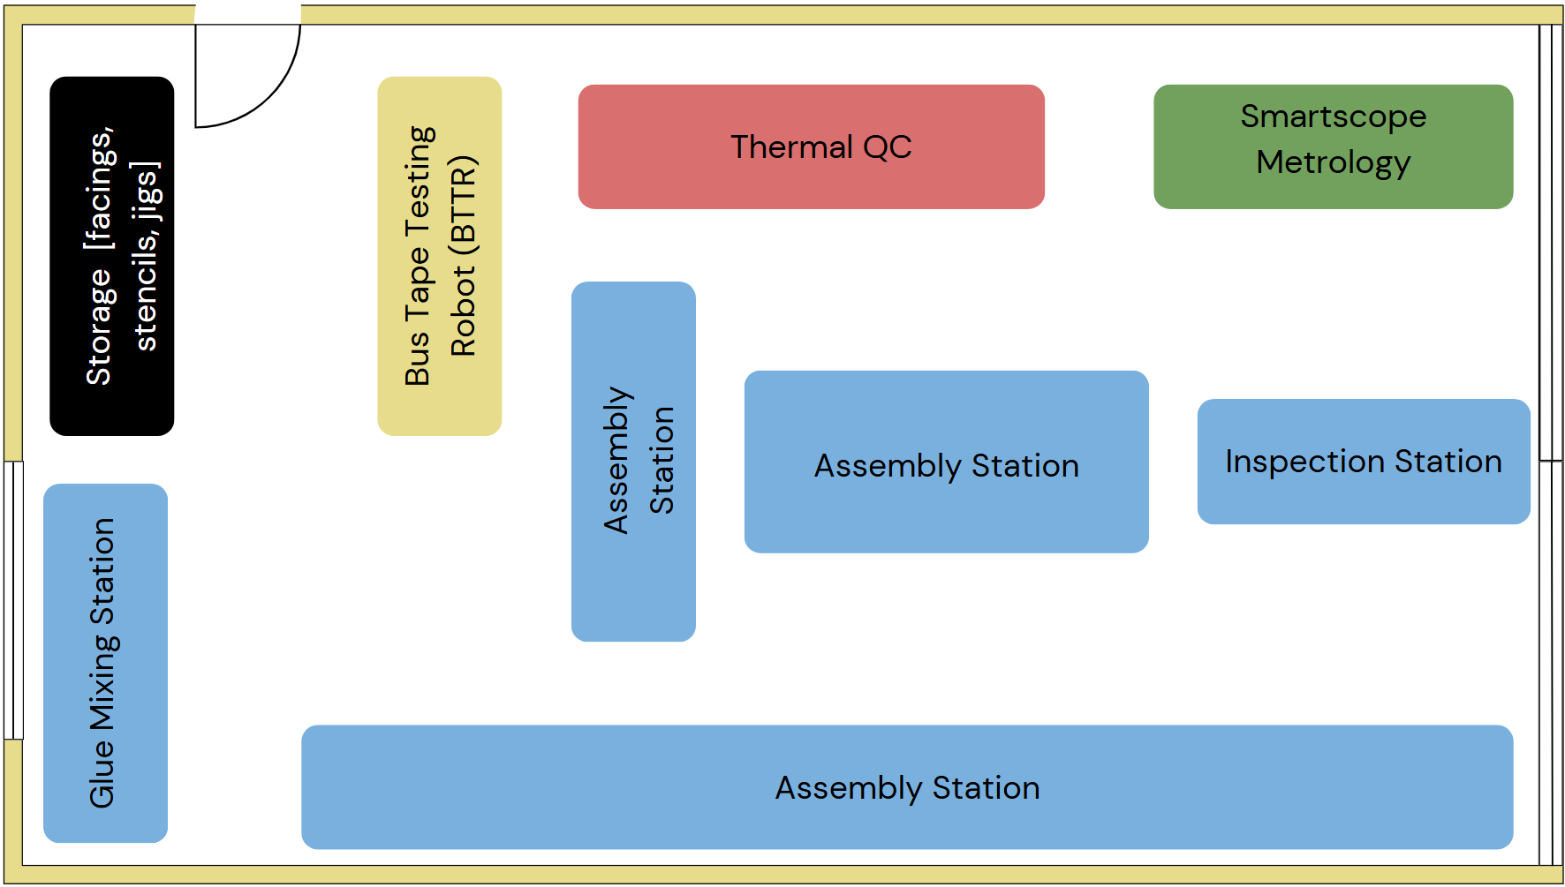
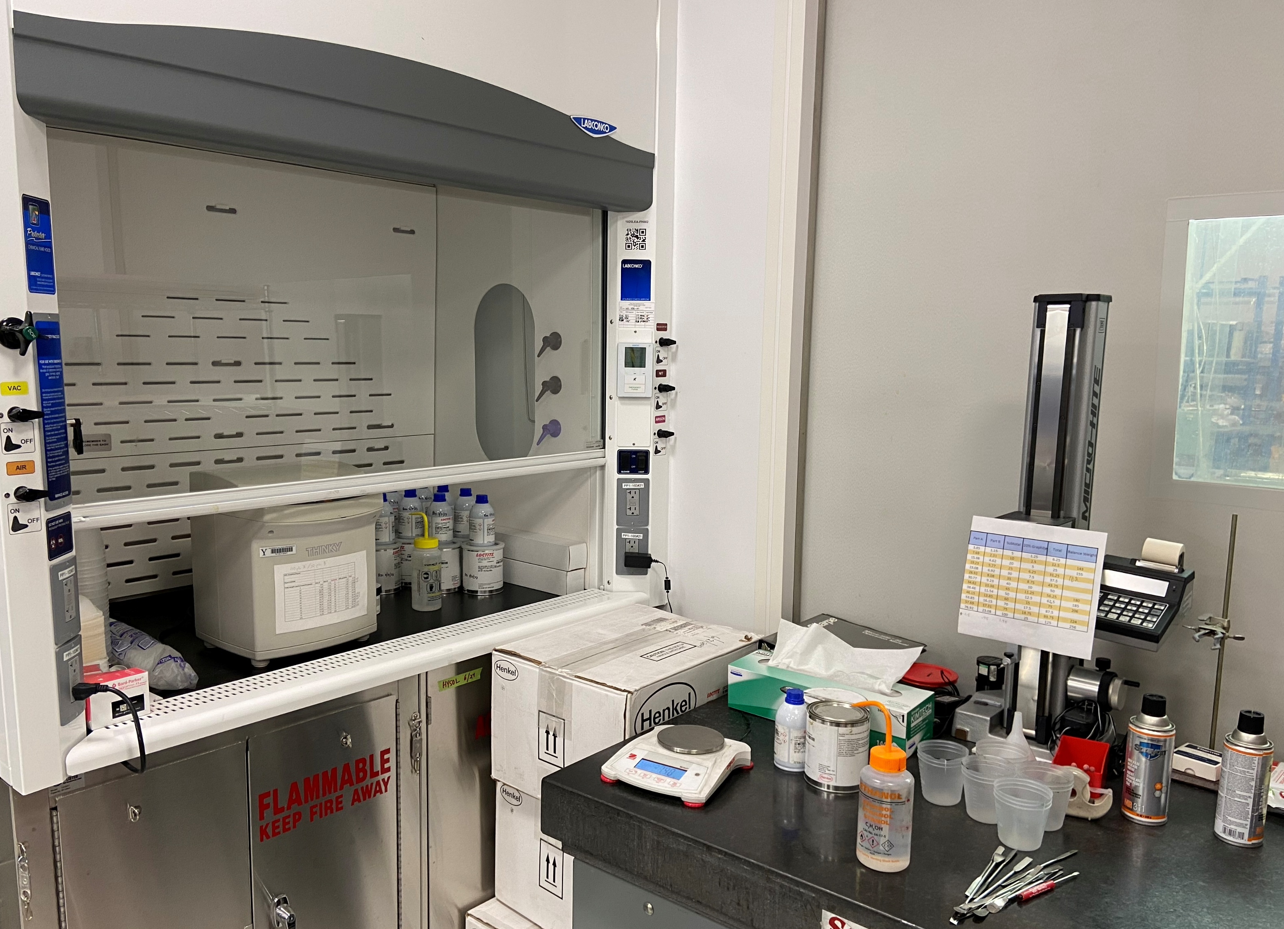
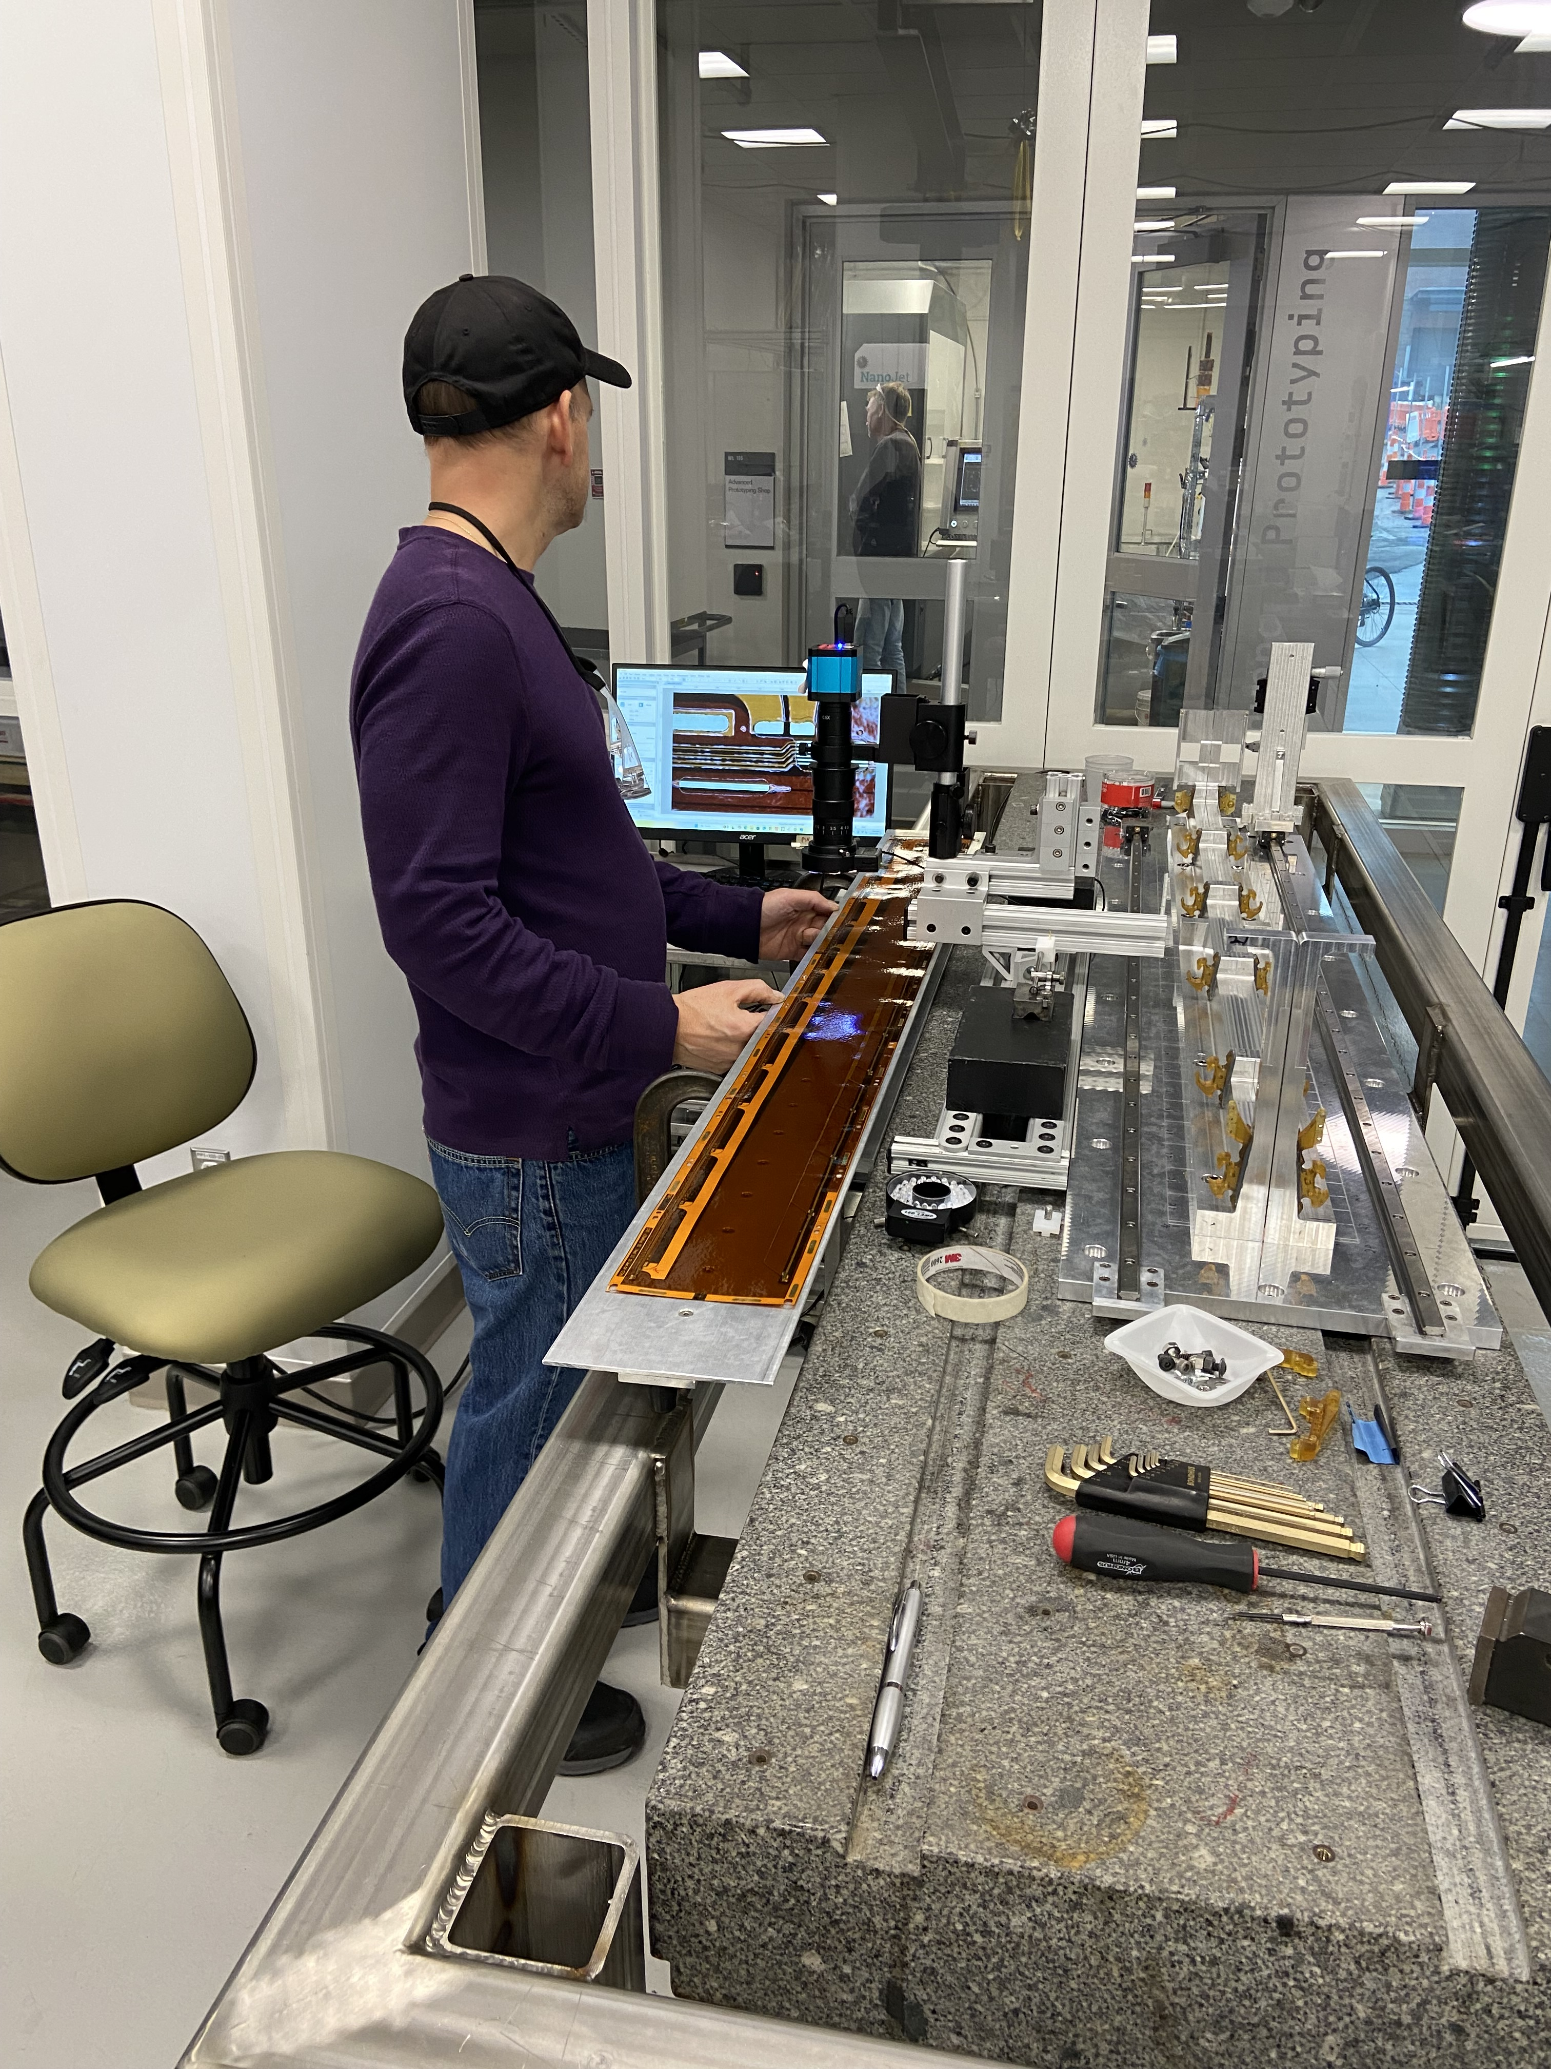
Here at Yale – Cleanroom 106
Side - Main entrance
Room 110

Slide 4
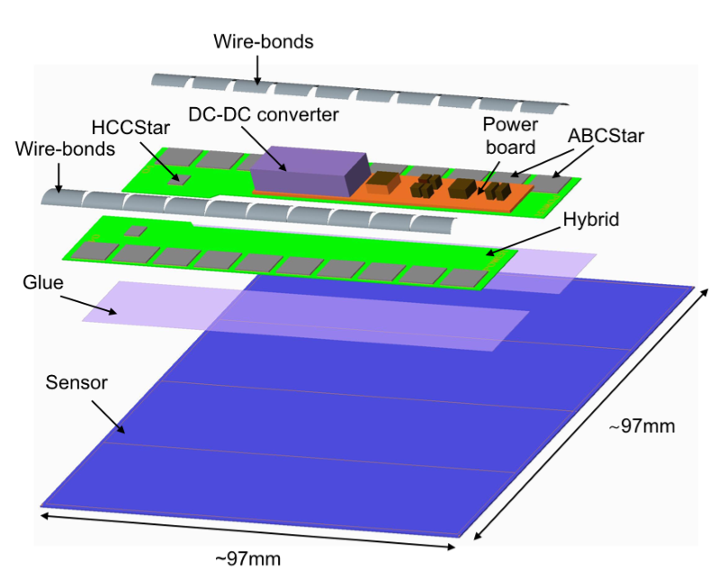
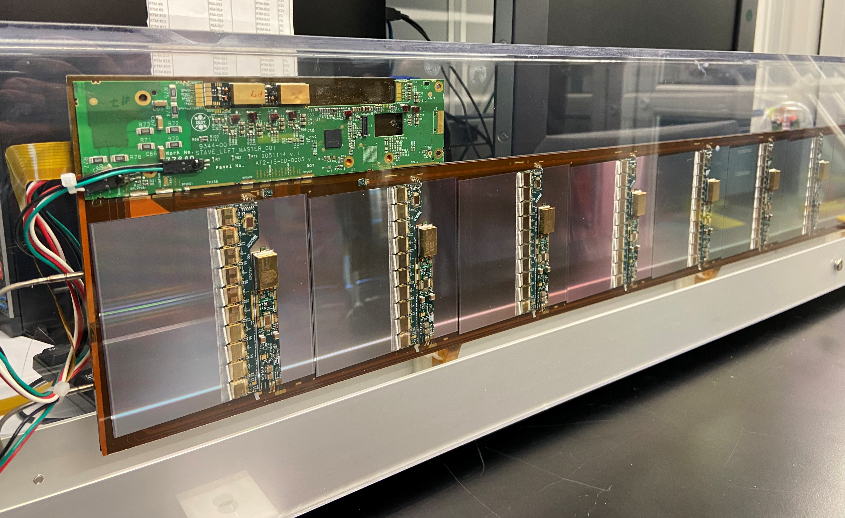
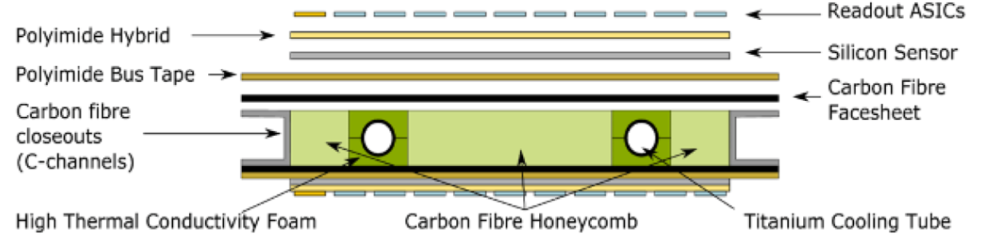
Loaded Stave
US Deliverables:
Cores – Yale
Modules – LBNL, SCIPP, BNL
Module loading – BNL

Slide 5








Contributions…
Affiliated institutes
Internal Effort
Staff: Jeff Ashenfelter, Tom Barker, Mark Haeckel, Tom Hurteau, Frank Lopez, Craig Miller, Brandon Ramirez, and James Wilhelmi
Scientific Effort: Paul Tipton (PI), Arianna Garcia Caffaro, Jesse Farr, Chase Shimmin
Undergrads: Nikita Mazotov, George Ploumis, and Pev Vail

Slide 6
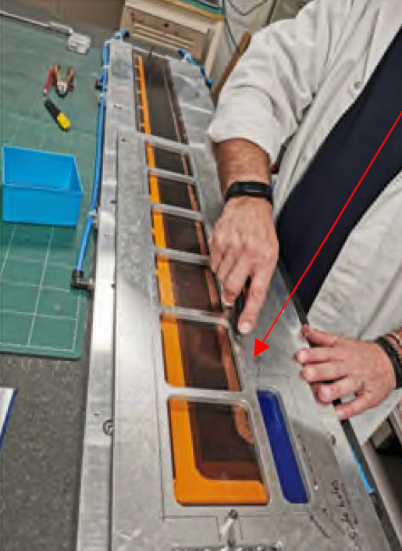
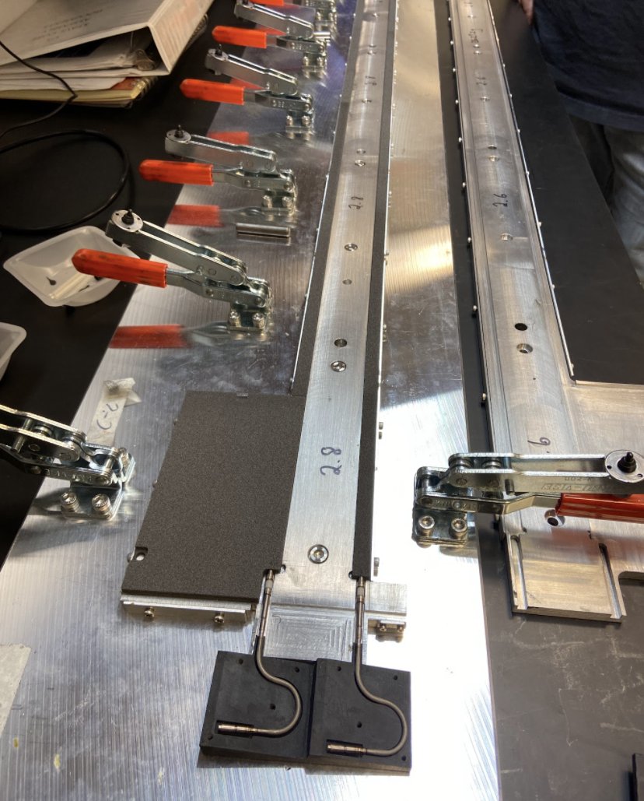
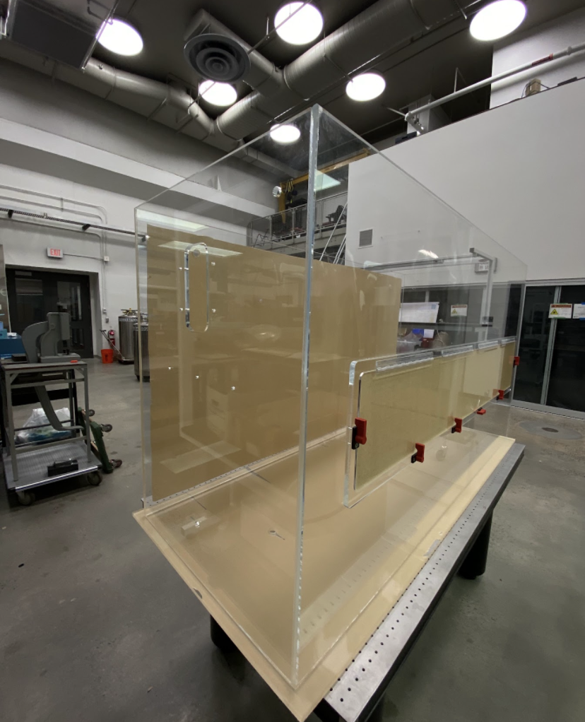
Contributions by the APC
Stave Core trimming fixture
3D printed gauge check for cooling tubes
Laser cut panels for Thermal QC enclosure

Slide 7
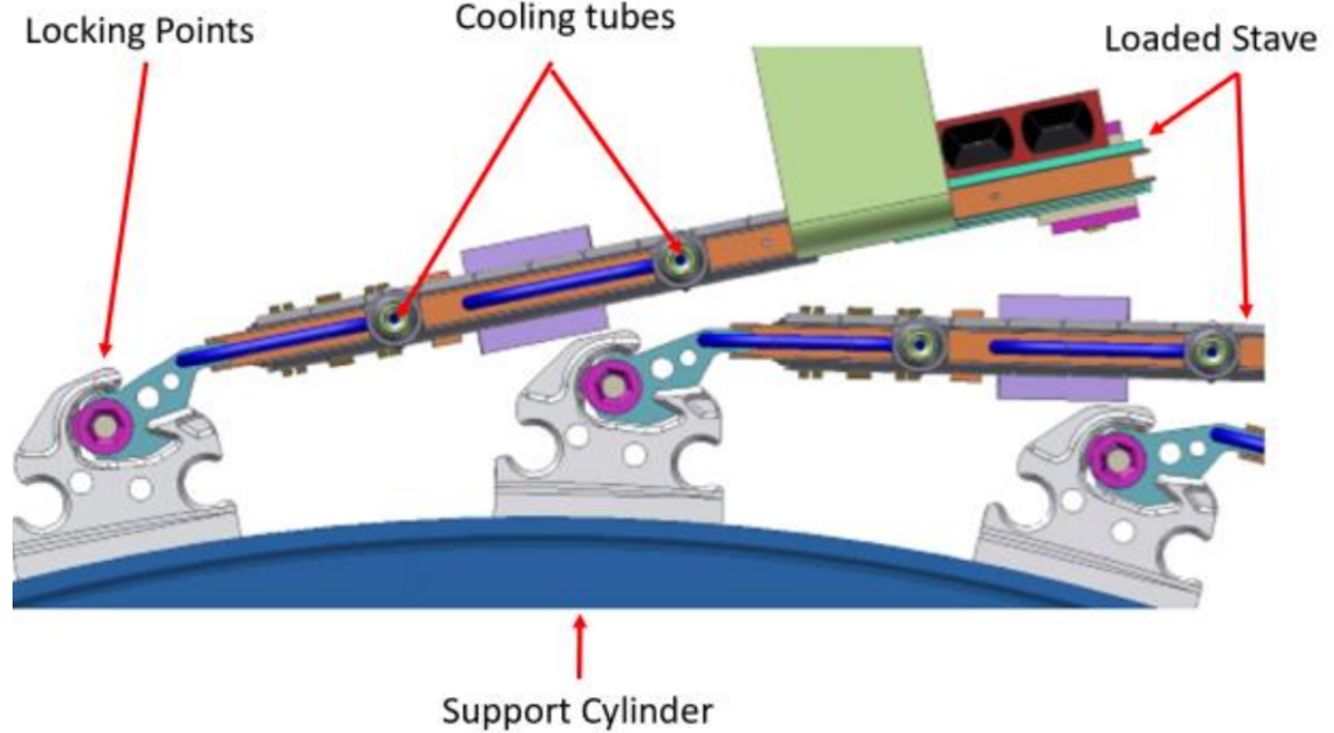
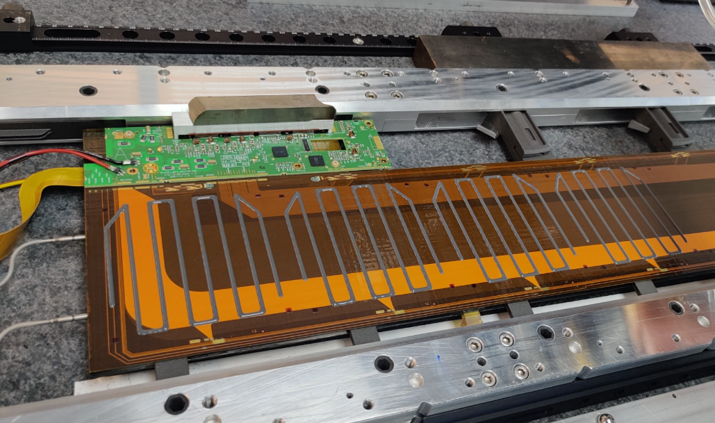
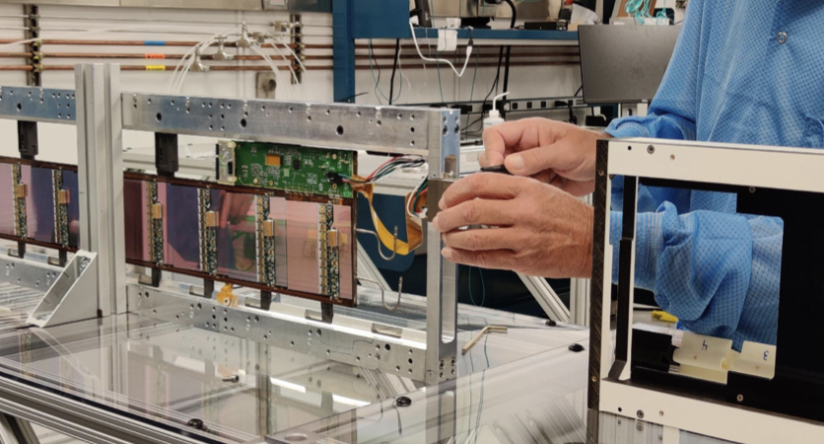
Production
Stave Cores that pass QA/QC testing are delivered to BNL for module loading.
Loaded staves are then sent to CERN for reception testing and storage.
Scheduled to complete contract requirements in two years. (Jan 2027)

